Slide 1
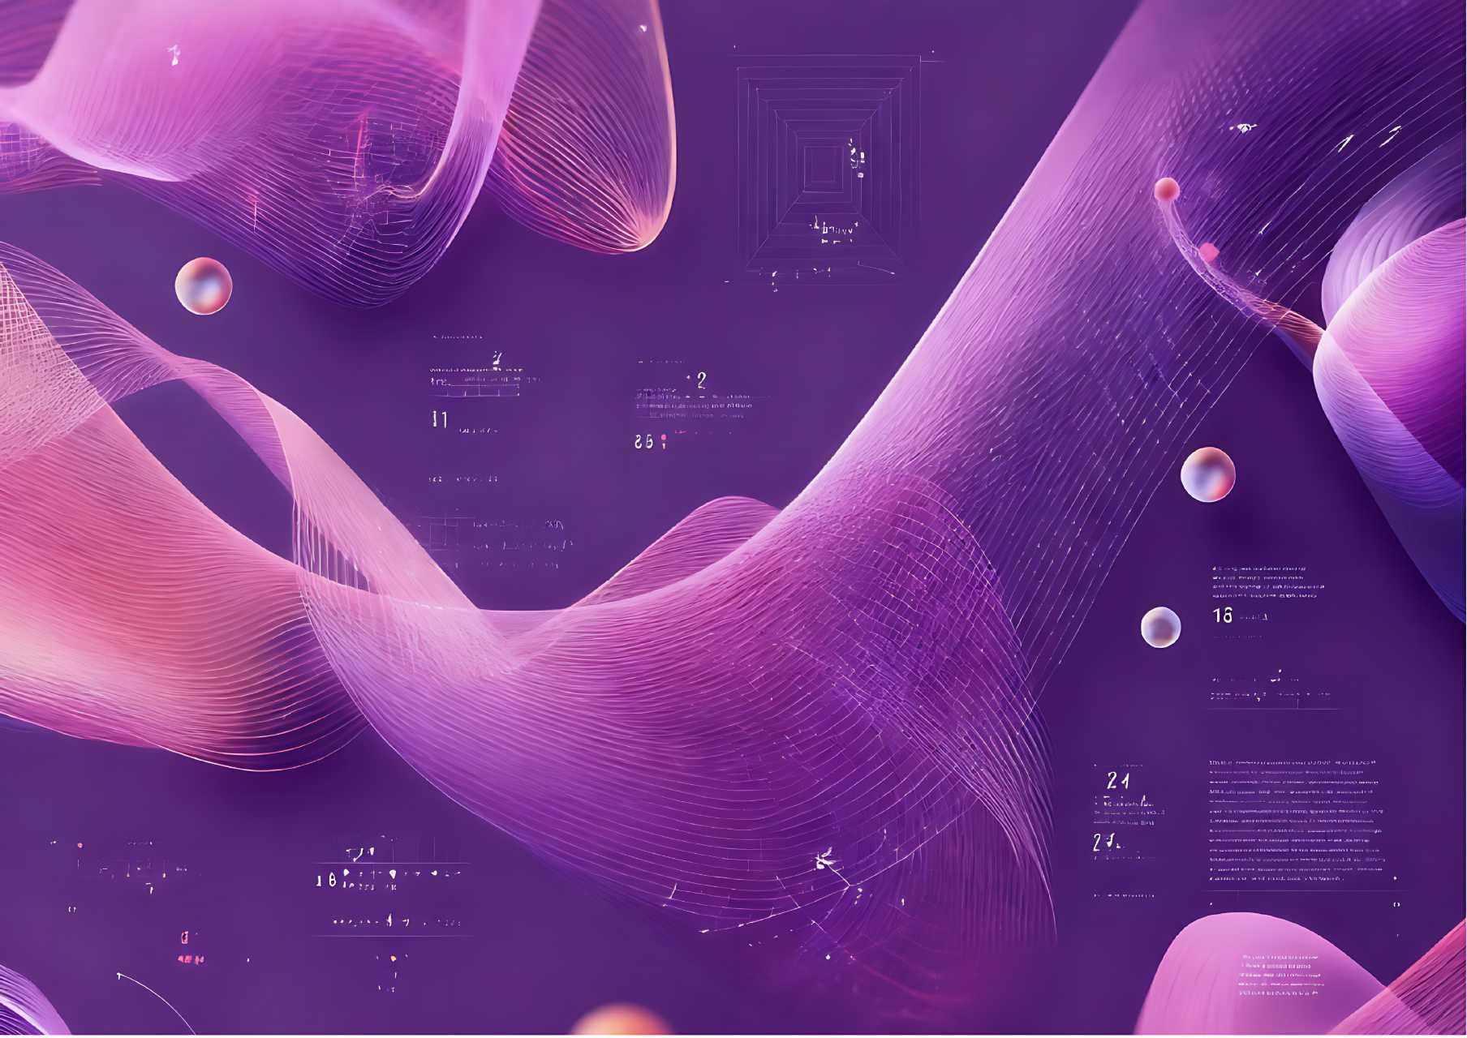

第四届国际民俗礼品时尚创新大赛
THE 4TH INTERNATIONAL FOLK GIFTS INNOVATIVE DESIGN CONTEST
[ 赛道 TRACK 2 ]
智能可穿戴礼品设计作品设计要求与模版
SMART WEARABLE GIFT DESIGN WORDESIGN REQUIREMENTS & TEMPLATEKS
作品名称 TITLE OF WORK：
中文姓名 CHINESE NAME：
英文姓名 ENGLISH NAME：
国 家 COUNTRY :
城 市 CITY :
学 校 UNIVERSITY :
指导教师（如有） SUPERVISOR (IF ANY) :
联系方式（微信或手机）CONTACT INFORMATION (WECHAT OR MOBILE PHONE)：

Slide 2
作品提交要求
DESIGN SUBMISSION REQUIREMENTS
1. 提交内容：1份PPT电子文件（建议同步导出PDF文件一并提交）；所有设计稿源文件（PSD、AI或高清PDF格式）。
Submission content: 1 PPT electronic file (it is recommended to export the PDF file and submit it at the same time); Source files for all designs (PSD, AI or HD PDF format).
2. 作品规格：PPT页面设置为A3大小，页内图片及设计稿源文件精度不低于300dpi；源文件需包含设计效果图、 1:1图案设计稿，设计草图和AIGC的生成过程也需要一起提交，并请自行保留所有设计稿源文件至大赛全部结束；导出的PDF文件分辨率不低于300dpi。
Specifications: The PPT page is set to A3 size, and the accuracy of the pictures and design source files on the page is not less than 300dpi; The source files should contain design renderings, 1:1 pattern design drafts， the design sketch (No less than four) and the AIGC generation process also need to be submitted together, and please keep all the source files of the design draft until the end of the competition; The resolution of the exported PDF file should not be at least 300dpi.
3. 提交模板：组委会提供各赛道作品提交模板，可通过网站下载或大赛微信群获取。
Submission templates: The organizing committee provides submission templates for each track, which can be downloaded from the website or obtained from the WeChat group of the competition.
4. 提交路径：发送电子邮件至联系邮箱：sific386763542@163.com，邮件名：“学校-作者姓名-作品名”。
Submission path: Send an email to the contact email: , email name: sific386763542@163.com"school-author's name-work name".

Slide 3
作品内容
CONTENTS OF WORK
作品内容包含产品&品牌调研和设计作品两部分，调研占评分10% ，设计占评分90%。
参赛作品须为本人原创设计且未公开发表的作品，不得一稿多投，不得侵犯他人知识产权及其他权利。用于生成式人工智能产品的预训练、优化训练数据，也不可含有侵犯知识产权的内容。如有违反，将取消参赛资格，由此引起的一切法律后果由参赛者自行负责。
Submissions must comprise two key elements: product & brand research and design works，with the research component contributing 10% to the overall score and the design component accounting for 90%.
All entries must be original, unpublished works created solely for this competition, and must not infringe upon any third-party intellectual property rights or other legal rights. Additionally, any data used for pre-training or optimization of generative artificial intelligence products must be free from intellectual property violations. Any violation of these terms will result in disqualification, and the participant shall bear full legal responsibility for any consequences arising therefrom.

Slide 4
1.
产品&品牌调研
PRODUCT & BRAND RESEARCH
调研说明及要求
RESEARCH DESCRIPTION AND REQUIREMENTS
1. 请在设计方案开始之前做一份有关智能可穿戴产品的调研，完成一个品牌或一类智能可穿戴产品的调研；
Please do a product research on smart wearable products before the design plan begins，complete a survey on a brand or a category of smart wearable products；
2. 调研对象：聚焦于发热温控、运动装备、健康监护、柔性电子穿戴产品等类别。打破创意边界，深度融合智能科技与时尚穿戴美学，秉持绿色设计理念。选择任意一件智能可穿戴产品（服饰或配件均可，如智能手表、智能运动服、智能眼镜、智能鞋、智能首饰等），线上线下渠道均可；
Research subjects: Focused on categories such as fever temperature control, sports equipment, and health monitoring，and flexible electronic wearable products. Breaking creative boundaries, deeply integrating smart technology with fashionable wearable aesthetics, adhering to green design concept. Select any one smart wearable product (either clothing or accessories, such as smart watches, smart sportswear, smart glasses, smart shoes, smart jewelry, etc.), available through both online and offline channels；
3. 调研内容：记录每个产品的品牌名称、产品名称/型号、了解其设计特点（外观、材质、穿戴方式等）、功能特点（核心技术、传感类型、智能交互等）、技术原理、使用场景及用户体验。
Research content: Record the brand name of each product, product name/model, and understand the design features (appearance, material, wearing method, etc.), functional features (core technology, sensor type, smart interaction, etc.), technical principles, usage scenarios, and user experience of each product.

Slide 5
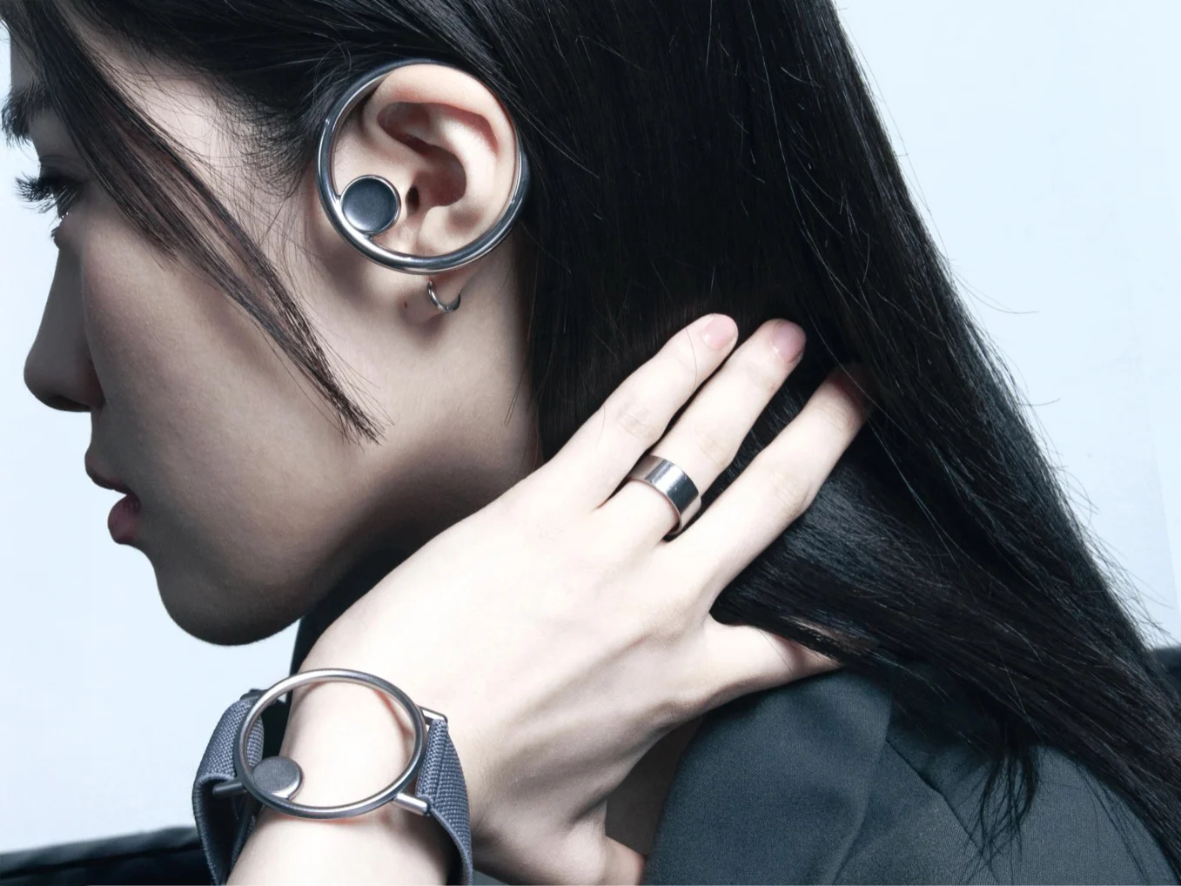
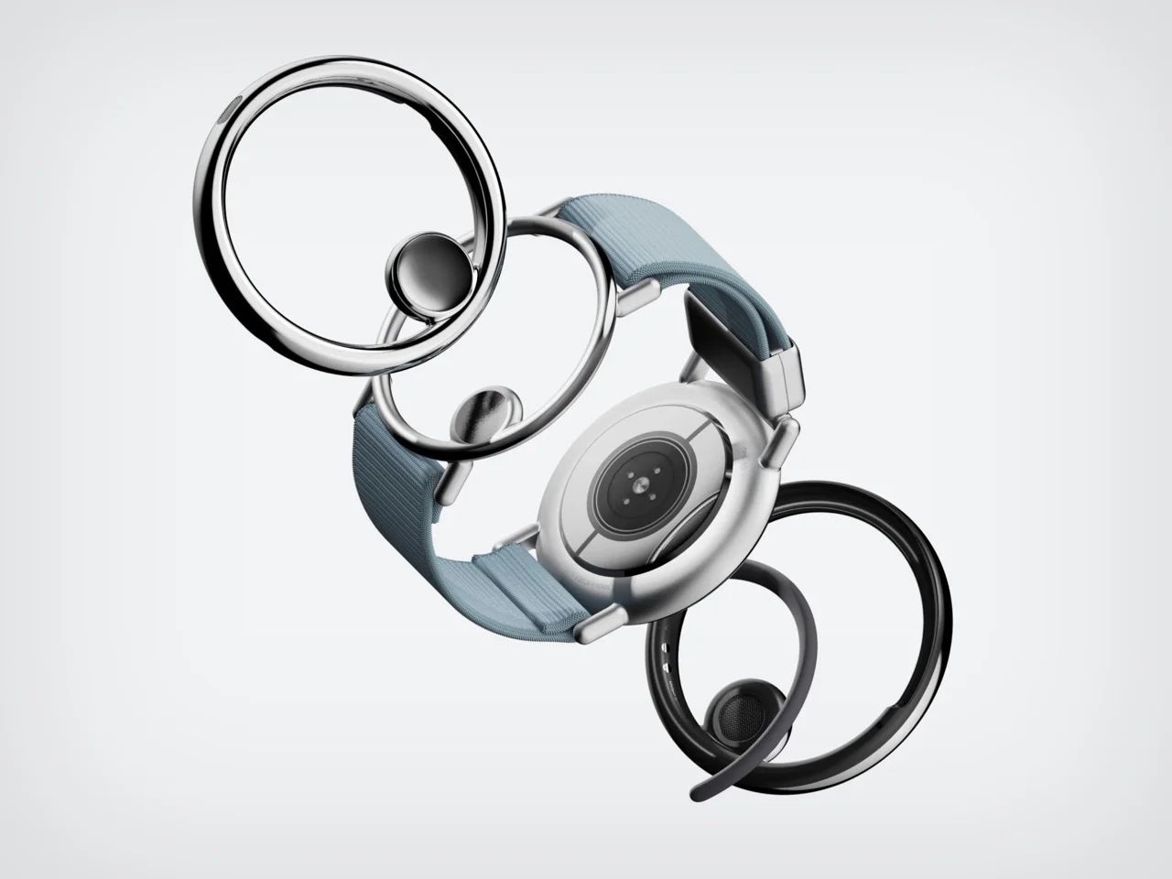
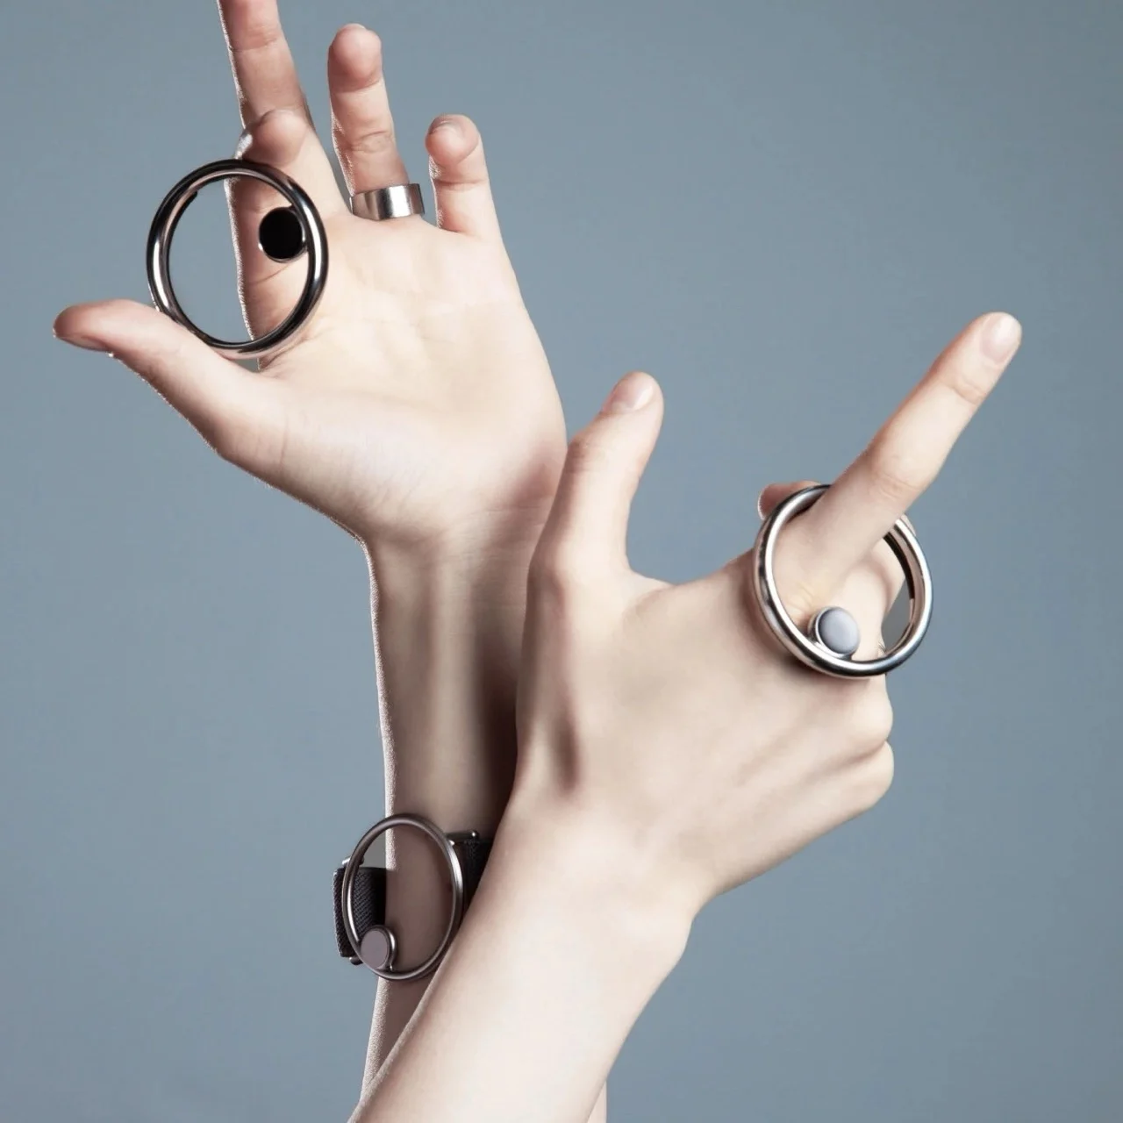
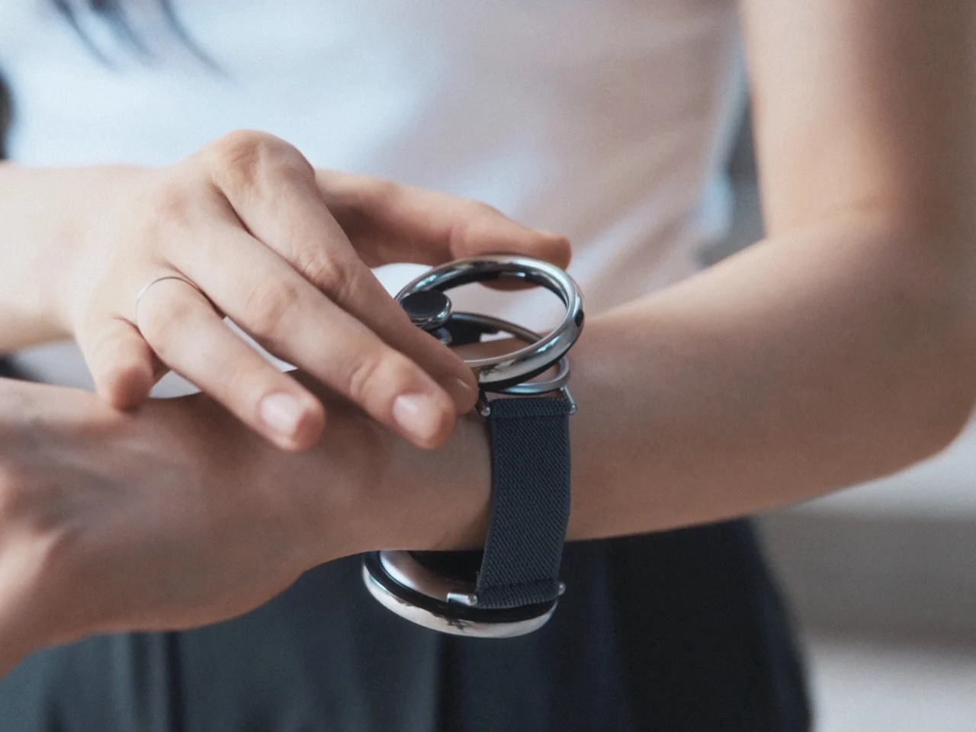
1.
产品&品牌调研
PRODUCT & BRAND RESEARCH
品牌名称/BRANDS NAME：三星SAMSUNG
产品名称/型号PRODUCTS NAME/MODEL：可穿戴耳机WEARABLE AUDIO
设计特点（外观、材质、穿戴方式等）/ DESIGN FEATURES (APPEARANCE, MATERIAL, WEARING METHOD, ETC.)：
开放式圆环耳挂搭配磁吸腕带，外形如首饰，收纳时耳饰吸附于腕饰变身手镯。
Open hoop earhook with magnetic wristband, looks like jewelry; earring snaps onto wristband to become a bracelet when not in use.
功能特点（核心技术、传感类型、智能交互等）/ FUNCTIONAL FEATURES (CORE TECHNOLOGY, SENSOR TYPE, SMART INTERACTION, ETC.)：
AI实时学习音频偏好并自动适配场景，旋转手腕即可切换专注与环境感知模式。
AI learns audio preferences in real time and auto-adapts to scenes; rotating wrist switches between content-focused and environment-aware modes.
技术原理/TECHNICAL PRINCIPLE
耳饰输出音频，腕饰追踪数据，AI分析24小时声音偏好并自动分类过滤。
Ear ring outputs audio, wrist piece tracks data, AI analyzes 24-hour sound preferences and automatically filters by category.
使用场景/USE CASES
通勤、办公、社交等日常场合，避免传统耳机的社交尴尬。
Daily scenarios like commuting, working, and social gatherings — avoids the social awkwardness of traditional earbuds.
用户体验/USER EXPERIENCE
开放式佩戴舒适无压迫，磁吸收纳变身手镯，转腕即可切换模式。
Open-ear design offers comfortable, pressure-free wear; magnetic storage transforms into a bracelet; rotating wrist switches modes instantly.
ACCESSORIES
产品照片
PRODUCT PICTURES

Slide 6
2.
设计作品
DESIGN WORKS
1. 请聚焦于发热温控、运动装备、健康监护、柔性电子穿戴产品等类别，完成智能可穿戴产品的创意概念设计。
打破创意边界，深度融合智能科技与时尚穿戴美学，秉持绿色设计理念，打造兼具质感与格调的全新生活礼品范式；
作品需明确产品服务对象及应用场景，如面向特殊群体的健康监测穿戴、面向户外运动人群的智能防护装备、面向办公场景的舒适调节产品等，解决具体使用痛点，展现科技赋能生活的创新价值；
作品以创意概念方案为主，无需实物打样，重点体现智能功能创新、穿戴体验、视觉美学与绿色设计理念，推动科技、时尚与实用功能的融合统一；
设计应基于现有成熟智能技术，兼顾安全舒适、可量产与成本可控等现实应用需求，具备一定产业化落地潜力；
参赛者可围绕上述方向任选主题，提交单件作品或系列化产品设计方案。
1. Please focus on categories such as heat dissipation and temperature control, sports equipment, health monitoring, and flexible electronic wearable products, and complete the creative concept design of smart wearable products.
Breaking creative boundaries, deeply integrating smart technology with fashionable wearable aesthetics, and adhering to the concept of green design, we create a new paradigm of lifestyle gifts that combines quality and style；
The works should clearly define the target audience and application scenarios of the products and services, such as health monitoring wearables for special groups, intelligent protective equipment for outdoor sports enthusiasts, and comfort adjustment products for office scenarios, etc., to solve specific pain points and demonstrate the innovative value of technology empowering life;
The works are mainly creative concept solutions, without the need for physical prototypes. They focus on showcasing intelligent functional innovation, wearable experience, visual aesthetics and green design concepts, and promote the integration and unity of technology, fashion and practicality.
The design should be based on existing mature intelligent technologies, taking into account the practical application needs such as safety and comfort, mass production and cost control, and have a certain potential for industrialization.
Participants may choose any theme from the above directions and submit a single work or a series of product design proposals.

Slide 7
2.
设计作品
DESIGN WORKS
2. 完整创意概念和设计方案包括：
创意概念：
  作品名称
  灵感来源
  预设的智能功能
  应用场景
  穿戴形式
设计方案：
  正、背面效果图，以及左、右侧面效果图
  色彩与材料构想
  标注色彩名称和潘通色号
  标注材料类别
  详细设计说明
  设计草图
2. The complete creative concept and design scheme include:
Creative concept:
  Title of the work
  Inspiration
  Preset smart functions
  Application scenarios
  Wearing form
Design scheme:
  Front and back views, as well as left and right side views.
  Color and Material Concepts
  Label the color name and Pantone color code.
  Label material category
  Detailed design specifications
  Design sketch

Slide 8
2.
设计作品
DESIGN WORKS
如果采用人工智能协助设计，需完整呈现AIGC的生成过程，包括使用的AI工具、提示词、工作流示意图或分工清单，清晰展示从概念意向到模型/手绘底图，再到初次生成、迭代，最终完成成图的整个流程。不得采用他人知识产权的图片垫图。
If the design is assisted by artificial intelligence, the generation process of AIGC should be fully presented, including the AI tools used, prompt words, workflow diagrams or labor division lists, and the entire process from conceptual intention to model/hand-drawn base drawing, to initial generation, iteration, and finally the completion of the drawing should be clearly shown. It is not allowed to use other people's intellectual property rights.

Slide 9
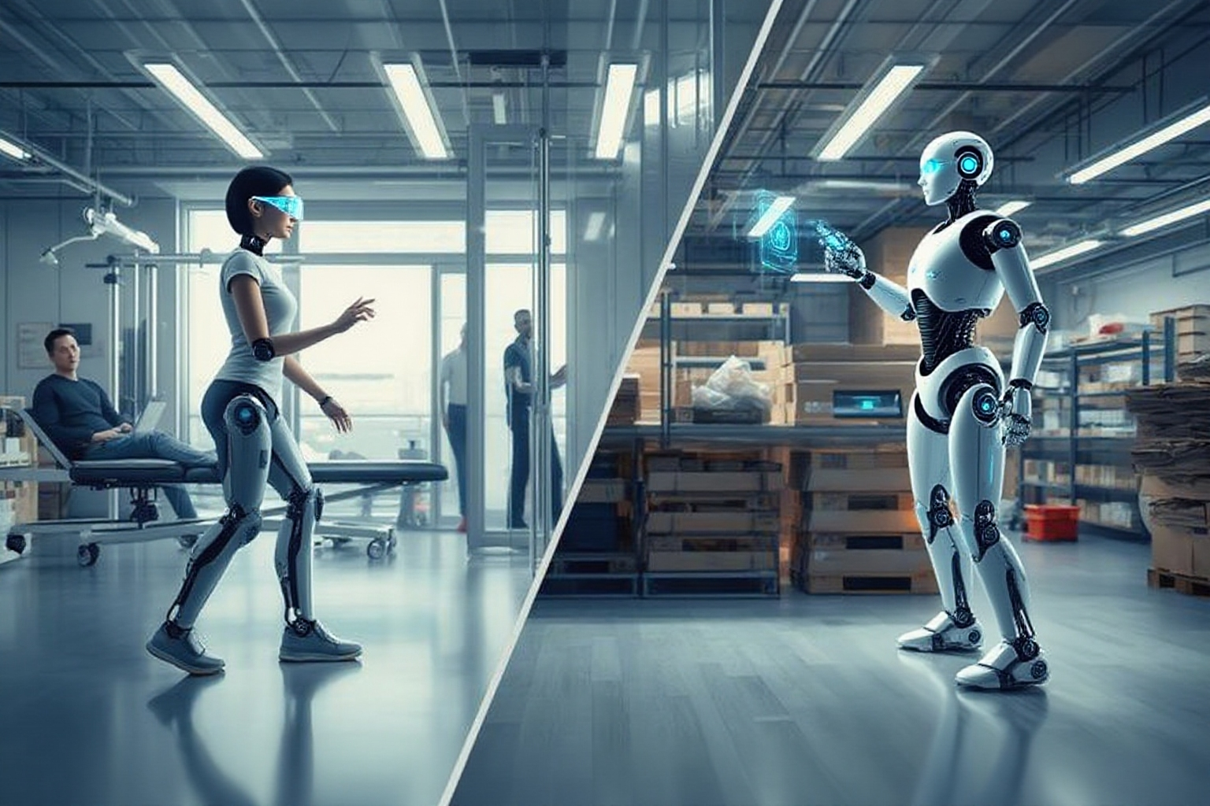
创意概念
CREATIVE CONCEPT
此图片仅为示例，请替换为自己的灵感图
This image is for reference only. Replace it with your own inspiration image.
  作品名称/Title of the work：
  灵感来源/Inspiration：
  预设的智能功能/Preset smart functions：
  应用场景/Application scenarios：
  穿戴形式/Wearing form：

Slide 10
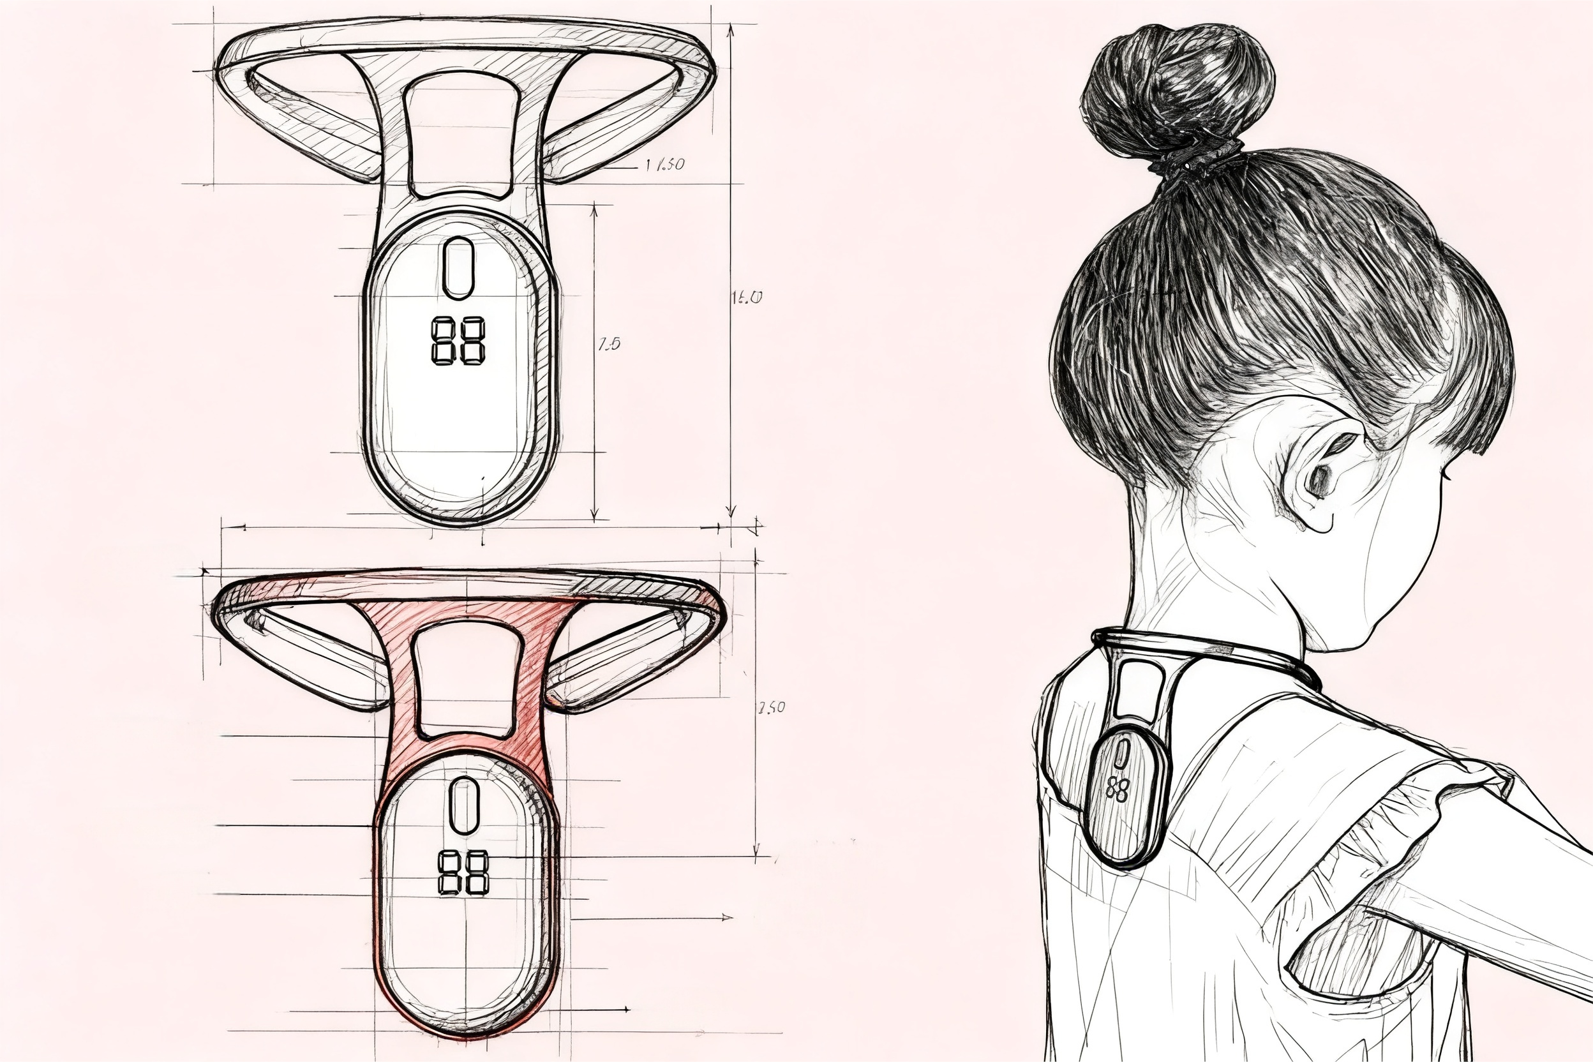
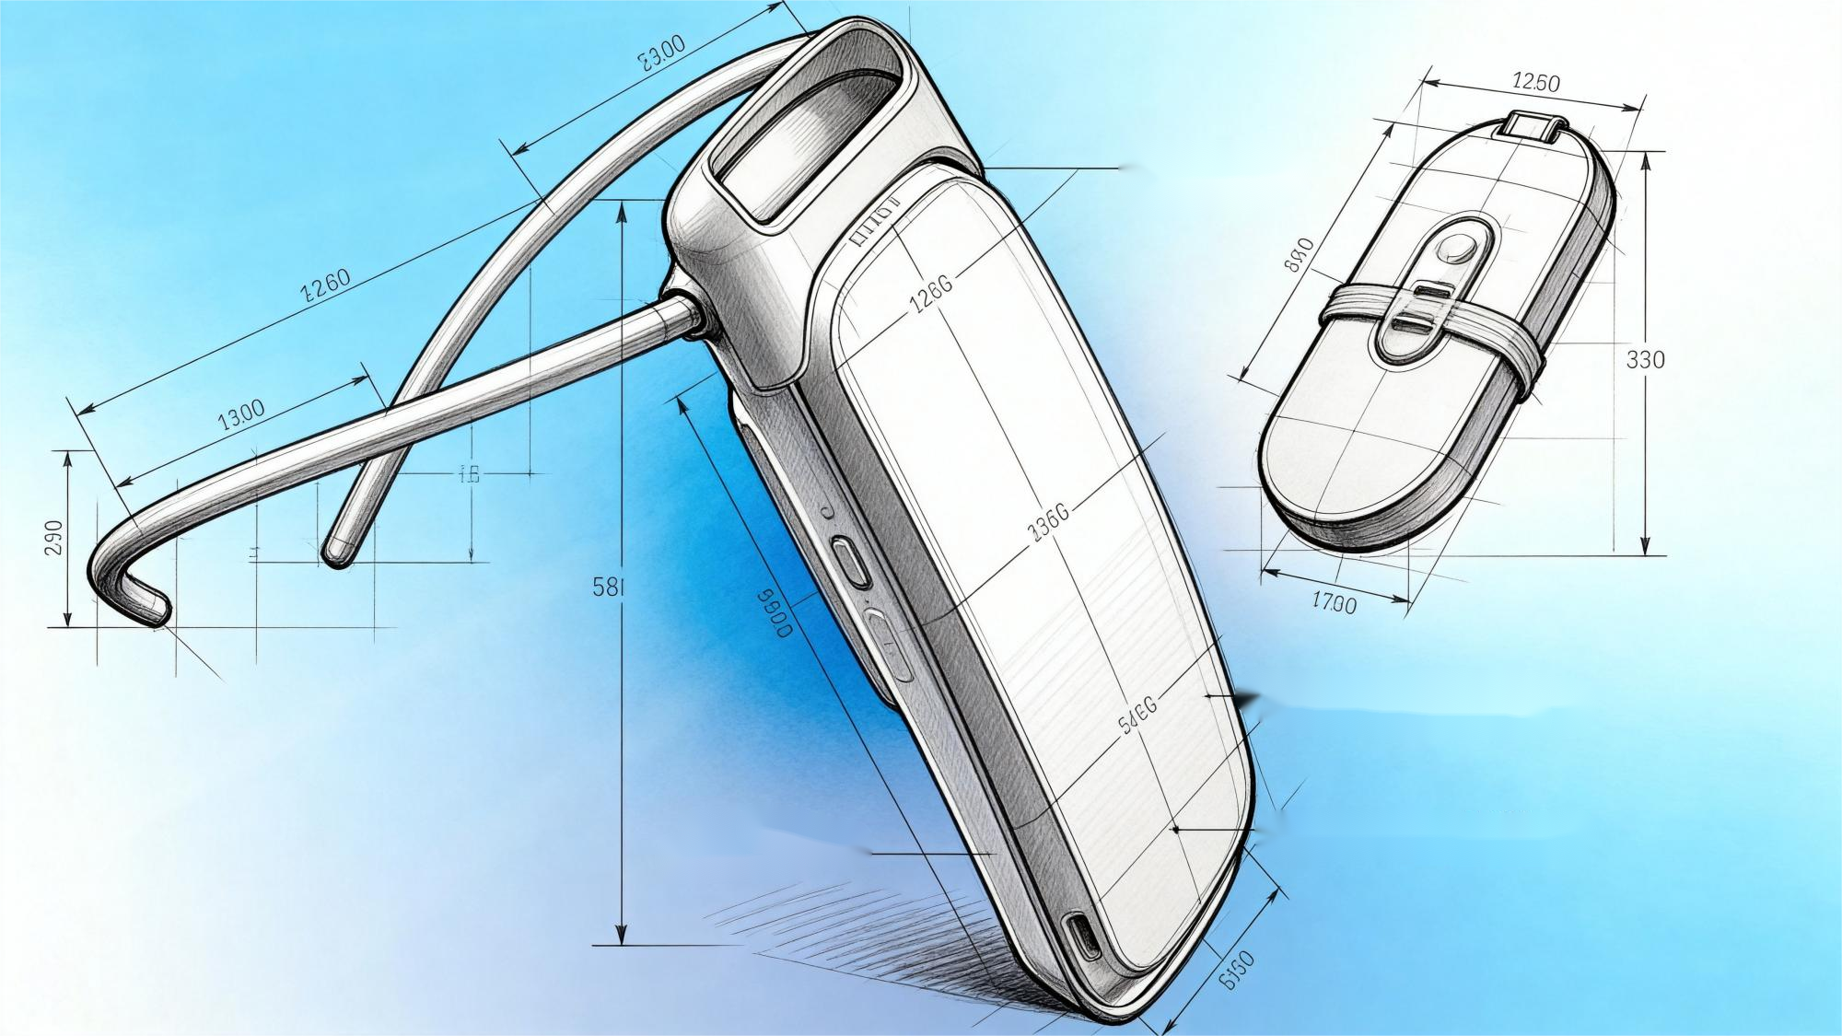
智能可穿戴产品设计
SMART WEARABLE PRODUCTS DESIGN
发热温控
Fever control temperature
作品说明/Work Description：
色彩/Color：
材料/Materials：
设计效果图/Design rendering：
Base Pattern Color
11-0616 TCX
粉蜡黄
17-0210 TCX
玉石色
系列产品1
Series 1
系列产品2
Series 2
页面内的文字和图示仅为示例，自行设计并撰写说明
The text and illustrations in the page are only examples, design and write your own instructions

Slide 11
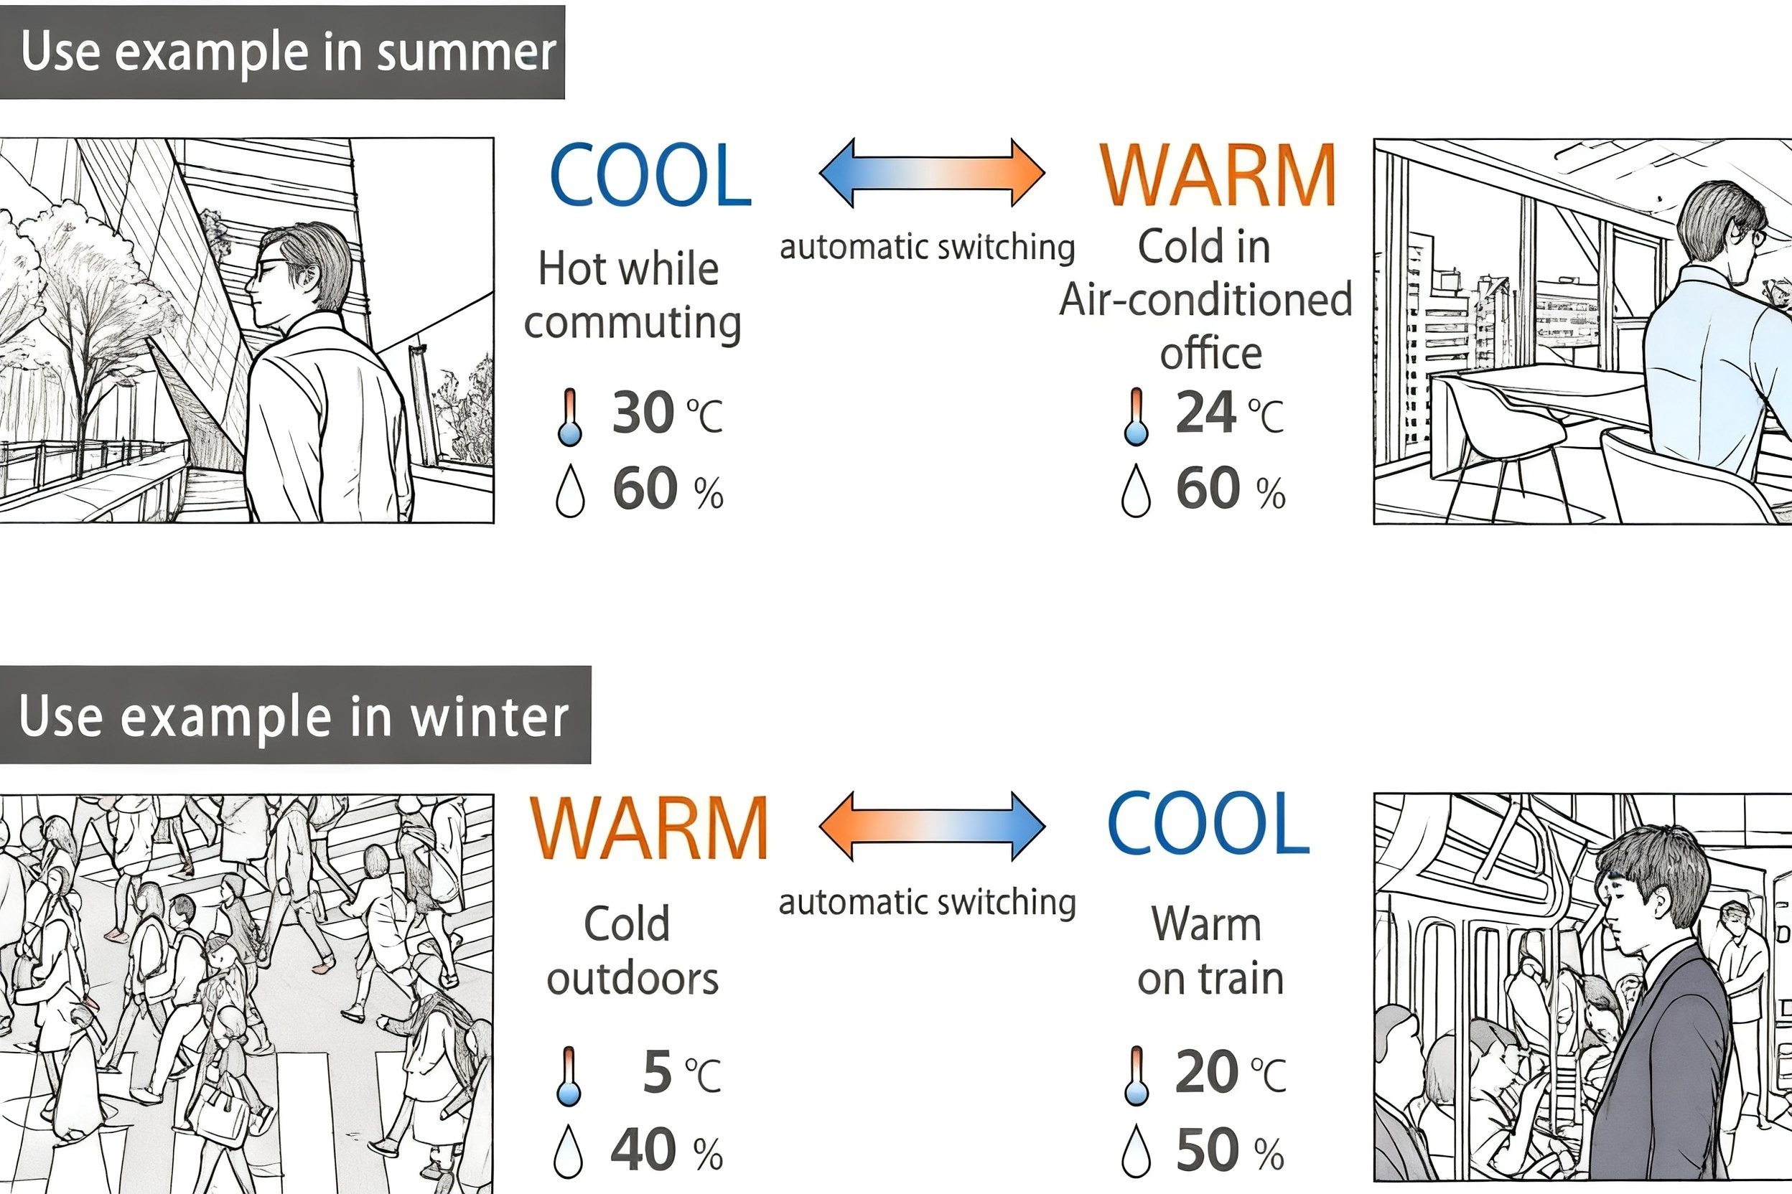
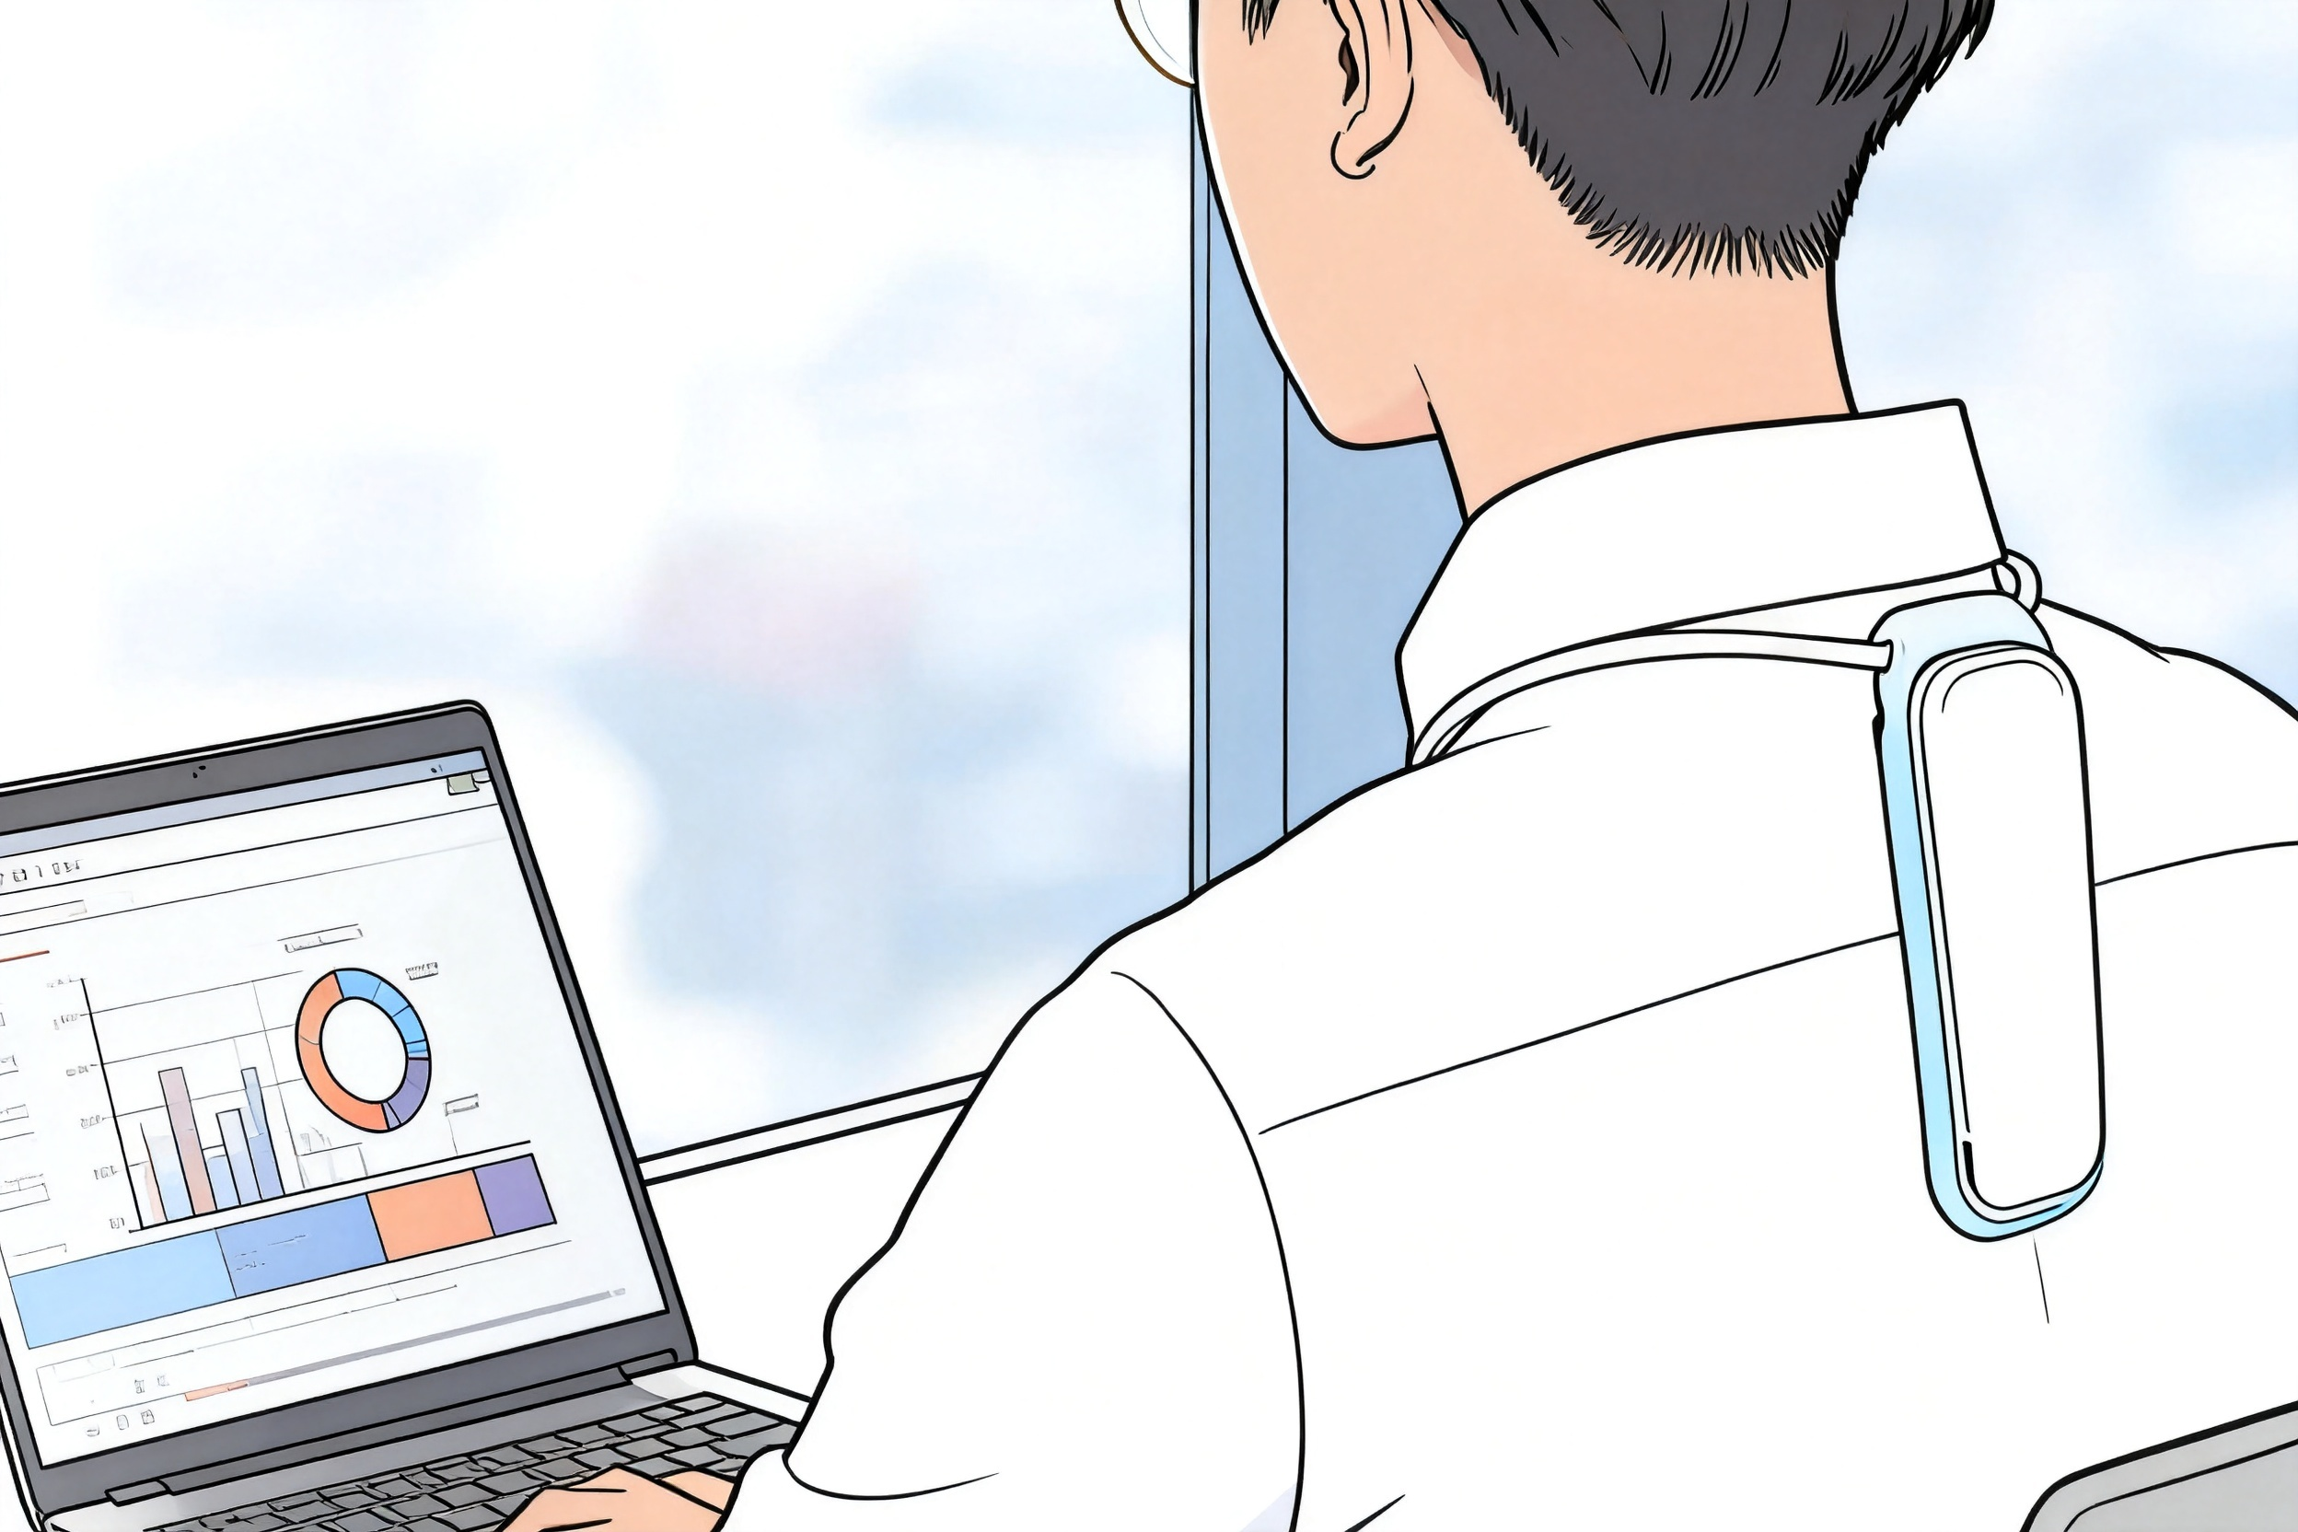
设计汇总
DESIGN SUMMARY PAGE
发热温控
Fever control temperature
产品/PRODUCTS：
使用场景/USE CASES：
系列产品1
Series 1
系列产品2
Series 2
页面内的文字和图示仅为示例，自行设计并撰写说明
The text and illustrations in the page are only examples, design and write your own instructions

Slide 12
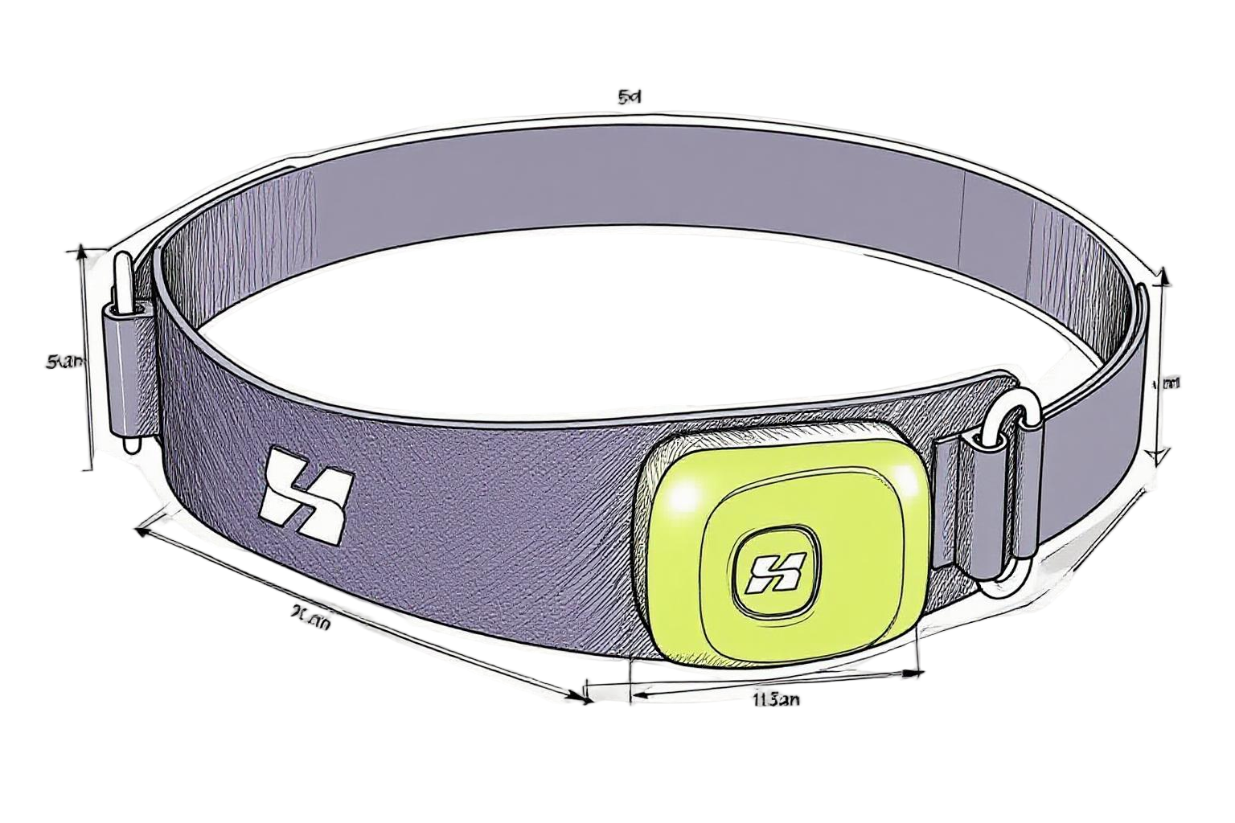
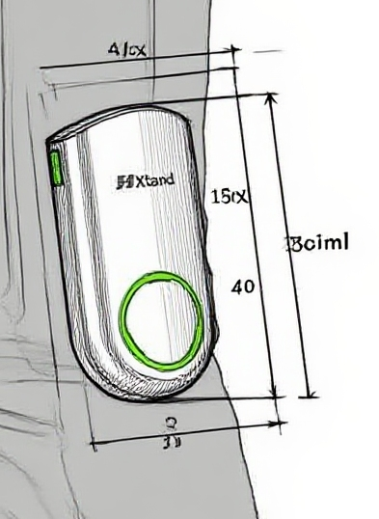
智能可穿戴产品设计
SMART WEARABLE PRODUCTS DESIGN
运动装备
Sports equipment
作品说明/Work Description：
色彩/Color：
材料/Materials：
设计效果图/Design rendering：
Base Pattern Color
11-0616 TCX
粉蜡黄
17-0210 TCX
玉石色
系列产品1
Series 1
系列产品2
Series 2
页面内的文字和图示仅为示例，自行设计并撰写说明
The text and illustrations in the page are only examples, design and write your own instructions

Slide 13
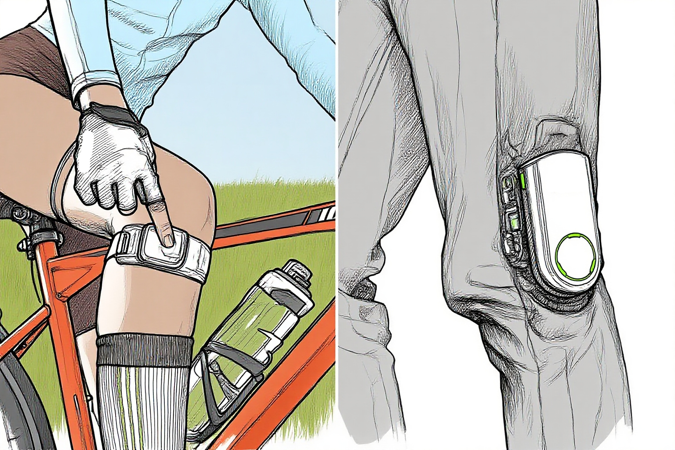
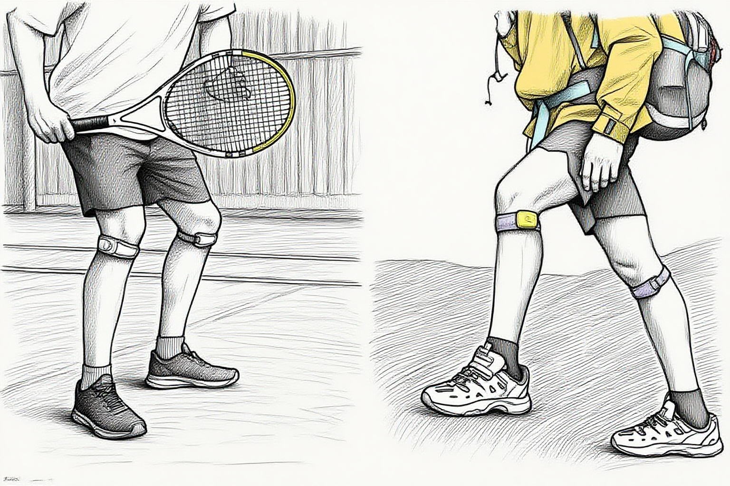
设计汇总
DESIGN SUMMARY PAGE
运动装备
Sports equipment
产品/PRODUCTS：
使用场景/USE CASES：
系列产品1
Series 1
系列产品2
Series 2
页面内的文字和图示仅为示例，自行设计并撰写说明
The text and illustrations in the page are only examples, design and write your own instructions

Slide 14
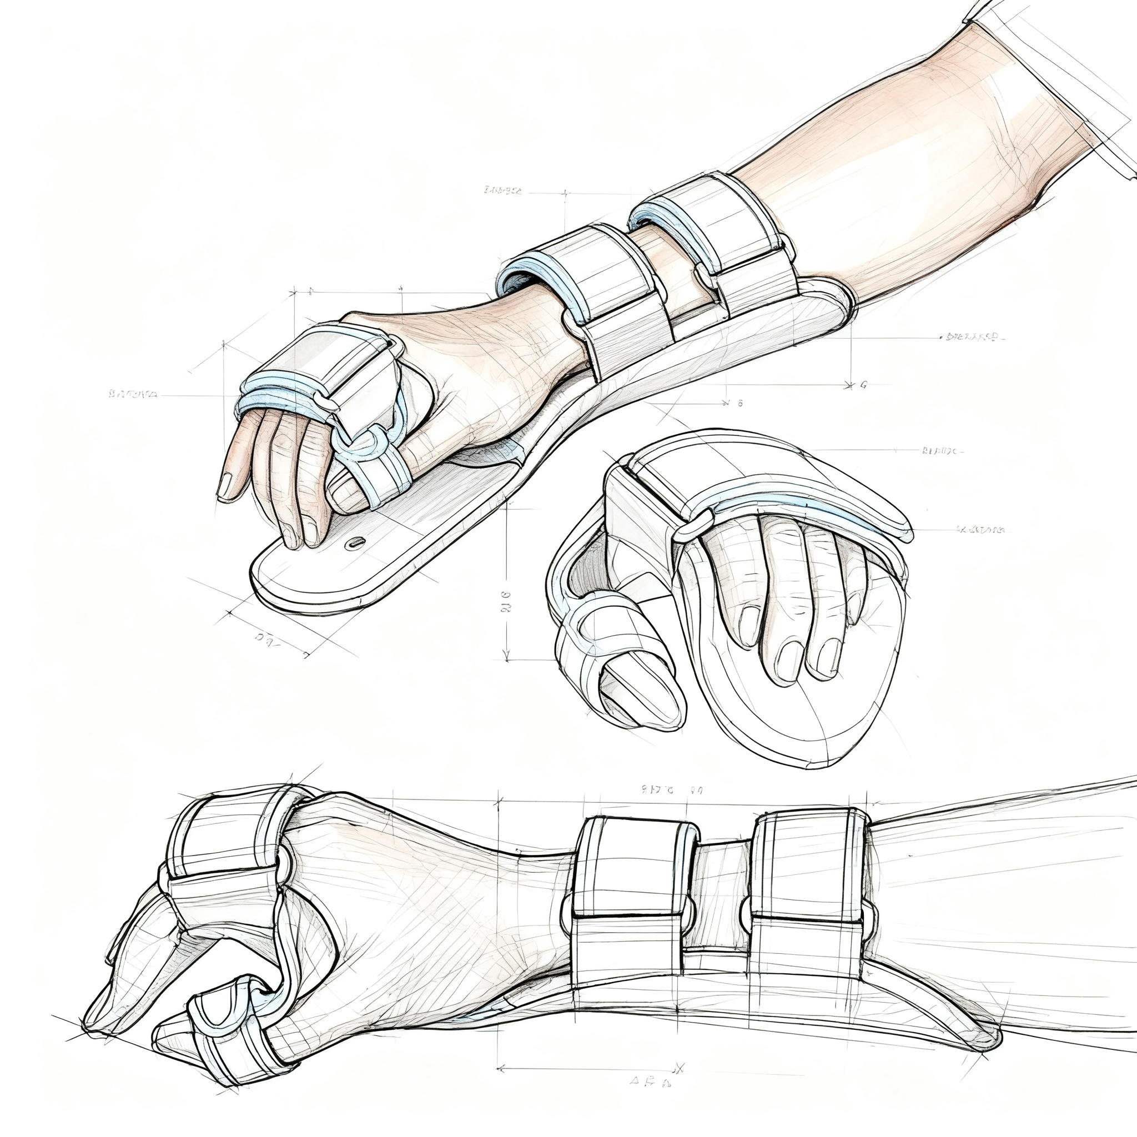
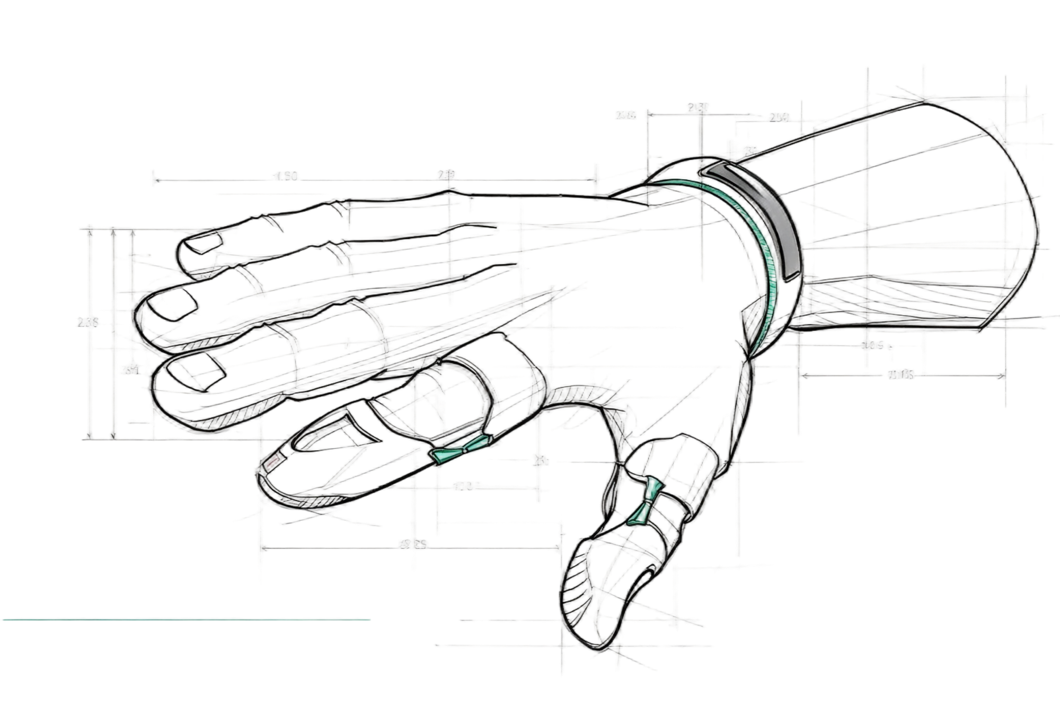
智能可穿戴产品设计
SMART WEARABLE PRODUCTS DESIGN
健康监护
Health monitoring
作品说明/Work Description：
色彩/Color：
材料/Materials：
设计效果图/Design rendering：
Base Pattern Color
11-0616 TCX
粉蜡黄
17-0210 TCX
玉石色
系列产品1
Series 1
系列产品2
Series 2
页面内的文字和图示仅为示例，自行设计并撰写说明
The text and illustrations in the page are only examples, design and write your own instructions

Slide 15
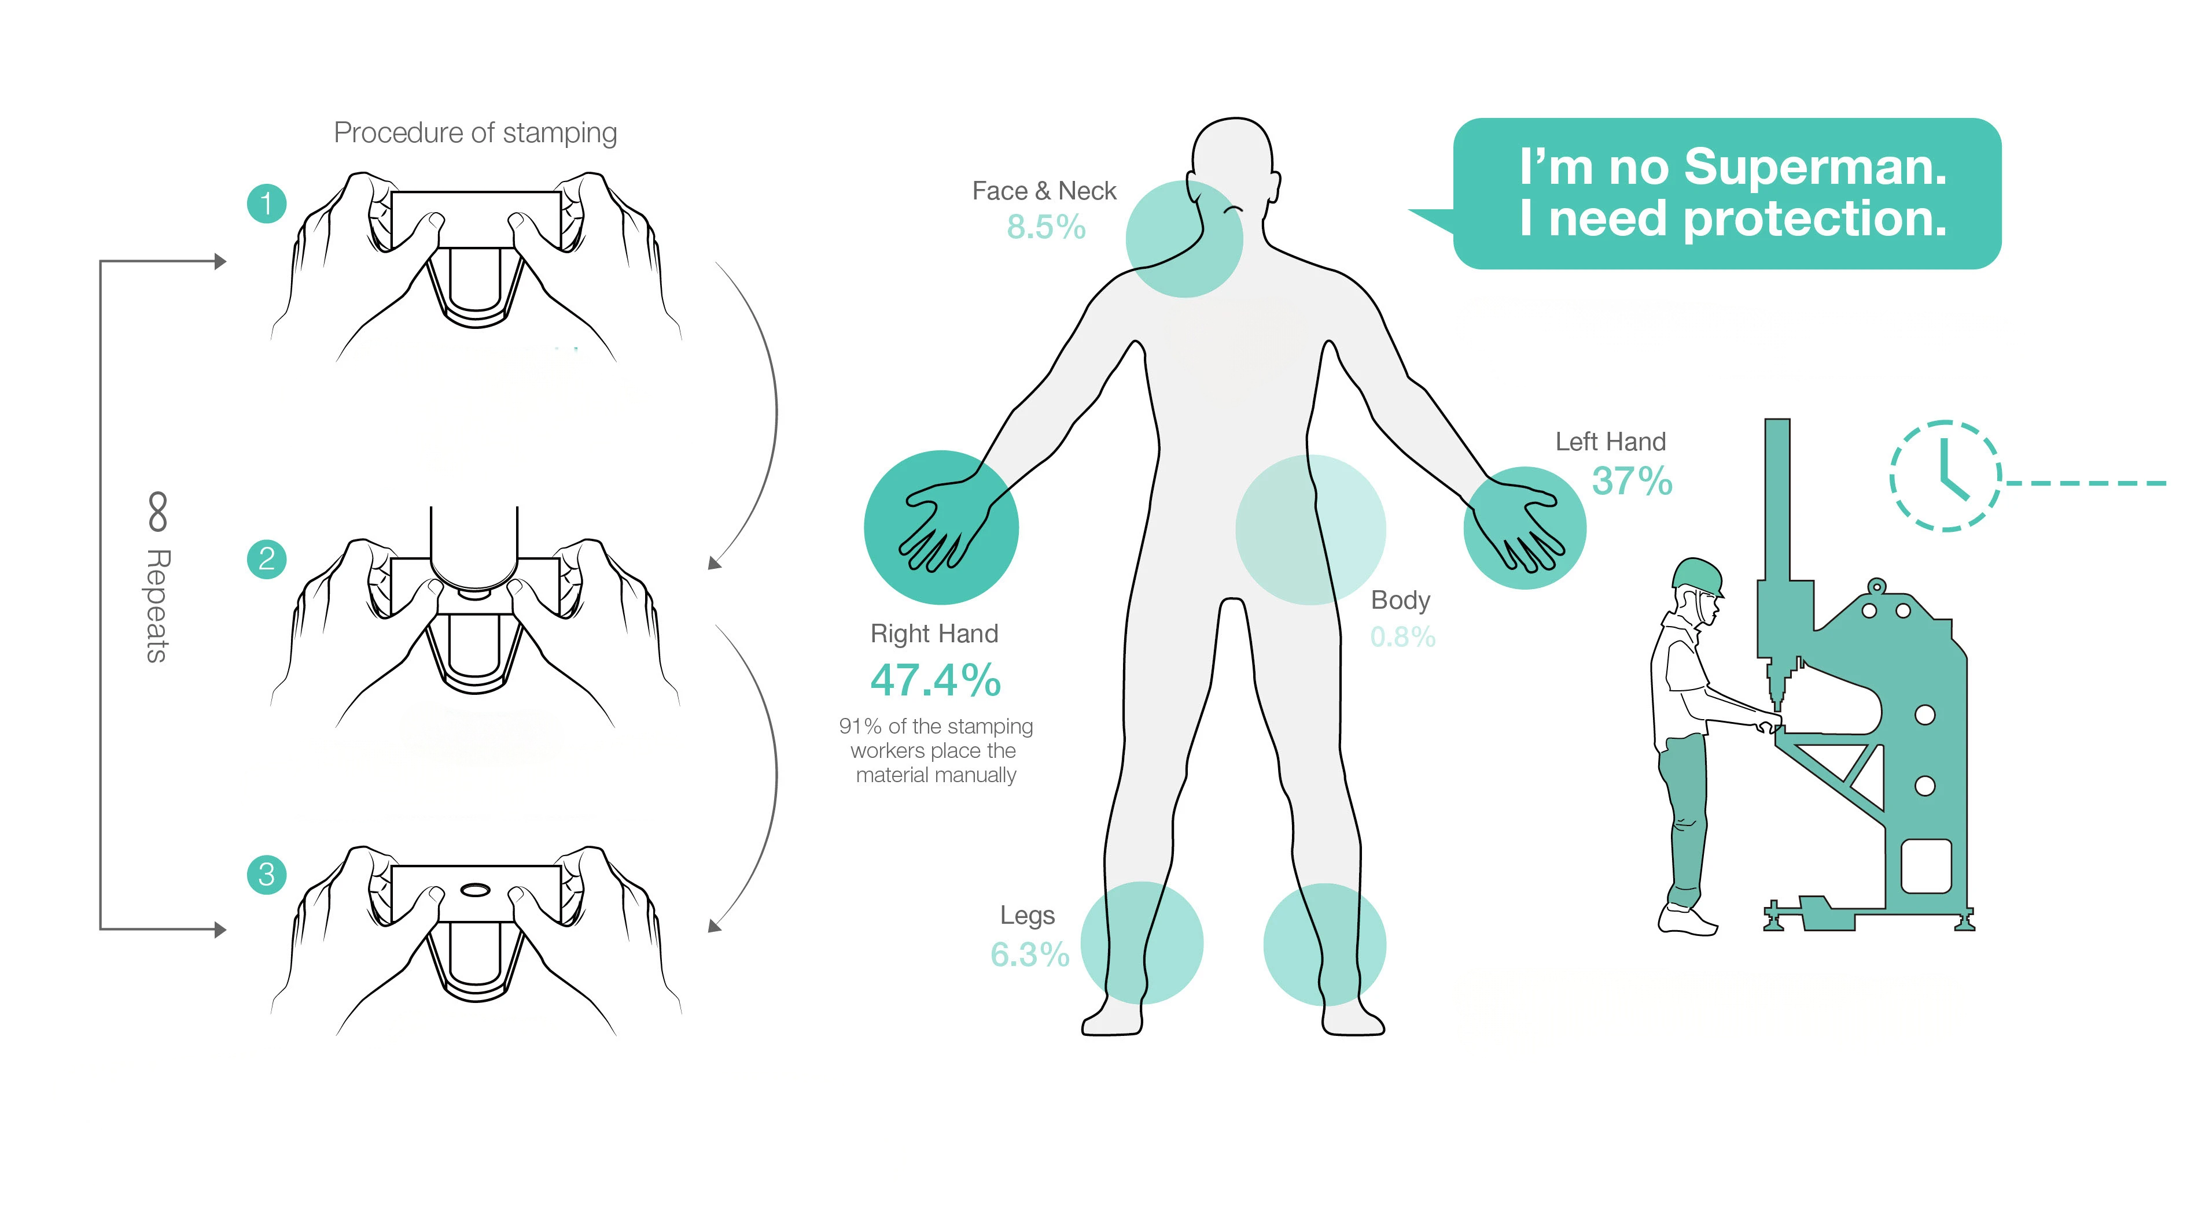
设计汇总
DESIGN SUMMARY PAGE
健康监护
Health monitoring
产品/PRODUCTS：
使用场景/USE CASES：
系列产品1
Series 1
系列产品2
Series 2
页面内的文字和图示仅为示例，自行设计并撰写说明
The text and illustrations in the page are only examples, design and write your own instructions

Slide 16
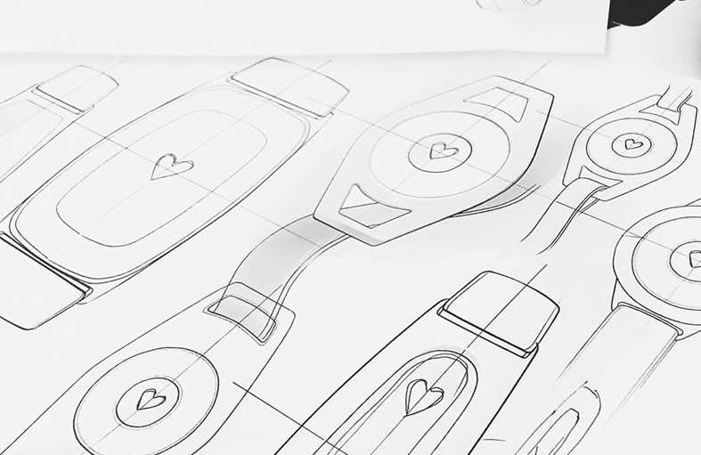
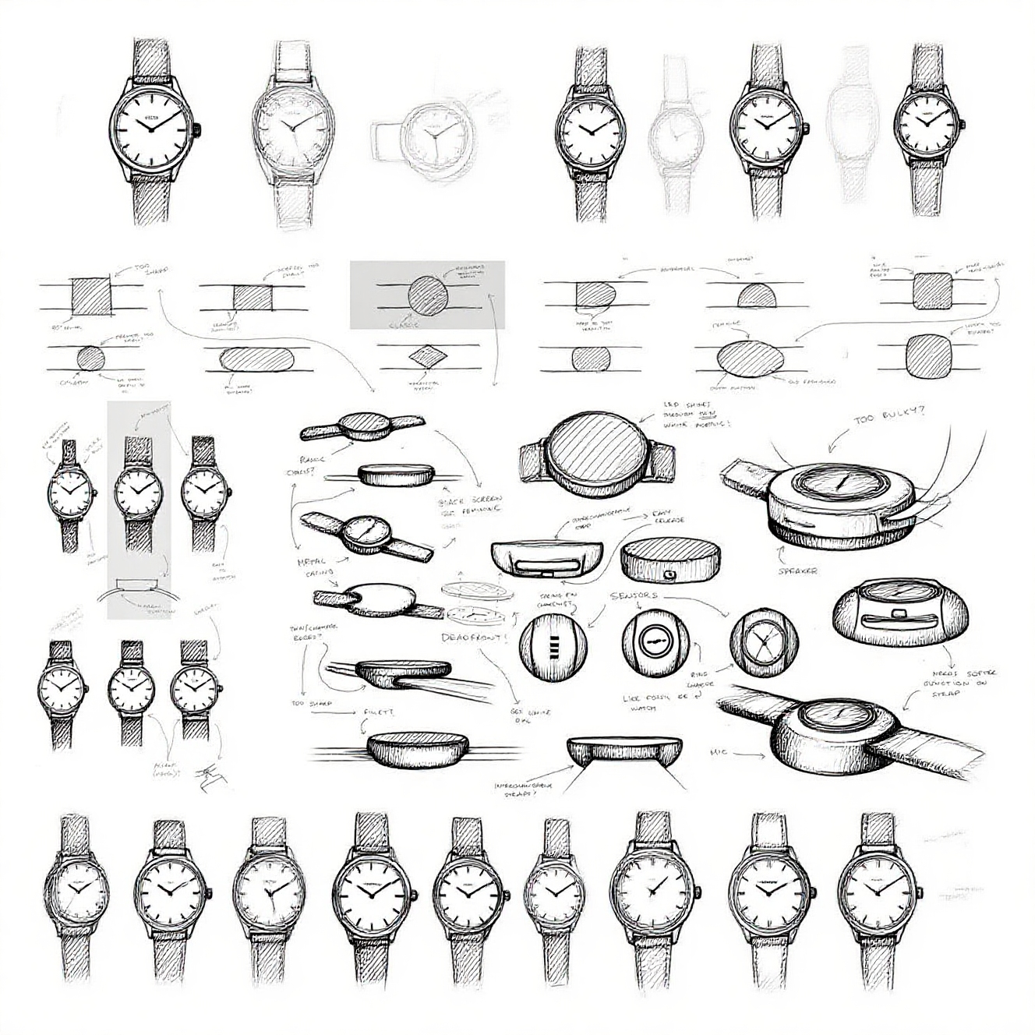
设计草图
DESIGN DRAFT
不少于四张
(no less than four)
页面内的文字和图示仅为示例，自行设计并撰写说明
The text and illustrations in the page are only examples, design and write your own instructions

Slide 17
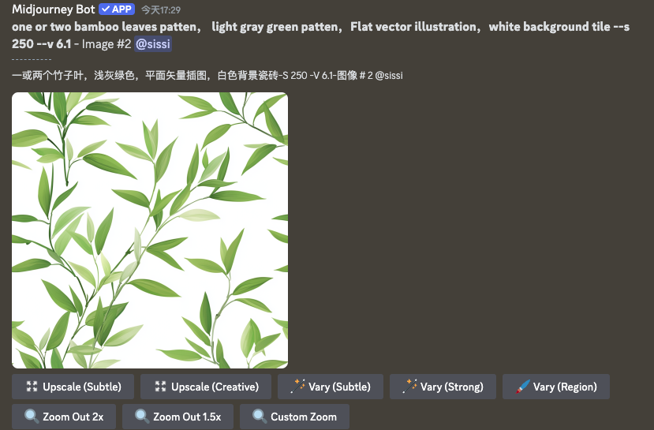
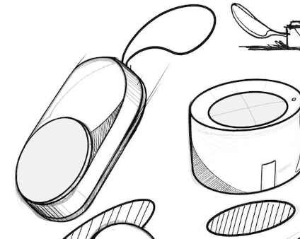
AIGC的生成过程
THE AIGC GENERATION PROCESS
Prompt：one or two bamboo leaves patten， light gray green patten，Flat vector illustration，white background tile --s 250 --v 6.1 - Image #2
AI工具：deepseek+豆包
AI tool: deepseek+ doubao
页面内的文字和图示仅为示例，自行设计并撰写说明
The text and illustrations in the page are only examples, design and write your own instructions

Slide 18
2026 ISFS Award 第四届国际民俗礼品时尚创新大赛参赛作品知识产权协议
2026 ISFS AWARD THE 4TH INTERNATIONAL FOLK GIFTS INNOVATIVE DESIGN CONTEST INTELLECTUAL PROPERTY AGREEMENT
  1. 参赛者所填写的资料必须真实有效。如提供虚假材料，将取消其比赛资格。
  Information provided by participants must be truthful and valid. Providing false materials will result in disqualification.
  2.参赛作品须为本人原创设计且未公开发表的作品，不得一稿多投，不得侵犯他人知识产权及其他权利。用于生成式人工智能产品的预训练、优化训练数据，也不可含有侵犯知识产权的内容。如有违反，将取消参赛资格，由此引起的一切法律后果由参赛者自行负责。
  All entries must be original, unpublished works created solely for this competition, and must not infringe upon any third-party intellectual property rights or other legal rights. Additionally, any data used for pre-training or optimization of generative artificial intelligence products must be free from intellectual property violations. Any violation of these terms will result in disqualification, and the participant shall bear full legal responsibility for any consequences arising therefrom.
  3. 大赛主办方及相关单位有权无偿使用所有参赛作品及参赛者肖像作为活动宣传或商业推广用途。对于获奖作品（包括时尚大奖、最佳创意奖、最佳设计奖和文化交流奖），大赛主办方及相关单位向参赛者支付对应奖金，同时大赛主办方及相关单位拥有获奖作品的全部知识产权，参赛者仅享有署名权并不得将该作品以任何方式提供给其他任何第三方使用或者自行使用。
  The organizers and related entities have the right to use all submitted works and participant images for promotional or commercial purposes. For winning works (including fashion awards, best creative awards, best design awards, and cultural exchange awards), the organizers will pay corresponding prizes, and they will have full intellectual property rights. Participants only have the right to be credited and cannot provide or use the work for any other third party.
  参赛者学校/Name of your University：
  参赛作品名称/Name of your Works：
  参赛者签名/Signature：
  日期/Date：

