Slide 1


安吉∙余村第三届国际民俗礼品时尚创新大赛
ANJI ∙ YUCUN THE 3RD INTERNATIONAL FOLK GIFTS INNOVATIVE DESIGN CONTEST
[ 赛道 TRACK 1 ]
竹艺文创设计作品
BAMBOO ART CULTURAL AND CREATIVE DESIGN WORKS
设计要求与模版
DESIGN REQUIREMENTS &TEMPLATE
作品名称 TITLE OF WORK：
中文姓名 CHINESE NAME：
英文姓名 ENGLISH NAME：
国 家 COUNTRY :
城 市 CITY :
学 校 UNIVERSITY :
指导教师（如有） SUPERVISOR (IF ANY) :
联系方式（微信或手机）CONTACT INFORMATION (WECHAT OR MOBILE PHONE)：

Slide 2
作品提交要求
DESIGN SUBMISSION REQUIREMENTS
1. 提交内容：1份PPT电子文件（建议同步导出PDF文件一并提交）；所有设计稿源文件（PSD、AI或高清PDF格式）。
Submission content: 1 PPT electronic file (it is recommended to export the PDF file and submit it at the same time); Source files for all designs (PSD, AI or HD PDF format).
2. 作品规格：PPT页面设置为A3大小，页内图片及设计稿源文件精度不低于300dpi；源文件需包含设计效果图、工艺尺寸图、1:1图案设计稿， 设计草图（不少于四张）和AIGC的生成过程也需要一起提交，并请自行保留所有设计稿源文件至大赛全部结束；导出的PDF文件分辨率不低于300dpi。
Specifications: The PPT page is set to A3 size, and the accuracy of the pictures and design source files on the page is not less than 300dpi; The source file should include design renderings, process size drawings, 1:1 pattern design drafts, design sketches (no less than four) and the AIGC generation process also need to be submitted together, and please keep all the source files of the design draft until the end of the competition; The resolution of the exported PDF file should not be at least 300dpi.
3. 提交模板：组委会提供各赛道作品提交模板，可通过网站下载或大赛微信群获取。
Submission templates: The organizing committee provides submission templates for each track, which can be downloaded from the website or obtained from the WeChat group of the competition.
4. 提交路径：发送电子邮件至联系邮箱：sific10260461@163.com，邮件名：“学校-作者姓名-作品名”。
Submission path: Send an email to the contact email: sific10260461@163.com, email name: "school-author's name-work name".

Slide 3
作品内容
CONTENTS OF WORK
作品内容包含产品&品牌调研和设计作品两部分，调研占评分10% ，设计占评分90%。
参赛作品须为本人原创设计且未公开发表的作品，不得一稿多投，不得侵犯他人知识产权及其他权利。用于生成式人工智能产品的预训练、优化训练数据，也不可含有侵犯知识产权的内容。如有违反，将取消参赛资格，由此引起的一切法律后果由参赛者自行负责。
Submissions must comprise two key elements: product & brand research and design works，with the research component contributing 10% to the overall score and the design component accounting for 90%.
All entries must be original, unpublished works created solely for this competition, and must not infringe upon any third-party intellectual property rights or other legal rights. Additionally, any data used for pre-training or optimization of generative artificial intelligence products must be free from intellectual property violations. Any violation of these terms will result in disqualification, and the participant shall bear full legal responsibility for any consequences arising therefrom.

Slide 4
1.
产品&品牌调研
PRODUCT & BRAND RESEARCH
调研说明及要求
RESEARCH DESCRIPTION AND REQUIREMENTS
1. 请在设计方案开始之前做一份有关竹子材料产品的调研，包括但不限于茶叶的包装礼盒、时尚日用品、台灯、时尚包袋及配饰等；
Please do a research on bamboo material products before the start of the design plan, including but not limited to tea packaging gift boxes, fashion daily necessities, table lamps, fashion bags and accessories, etc.；
2. 你可以挑选任意国家地区的竹子材料产品和品牌进行调研；
You can choose bamboo material products & brands from any country and region for research；
3. 调研包括：品牌介绍、竹制品品类、产品特色说明、以及店内产品照片，若无法拍摄店铺照片也可以网上找典型图片代替。
The research includes: Brand introduction, bamboo product categories, product feature descriptions, and in-store product photos. If you can't take store photos, you can also find typical pictures online instead

Slide 5
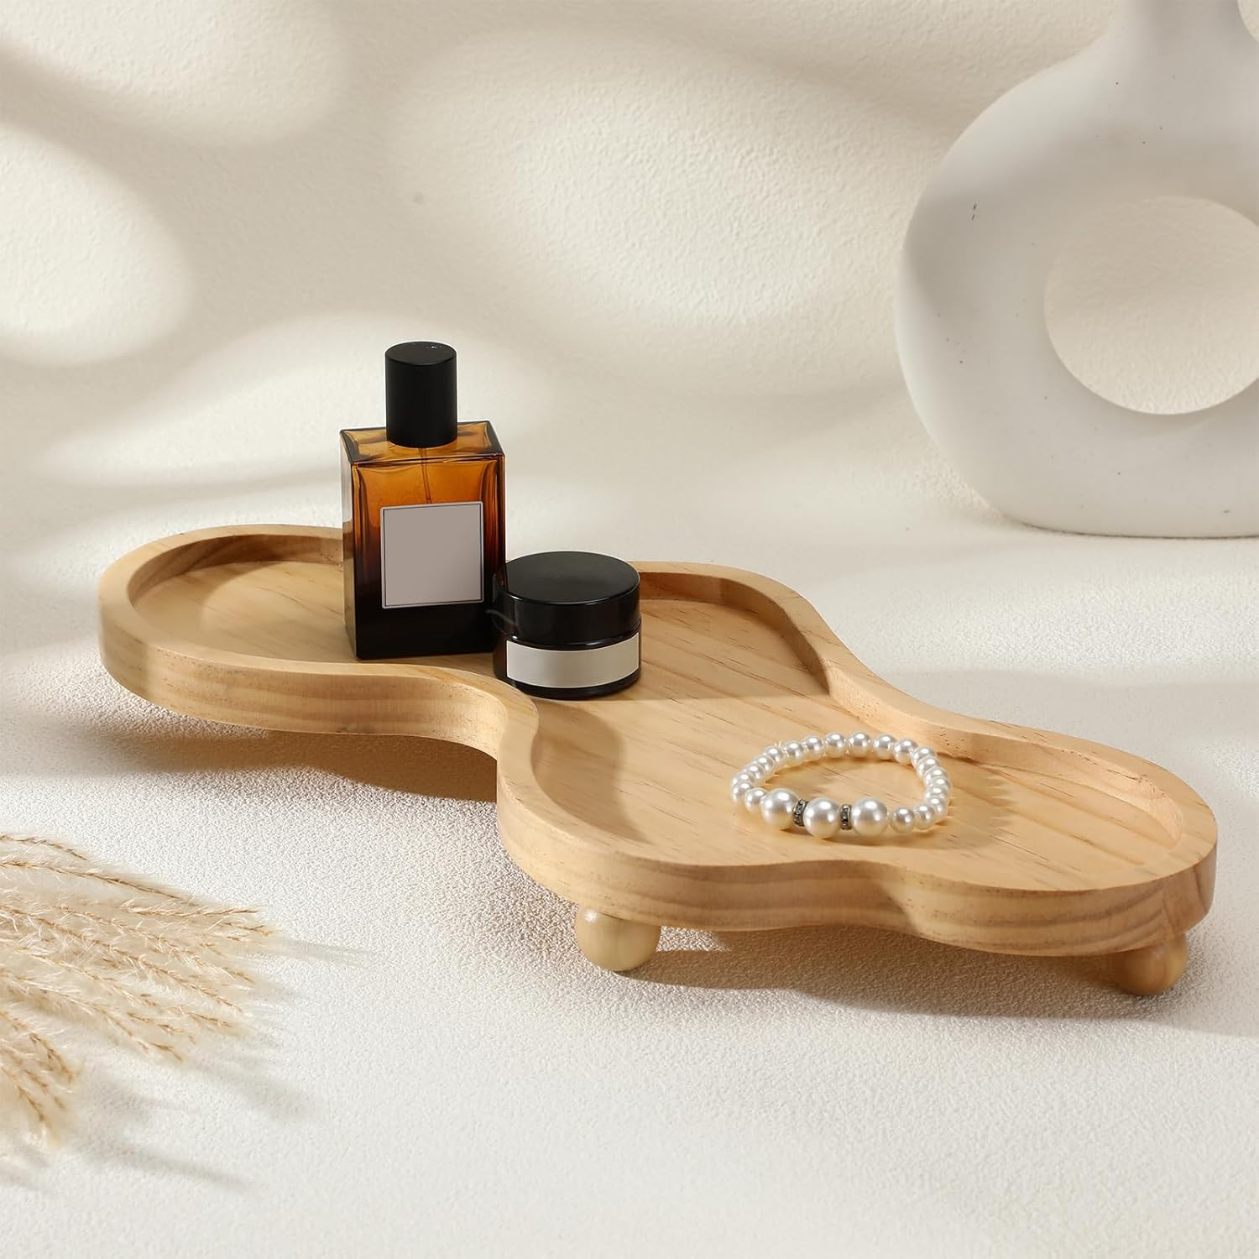
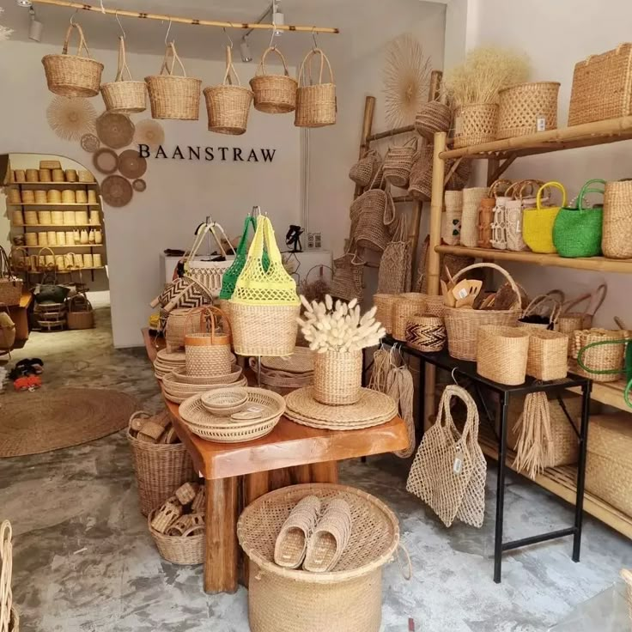
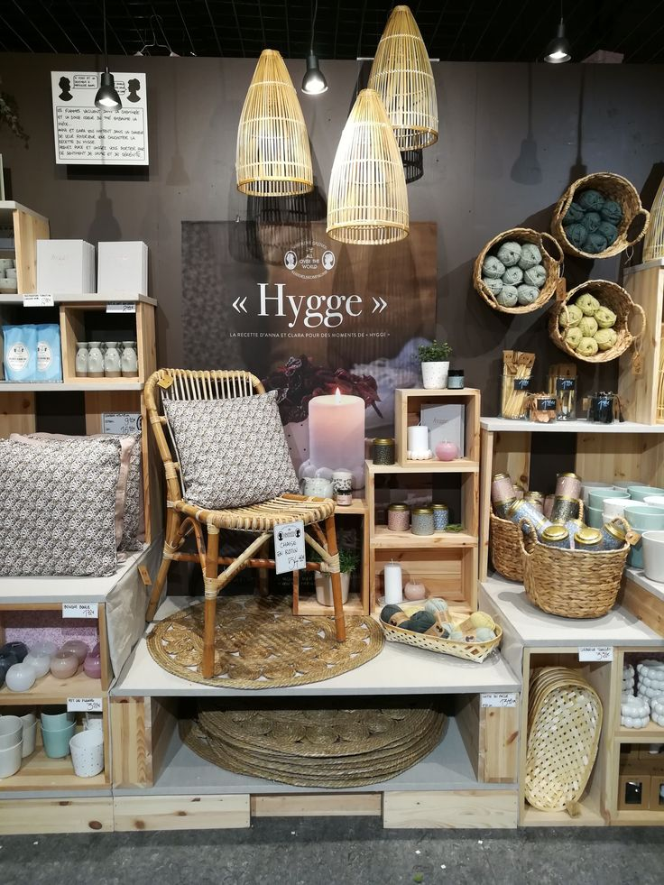
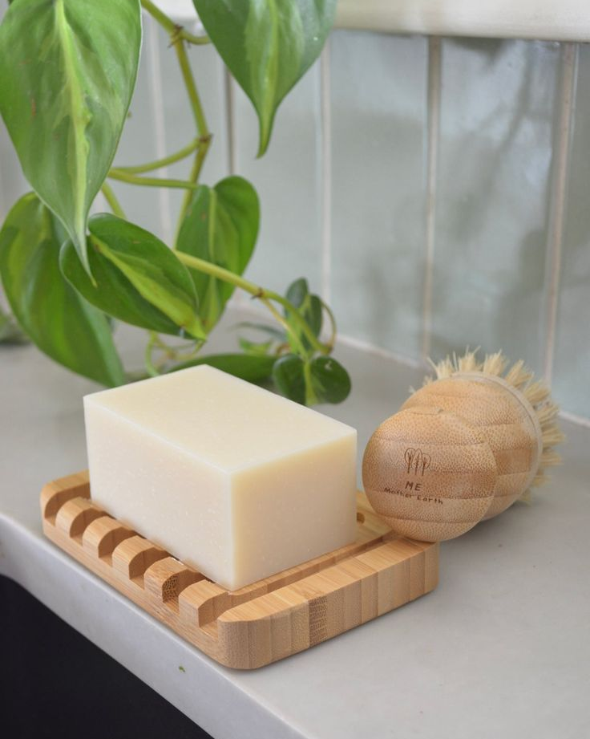
1.
产品与品牌调研
PRODUCT & BRAND RESEARCH
品牌介绍 BRAND INTRODUCTION：
产品品类 PRODUCT CATEGORY ：
产品特色说明 PRODUCT FEATURE DESCRIPTION ：
产品照片
PRODUCT PICTURES
Notes:
根据国际竹藤组织提出的“以竹代塑”倡议，结合竹子材料及竹文化为设计元素，完成单个或一个系列的文创产品、家居产品设计(如:家居装饰、灯具类、日用器具等)。

Slide 6
2.
设计作品
DESIGN WORKS
设计说明及要求 DESIGN DESCRIPTION AND REQUIREMENTS ：
1. 请结合竹文化为设计元素，从以下四类设计方向中挑选一类，完成一个系列的民俗礼品设计：
1. Please combine bamboo culture as the design element, choose one of the following four design directions, and complete a series of folk gift designs ：
  设计两组安吉白茶包装设计，材料以竹板材为主，原竹、竹帘为辅。
  二两装/100g茶叶包装设计（含50g内包装设计，外包装盒设计）
  半斤装/250g茶叶包装设计（含50g内包装设计，外包装盒设计）
  Design two sets of Anji white tea packaging design, the material is mainly bamboo plate, supplemented by original bamboo and bamboo curtain.
  Two packs/100g tea packaging design (including 50g inner packaging design, outer packaging box design)
  Half jin/250g tea packaging design (including 50g inner packaging design, outer packaging box design)
  设计三组时尚日用品， 材料以竹板材为主，原竹为辅。
  创意餐具（如勺子叉子、水果签等）
  时尚家居（如各类托盘等）
  外包装设计
  Design three groups of fashion daily necessities, the materials are mainly bamboo plate, supplemented by original bamboo.
  Creative tableware (such as spoons, forks, fruit sticks, etc.)
  Fashion home furnishing (such as various pallets, etc.)
  Outer packaging design
Notes:
根据国际竹藤组织提出的“以竹代塑”倡议，结合竹子材料及竹文化为设计元素，完成单个或一个系列的文创产品、家居产品设计(如:家居装饰、灯具类、日用器具等)。

Slide 7
2.
设计作品
DESIGN WORKS
设计说明及要求 DESIGN DESCRIPTION AND REQUIREMENTS ：
  完成可做伴手礼的竹台灯及其包装设计，材料以竹板材为主、电器元件为辅，辅料自选。
  ③ Complete the design of the bamboo table lamp and its packaging that can be used as a souvenir. The material is mainly bamboo plate, supplemented by electrical components, and the accessories are optional.
  设计三组时尚包袋及配饰设计，以竹丝为主，原竹为辅，与布、皮革材料搭配。
  包袋设计
  包的配饰设计（如卡包、挂件等）
  时尚配饰（与包袋相搭配的配饰，如耳环、手镯等）
  Design three sets of fashion bags and accessories design, mainly bamboo silk, supplemented by original bamboo, and matched with cloth and leather materials.
  Bag design
  Accessory design of the bag (such as card case, pendant, etc.)
  Fashion accessories (accessories that match bags, such as earrings, bracelets, etc.)
Notes:
根据国际竹藤组织提出的“以竹代塑”倡议，结合竹子材料及竹文化为设计元素，完成单个或一个系列的文创产品、家居产品设计(如:家居装饰、灯具类、日用器具等)。

Slide 8
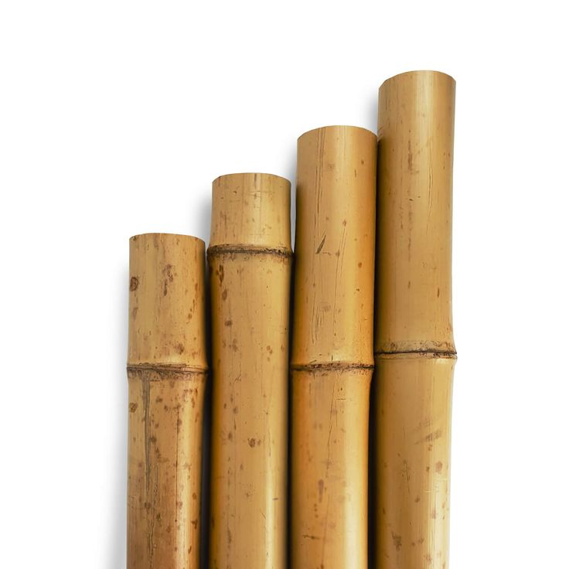
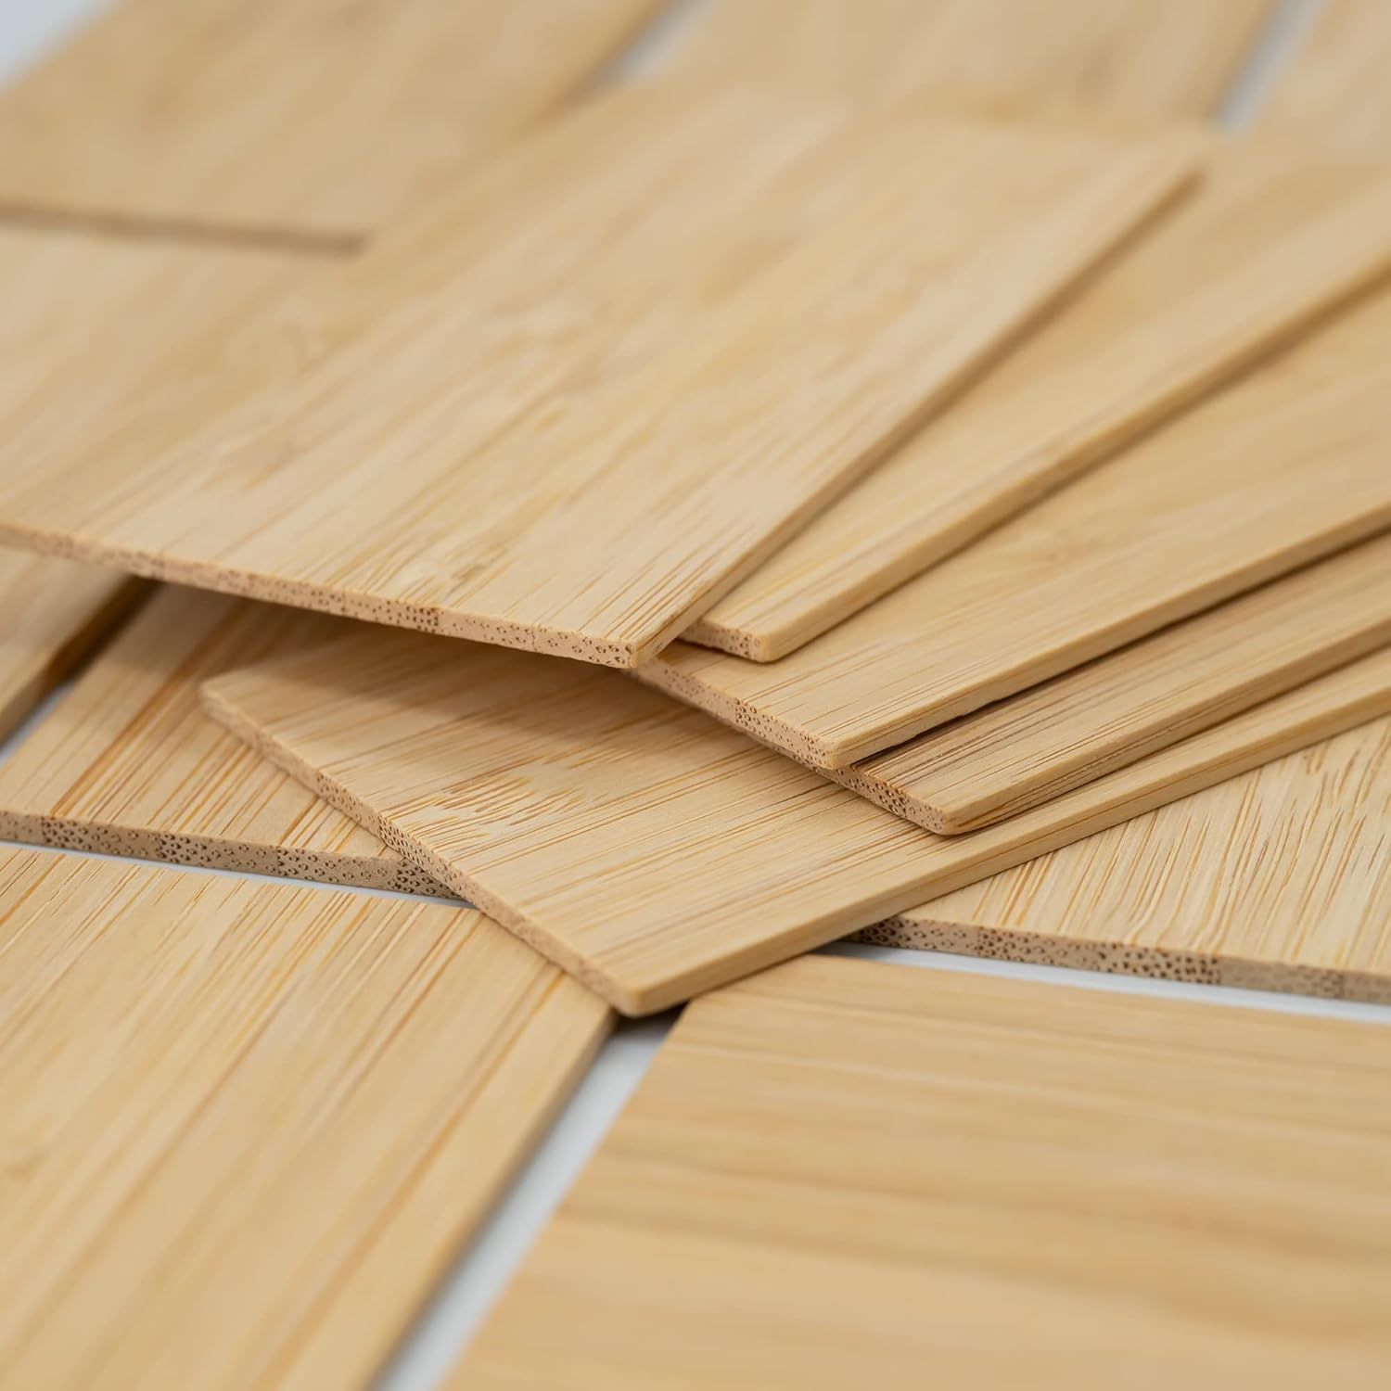
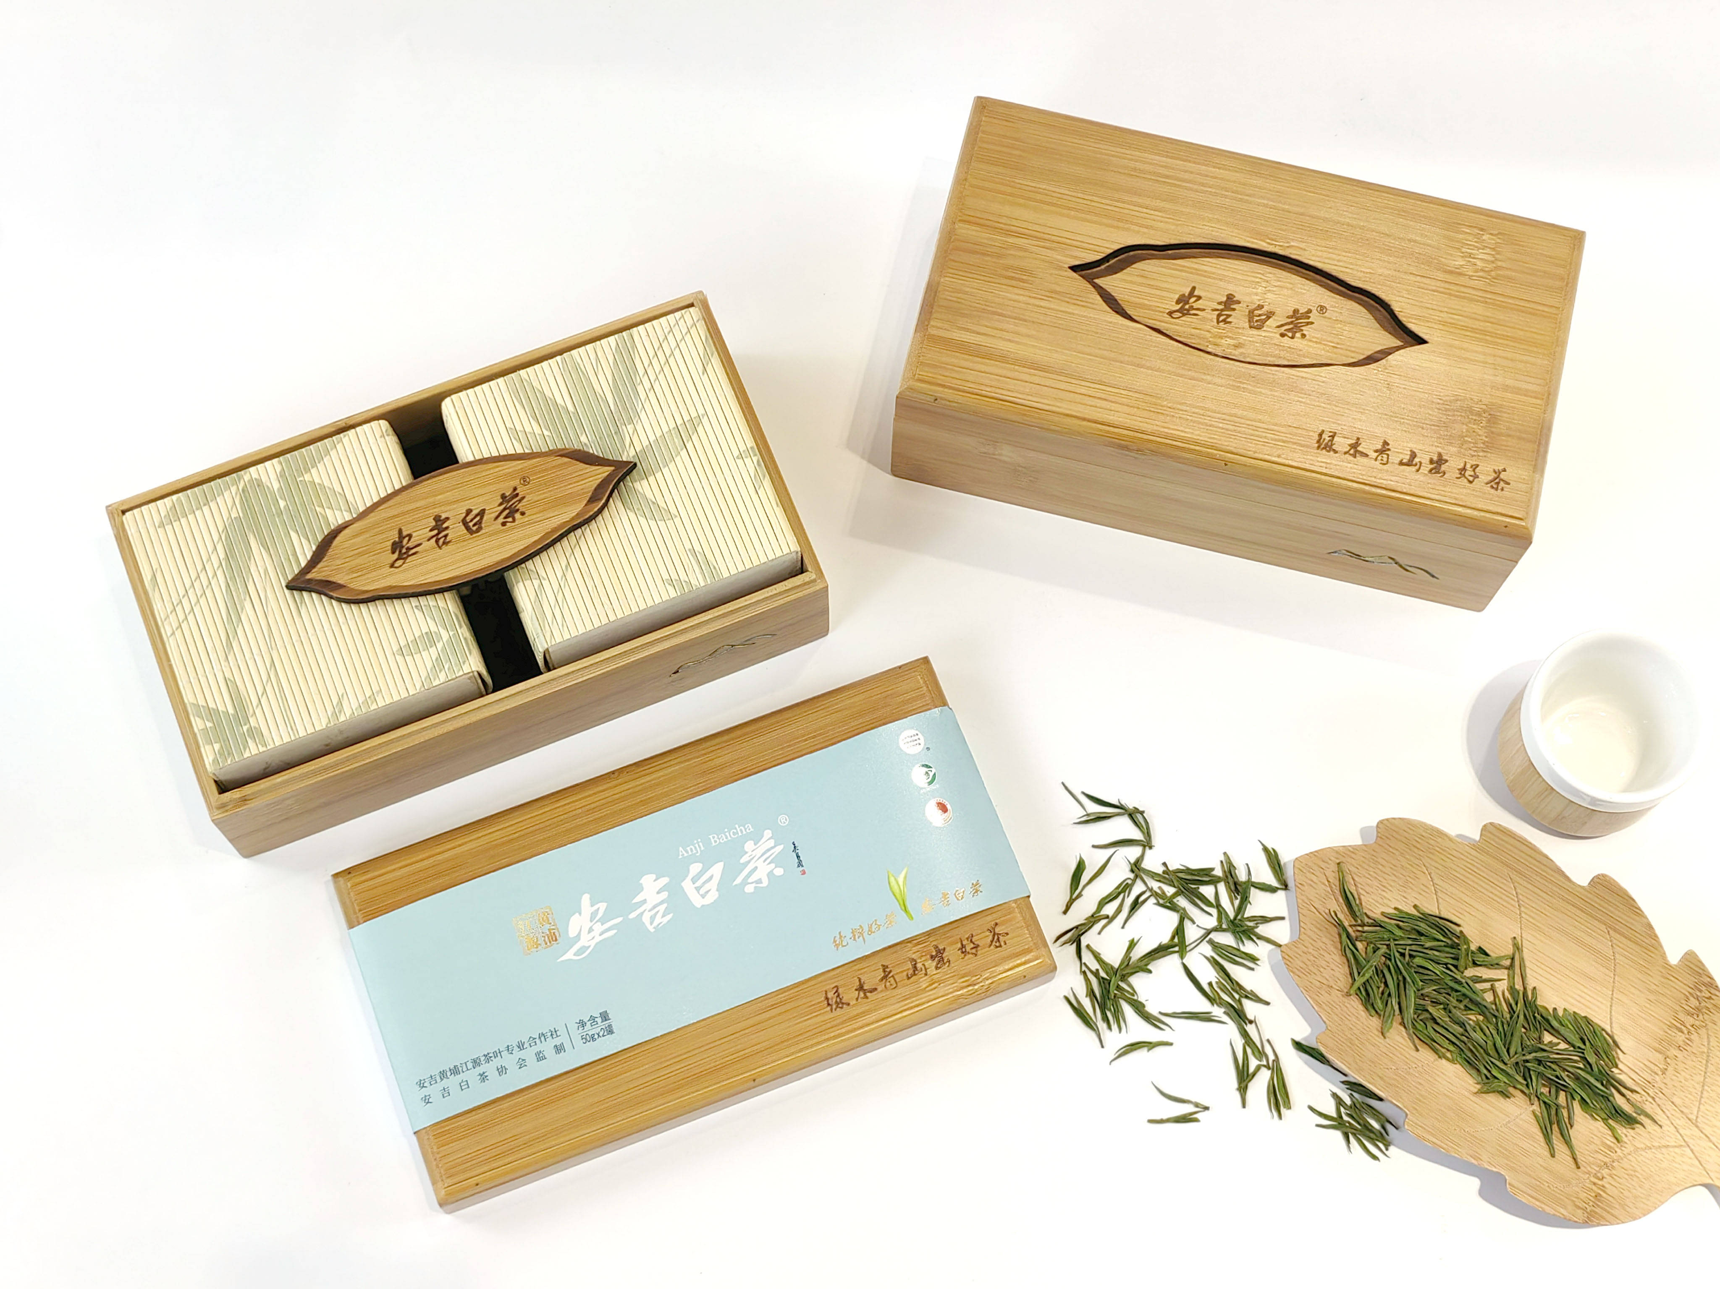
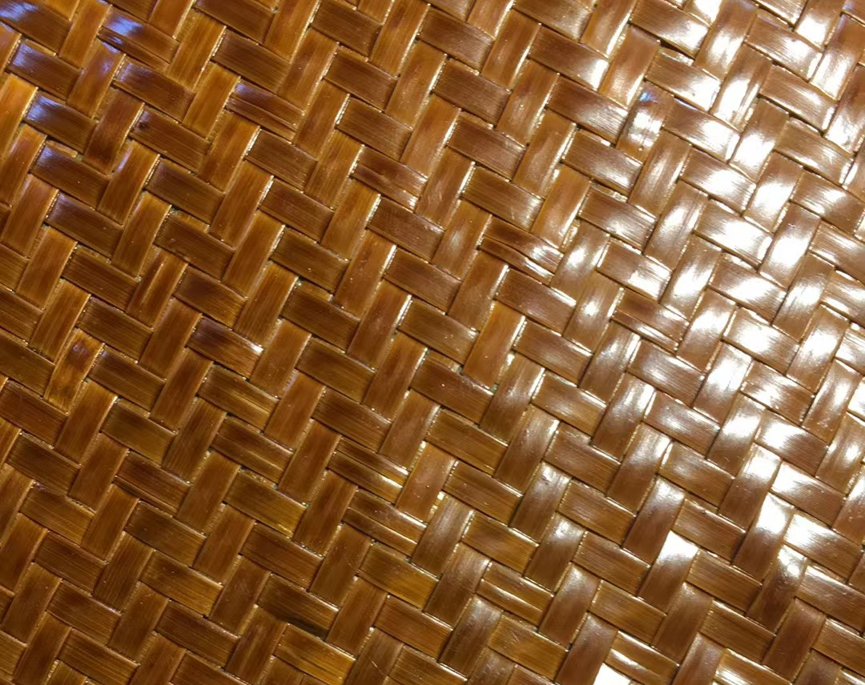
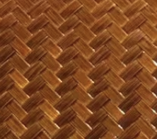

2.
设计作品
DESIGN WORKS
设计说明及要求 DESIGN DESCRIPTION AND REQUIREMENTS ：
2. 材料和色彩的选择 The choice of materials and colors ：
类别CATEGORY | 参考图 REFERENCE DIAGRAM | 规格 SPECIFICATION | 颜色 COLOR | 可选工艺 CRAFTSMANSHIP | 适用设计方向 APPLICABLE DESIGN DIRECTION
原竹类 Original bamboo |  | 直径5～10cm Diameter 5~10cm | 颜色分为原色（ ）、碳化（ ）和其余颜色三种类型，其余颜色需要标注潘通色号 Color selection: The color of bamboo is divided into three types: primary color ( ), carbonization ( ) and other colors, and the rest of the colors need to be marked with Pantone color number | 激光雕刻 Laser engraving | 方向Direction①②③
竹板材类 Bamboo plate |  | 白茶包装、日用品：厚度3～6mm White tea packaging, daily necessities: thickness 3~6mm 灯具：厚度2-35mm Lamp: thickness 2-35mm |  | 激光雕刻 Laser engraving | 方向Direction①②③
竹帘类 Bamboo curtains |  | 厚度1.7mm Thickness 1.7mm | 原色Primary colors | UV印刷图案 UV printing pattern | 方向Direction①②③
竹编类 Bamboo weaving |  | 竹丝宽度3毫米，厚度2毫米 最大规格1.8×2米 The width of the bamboo wire is 3 mm, and the thickness is 2 mm The maximum size is 1.8×2 meters | 偏红（ ），偏黄（ ） | 与皮革、丝绸、金属或其他材料配件搭配设计 Designed with leather, silk, metal or other material accessories | 方向Direction④
原色
碳化
原色
碳化
Notes:
根据国际竹藤组织提出的“以竹代塑”倡议，结合竹子材料及竹文化为设计元素，完成单个或一个系列的文创产品、家居产品设计(如:家居装饰、灯具类、日用器具等)。

Slide 9
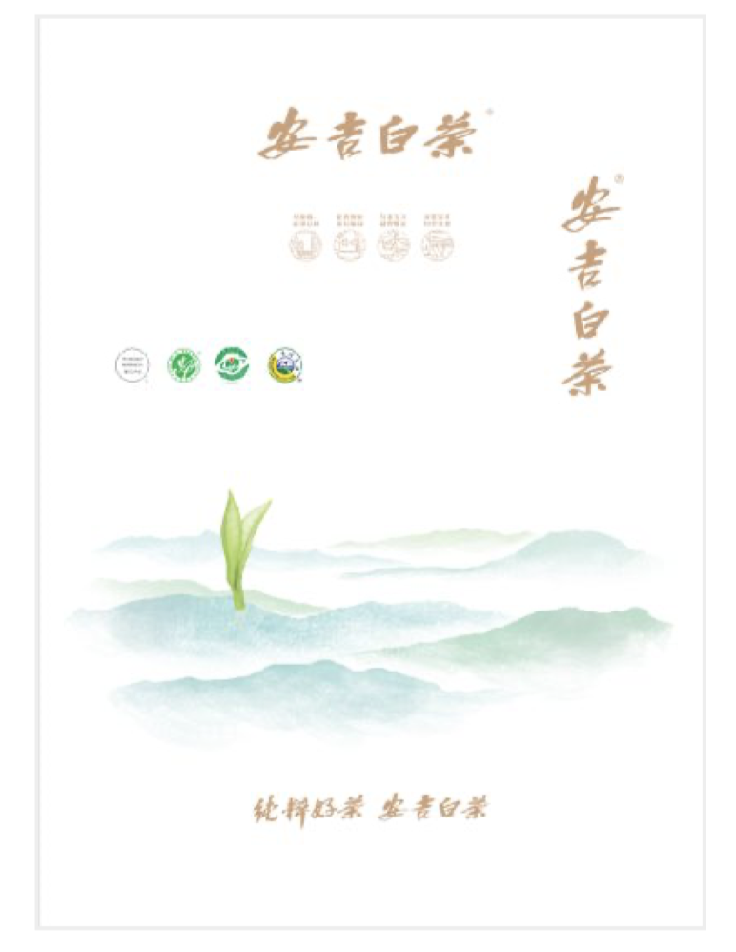
2.
设计作品
DESIGN WORKS
设计说明及要求 DESIGN DESCRIPTION AND REQUIREMENTS ：
3. 包装设计要求：
包装礼盒的设计要符合设计主题要求，需要有生产后包装上市销售的可能性
二两装/100g ：长(cm)*宽(cm)*高(cm)<3333CM³
半斤装/250g ：长(cm)*宽(cm)*高(cm)<8333CM³
盒子重量是茶叶净含量的8倍
安吉白茶公版如右图（不可改动，文字和图案元素可以自由组合，放在包装盒的正面、侧面或底部，附安吉白茶公版图案素材）
3. Packaging Design Requirements:
The design of the packaging gift box should meet the requirements of the design theme, and it needs to have the possibility of packaging and marketing after production
Two taels/100g: length (cm) * width (cm) * height (cm) < 3333CM³
Half catty /250g: length (cm) * width (cm) * height (cm) < 8333CM³
The public version of Anji White Tea is shown on the right (cannot be changed, the text and pattern elements can be freely combined, placed on the front, side or bottom of the packaging box, attached is the Anji white tea public version pattern material)
安吉白茶公版
The public version of Anji white tea
Notes:
根据国际竹藤组织提出的“以竹代塑”倡议，结合竹子材料及竹文化为设计元素，完成单个或一个系列的文创产品、家居产品设计(如:家居装饰、灯具类、日用器具等)。

Slide 10
2.
设计作品
DESIGN WORKS
4. 设计作品包括：灵感来源、作品名称、色彩、材质、设计说明、设计效果图、尺寸工艺图和1:1图案设计稿。
设计说明应详细阐述设计的文化理念，着重说明如何将这些理念转化为具体的设计方案，并介绍产品的功能、结构、应用等。
尺寸工艺图包括：产品整体尺寸，材料的宽度、厚度，重要位置尺寸，细节尺寸需要备注。
1:1图案设计稿：所有LOGO（文字或图形）、图案需要标注1:1尺寸。
如果采用人工智能协助设计，需完整呈现AIGC的生成过程，包括使用的AI工具、提示词、工作流示意图或分工清单，清晰展示从概念意向到模型/手绘底图，再到初次生成、迭代，最终完成成图的整个流程。不得采用他人知识产权的图片垫图。
Design works include: inspiration source, work name, color, material, design description, design effect drawing, size process drawing and 1:1 pattern design drafts.
The design description should elaborate on the cultural ideas of the design, emphasize how to translate these ideas into specific design schemes, and introduce the function, structure and application of the product.
The size process diagram includes: the overall size of the product, the width and thickness of the material, the size of the important position, and the detail size needs to be noted.
1:1 pattern design draft: All logos (text or graphics) and patterns need to be marked with 1:1 size.
If the design is assisted by artificial intelligence, the generation process of AIGC should be fully presented, including the AI tools used, prompt words, workflow diagrams or labor division lists, and the entire process from conceptual intention to model/hand-drawn base drawing, to initial generation, iteration, and finally the completion of the drawing should be clearly shown. It is not allowed to use other people's intellectual property rights.
Notes:
根据国际竹藤组织提出的“以竹代塑”倡议，结合竹子材料及竹文化为设计元素，完成单个或一个系列的文创产品、家居产品设计(如:家居装饰、灯具类、日用器具等)。

Slide 11
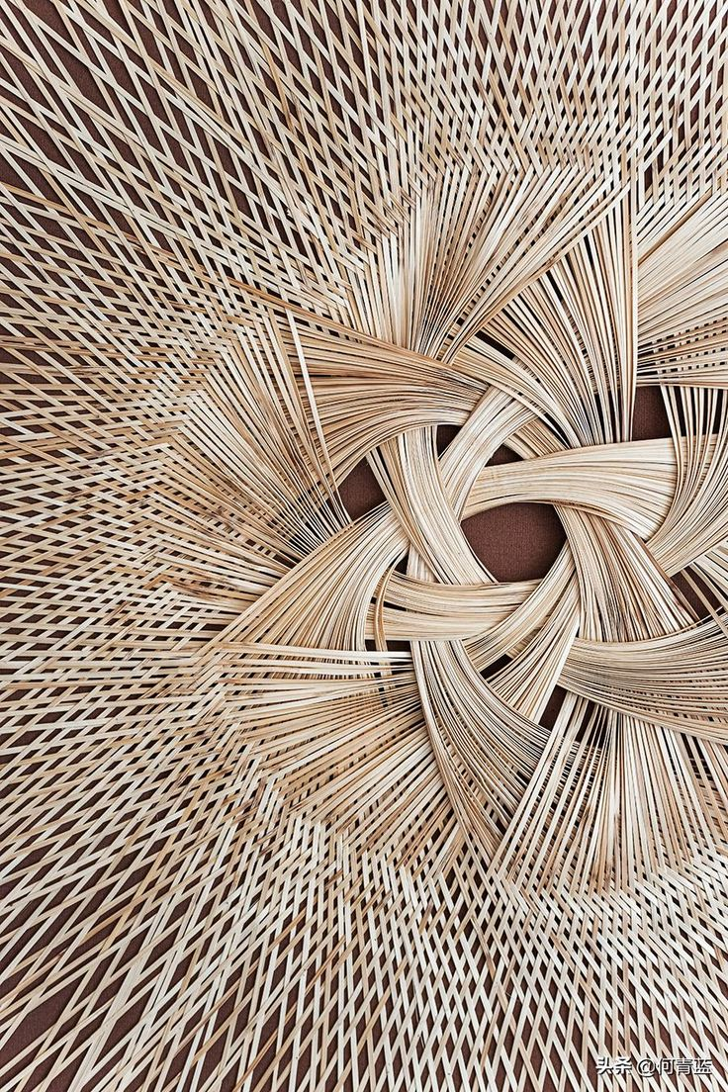
灵感来源
INSPIRATION SOURCES
灵感来源图片 INSPIRATION PICTURES
作品名称 THE TITLE OF THE WORK
文字描述 DESCRIPTION

Slide 12

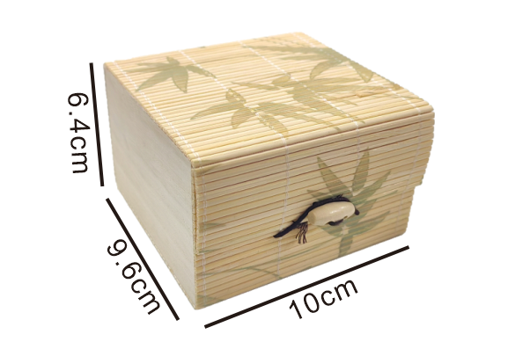
1. 安吉白茶包装设计
ANJI WHITE TEA PACKAGING DESIGN
二两装/100g茶叶包装设计（含50g内包装设计，外包装盒设计）
Two packs/100g tea packaging design (including 50g inner packaging design, outer packaging box design)
50cm
内盒竹帘厚度约1.7mm
尺寸参考
长10*宽9.6*高6.4cm
The thickness of the bamboo curtain in the inner box is about 1.7mm
Size reference: length 10 * width 9.6 * height 6.4cm
竹帘上的图案为UV印刷，颜色不限
The pattern on the bamboo curtain is UV printing, and the color is not limited
50cm
配件皮筋和木珠
Accessories rubber bands and wooden beads
设计效果图与尺寸工艺
Design renderings and dimensional technology
图案设计稿与尺寸Pattern design and size
（另附1:1矢量设计稿）(1:1 vector design draft attached)
色彩Color：
材质 Material：
竹板材 厚度4mm
竹帘 厚度1.7mm
Bamboo plate: Thickness 4mm
Bamboo curtain thickness 1.7mm
设计说明Design Description：
碳化

Slide 13
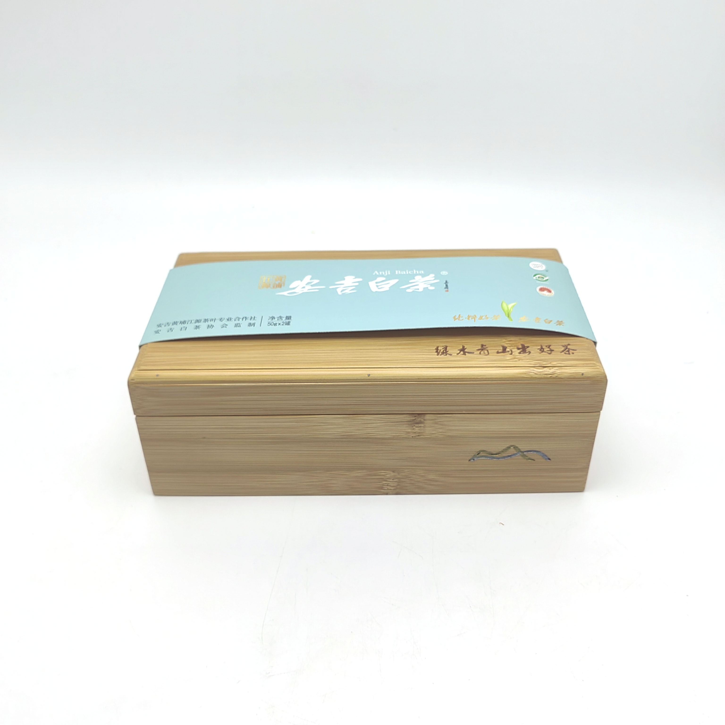

1. 安吉白茶包装设计
ANJI WHITE TEA PACKAGING DESIGN
二两装/100g茶叶包装设计（含50g内包装设计，外包装盒设计）
Two packs/100g tea packaging design (including 50g inner packaging design, outer packaging box design)
外盒板材厚度约3～6mm
尺寸参考
长23*宽12.5*高8cm
The thickness of the outer box plate is about 3～6mm
Size reference
Length 23*width 12.5*height 8cm
12.5cm
8cm
包装纸的设计方案
尺寸：长23*宽8cm
Design of wrapping paper
Size：Length 23*width 8cm
8cm
23cm
文字：长10*高2cm
图案：长8*高2cm
Text: Length 10* height 2cm
Pattern: length 8 * height 2cm
文字和图案使用激光雕刻工艺
Text and patterns are laser engraved
设计效果图与尺寸工艺
Design renderings and dimensional technology
图案设计稿与尺寸Pattern design and size
（另附1:1矢量设计稿）(1:1 vector design draft attached)
色彩Color：
材质 Material：
竹板材 厚度4mm
竹帘 厚度1.7mm
Bamboo plate: Thickness 4mm
Bamboo curtain thickness 1.7mm
设计说明Design Description：
碳化

Slide 14
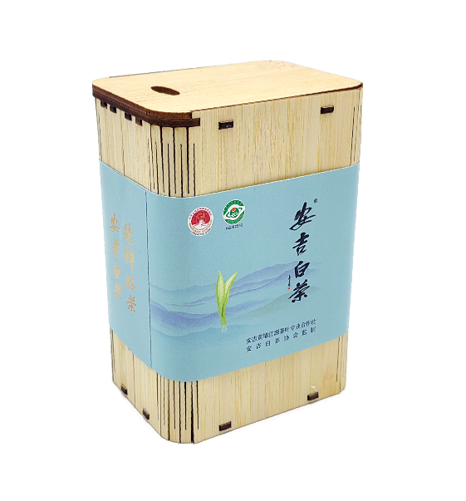
1. 安吉白茶包装设计
ANJI WHITE TEA PACKAGING DESIGN
半斤装/250g茶叶包装设计（含50g内包装设计，外包装盒设计）
Half jin/250g tea packaging design (including 50g inner packaging design, outer packaging box design)
内盒板材厚度约3～6mm
尺寸参考
长8.5*宽6.2*高12cm
The thickness of the inner box plate is about 3~6mm
Size reference
Length 8.5 * width 6.2 * height 12cm
抽拉盖设计
Pull-out cover design
12cm
内包装纸的设计方案
尺寸：长23*宽8cm
The design scheme of the inner wrapping paper
Size: length 23 * width 8cm
6.2cm
8.5cm
设计效果图与尺寸工艺
Design renderings and dimensional technology
图案设计稿与尺寸Pattern design and size
（另附1:1矢量设计稿）(1:1 vector design draft attached)
色彩Color：
材质 Material：
竹板材 厚度3mm
Bamboo plate: Thickness 3mm
设计说明Design Description：
碳化

Slide 15

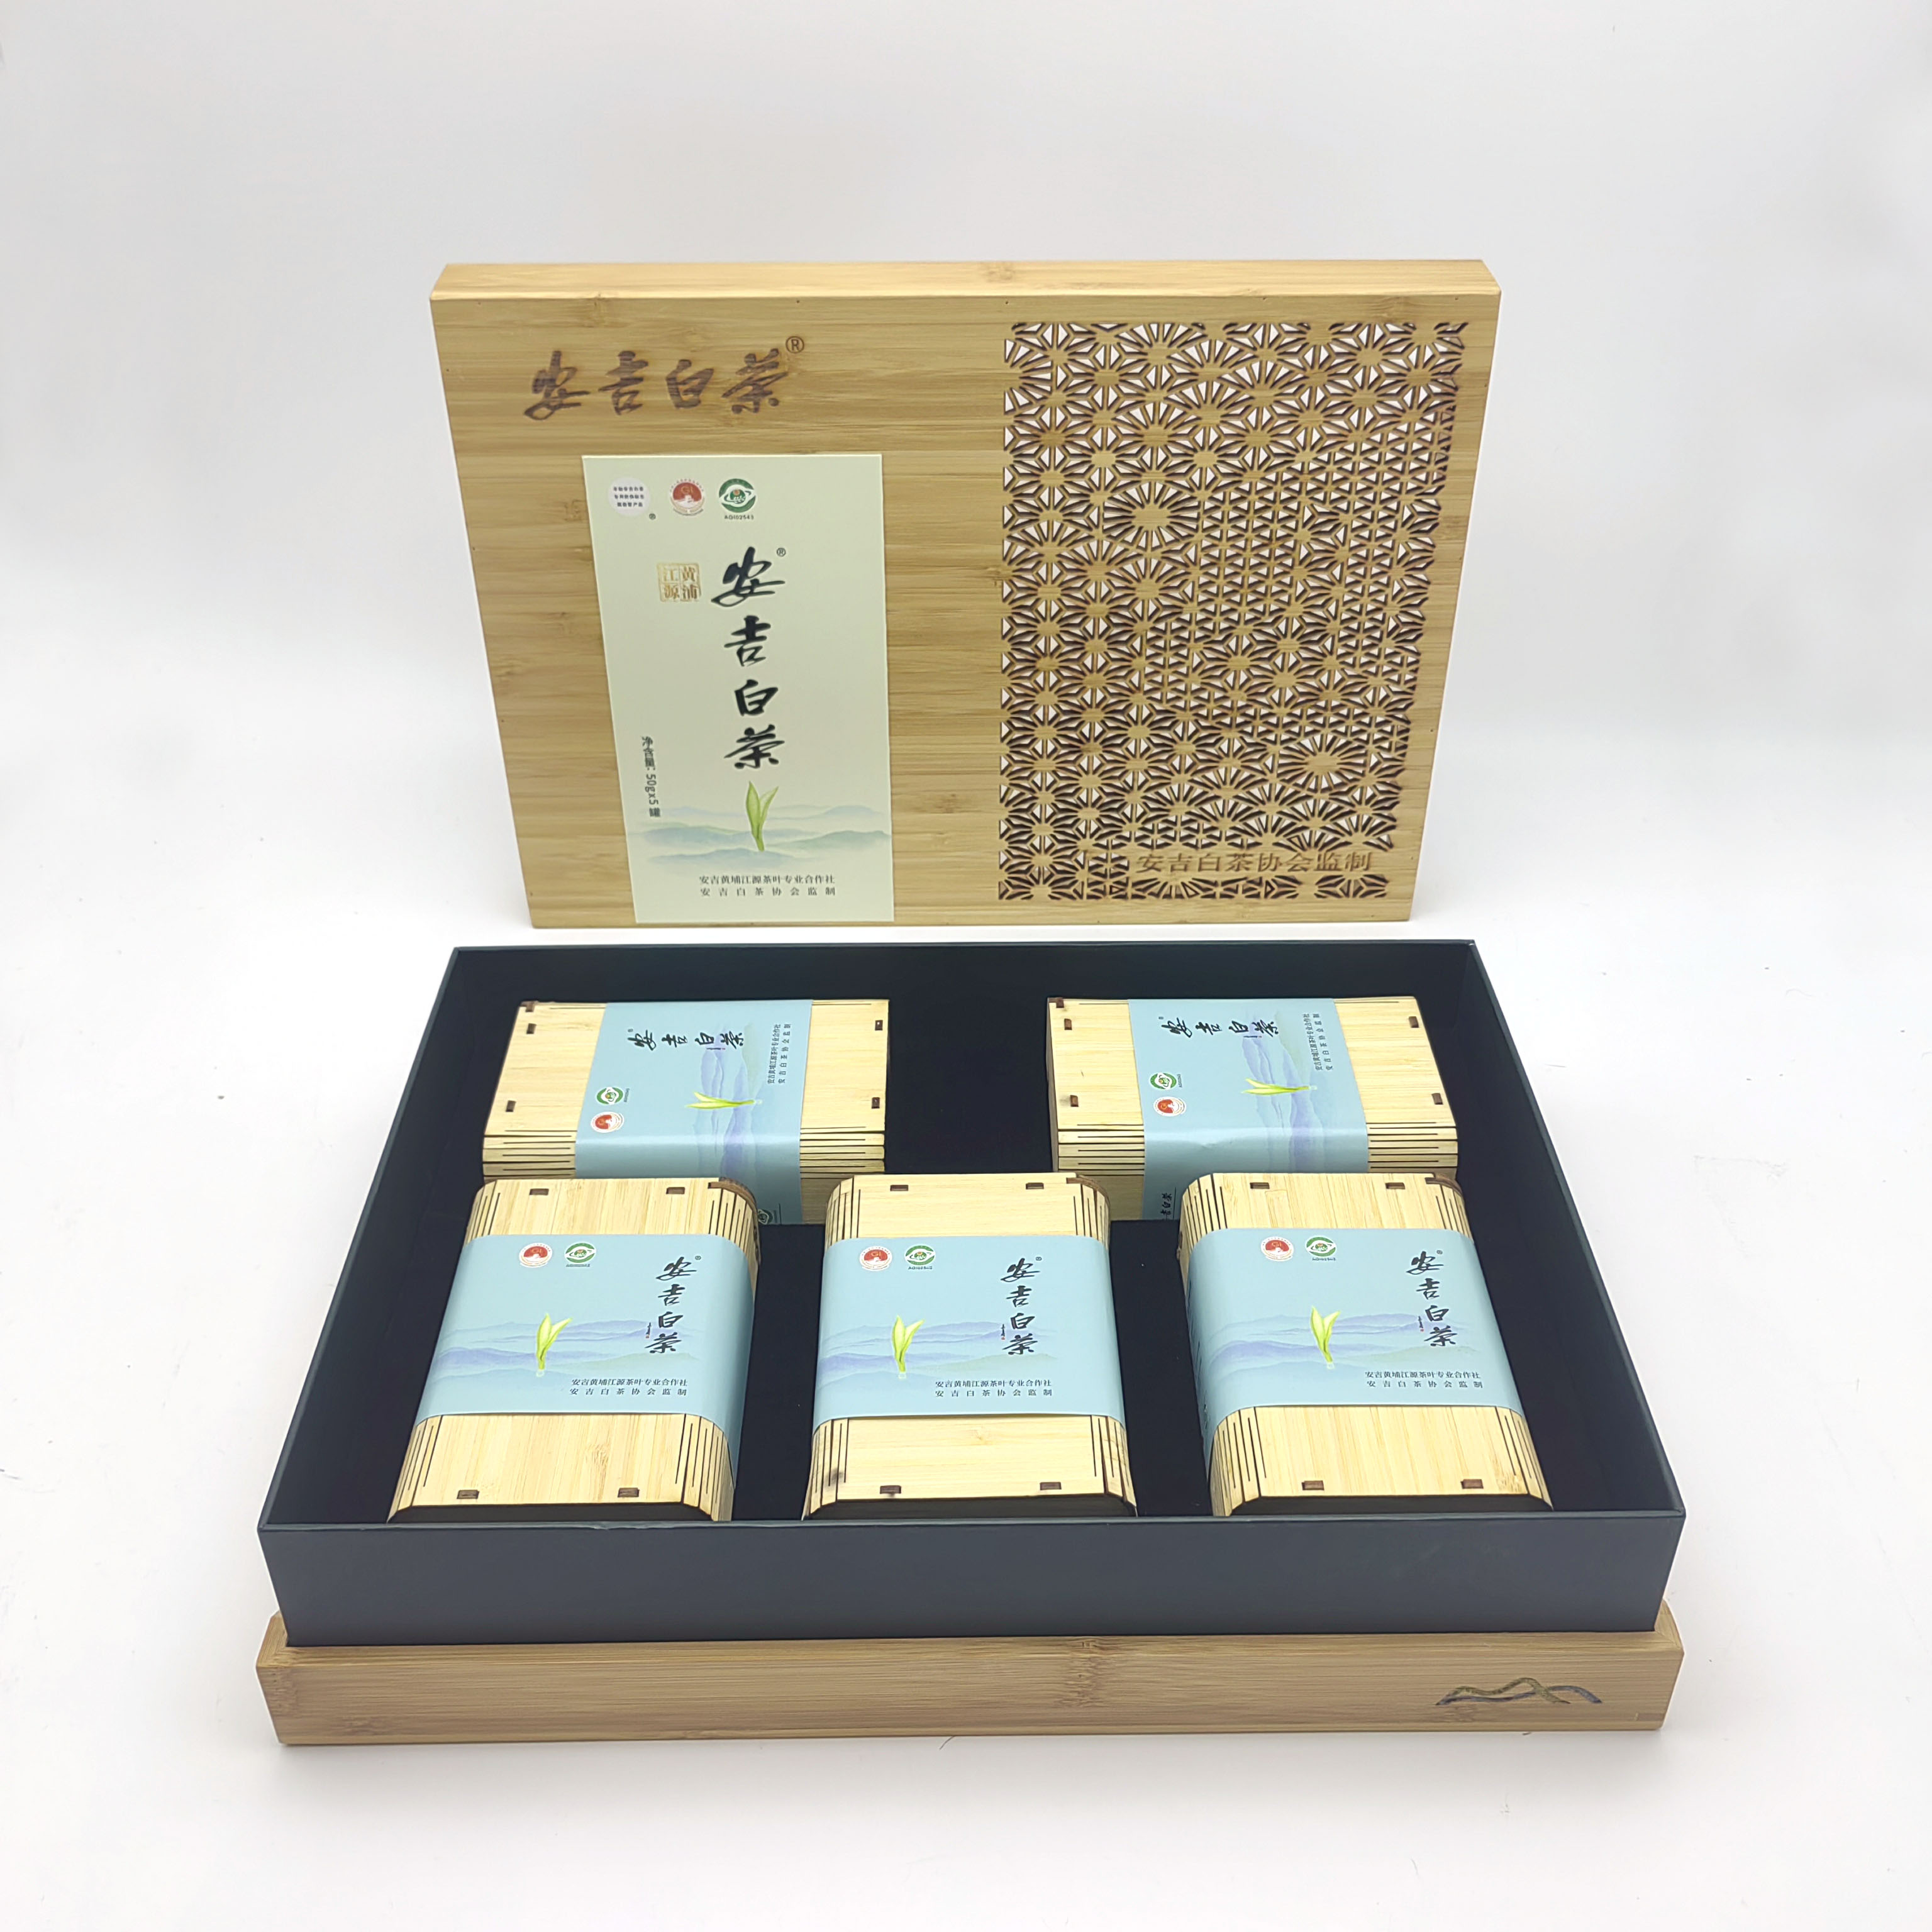
1. 安吉白茶包装设计
ANJI WHITE TEA PACKAGING DESIGN
半斤装/250g茶叶包装设计（含50g内包装设计，外包装盒设计）
Half jin/250g tea packaging design (including 50g inner packaging design, outer packaging box design)
外盒板材厚度约3～6mm
尺寸参考
长36*宽26*高8cm
The thickness of the outer box plate is about 3～6mm
Size reference
Length 36*width 26*height 8cm
文字和图案使用激光雕刻工艺
Text and patterns are laser engraved
26cm
外包装纸的设计方案
尺寸：高16*宽8cm
The design scheme of the outer wrapping paper
Size: Height 16 * width 8cm
激光雕刻工艺图案尺寸
高24*宽15cm
Laser engraving process pattern size
Height 24* width 15cm
8cm
36cm
设计效果图与尺寸工艺
Design renderings and dimensional technology
图案设计稿与尺寸Pattern design and size
（另附1:1矢量设计稿）(1:1 vector design draft attached)
色彩Color：
材质 Material：
竹板材 厚度3mm
Bamboo plate: Thickness 3mm
设计说明Design Description：
碳化

Slide 16
设计汇总
DESIGN SUMMARY
二两装/100g茶叶包装
Two taels/100g tea packaging
半斤装/250g茶叶包装
Half catty/250g tea packaging
页面内的文字和图示仅为示例，自行设计并撰写说明。安吉白茶公版不可改动
The text and illustrations in the page are only examples, design and write your own instructions.The public version of Anji White Tea cannot be changed

Slide 17
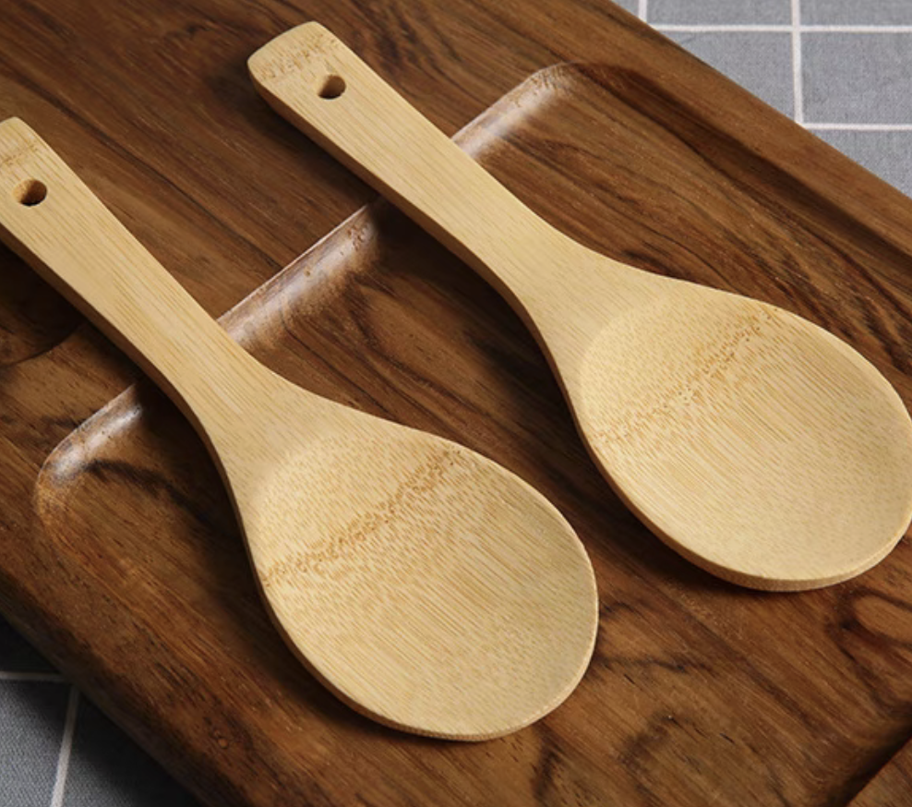
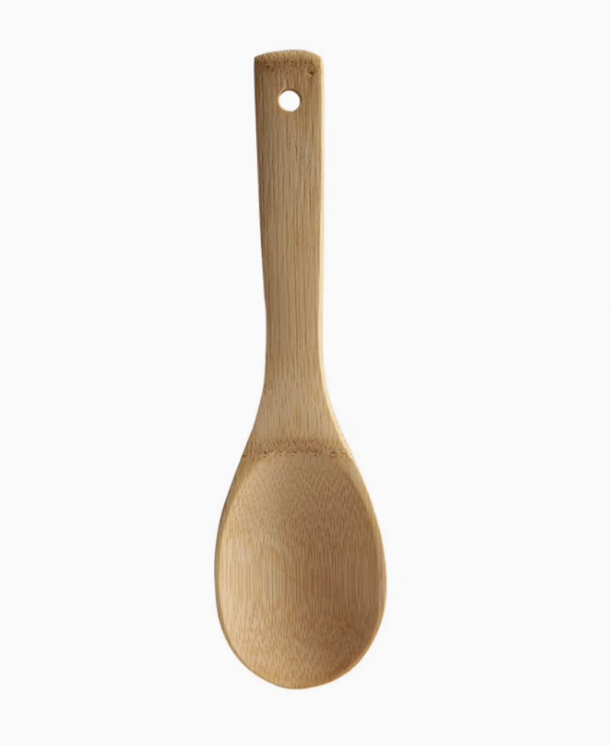
2. 时尚日用品设计
FASHION DAILY NECESSITIES DESIGN
勺子 Spoon
设计说明Design Description：
色彩Color：
材质 Material：
竹板材 厚度3mm
Bamboo plate: Thickness 3mm
设计效果图 Design Renderings：
工艺尺寸图Size Process Drawings ：
直径 0.8 cm
碳化
23cm
6.5cm
页面内的文字和图示仅为示例，自行设计并撰写说明
The text and illustrations in the page are only examples, design and write your own instructions

Slide 18
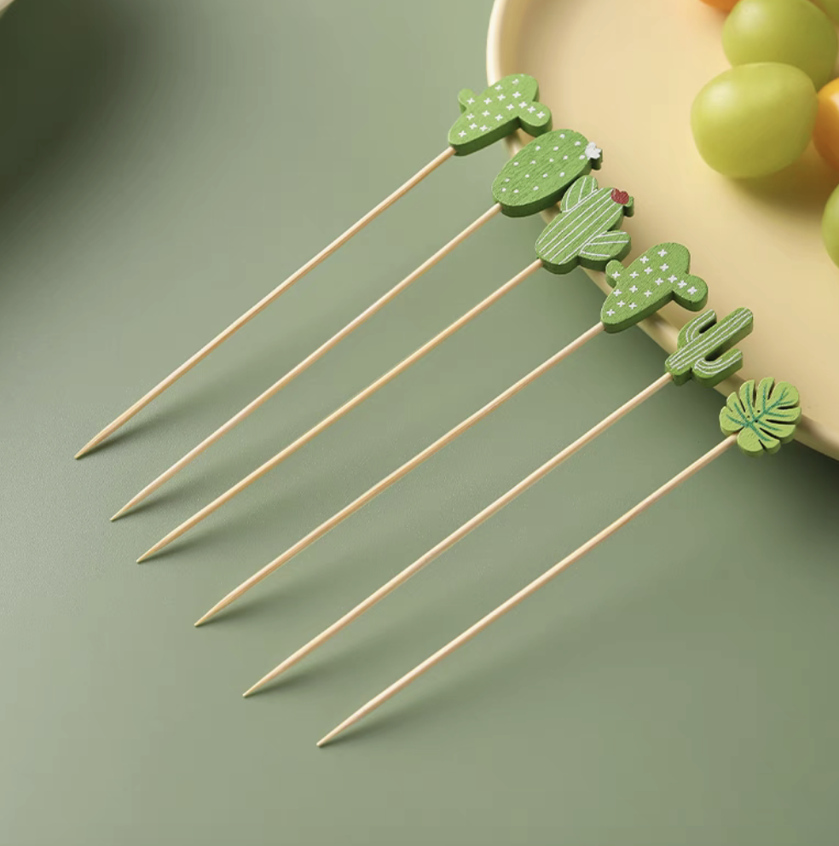
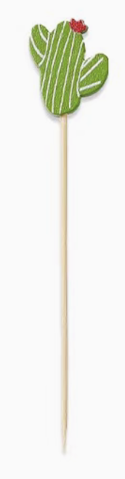
2. 时尚日用品设计
FASHION DAILY NECESSITIES DESIGN
水果签 BAMBOO FRUIT SKEWERS
设计说明Design Description：
色彩Color：
材质 Material：
竹签+木珠
Bamboo sticks + wooden beads
设计效果图 Design Renderings：
工艺尺寸图Size Process Drawings ：
2.5cm
碳化
19-3900 TPX
12cm
页面内的文字和图示仅为示例，自行设计并撰写说明
The text and illustrations in the page are only examples, design and write your own instructions

Slide 19
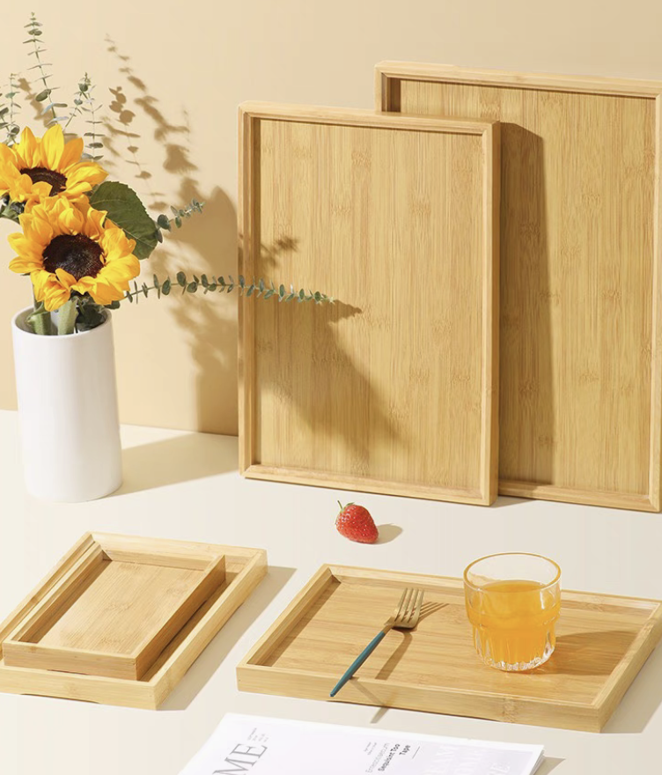
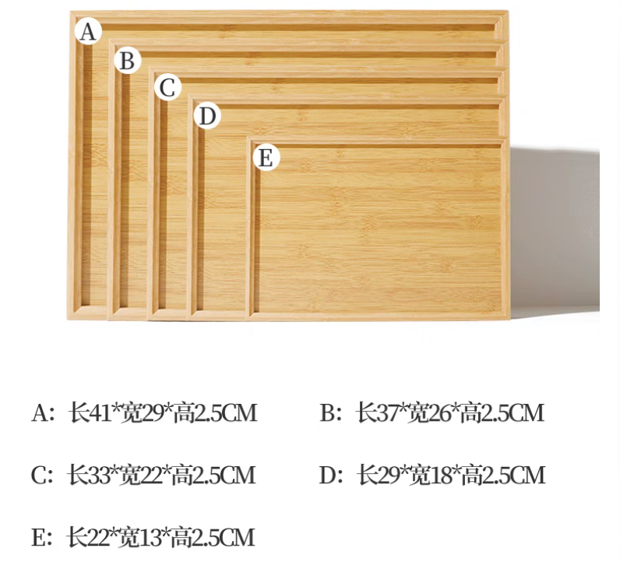
2. 时尚日用品设计
FASHION DAILY NECESSITIES DESIGN
竹收纳托盘Bamboo storage tray
设计说明Design Description：
色彩Color：
材质 Material：
竹板材 厚度3mm
Bamboo plate: Thickness 3mm
设计效果图 Design Renderings：
工艺尺寸图Size Process Drawings ：
碳化
长：36cm 宽：26cm 高：8cm
Length 36*width 26*height 8cm
页面内的文字和图示仅为示例，自行设计并撰写说明
The text and illustrations in the page are only examples, design and write your own instructions

Slide 20
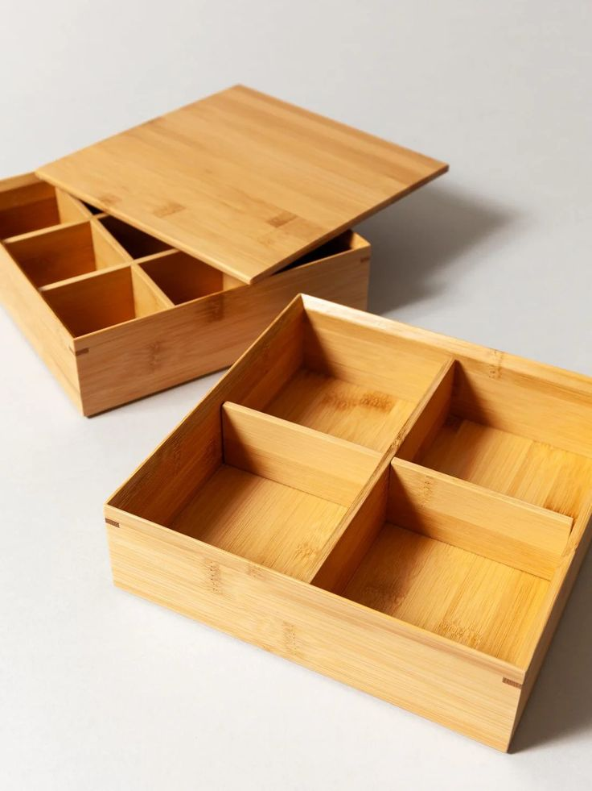
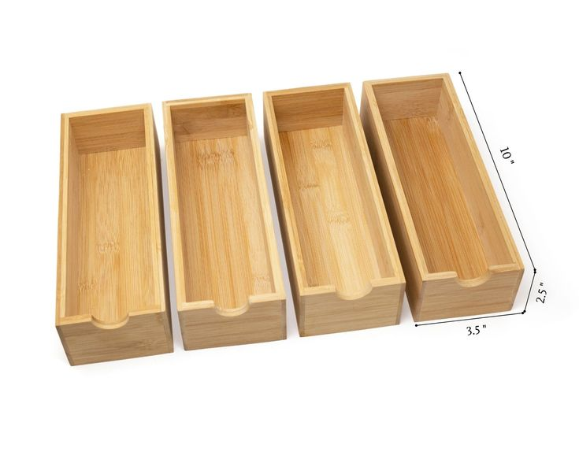
2. 时尚日用品设计
FASHION DAILY NECESSITIES DESIGN
外包装设计 Outer packaging design
设计说明Design Description：
色彩Color：
材质 Material：
竹板材 厚度3mm
Bamboo plate: Thickness 3mm
设计效果图 Design Renderings：
工艺尺寸图Size Process Drawings ：
碳化
长：36cm 宽：26cm 高：8cm
Length 36*width 26*height 8cm
页面内的文字和图示仅为示例，自行设计并撰写说明
The text and illustrations in the page are only examples, design and write your own instructions

Slide 21
设计汇总
DESIGN SUMMARY
勺子
SPOON
竹收纳托盘
BAMBOO STORAGE
TRAY
水果签
BAMBOO FRUIT SKEWERS
外包装设计
OUTER PACKAGING DESIGN

Slide 22
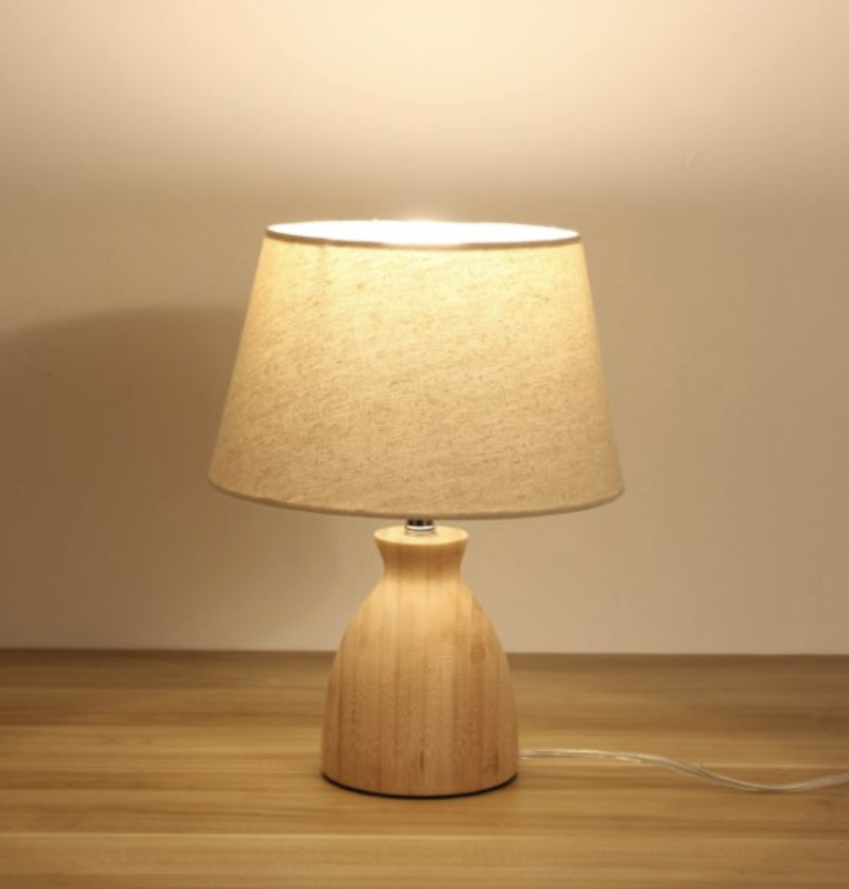
3. 台灯及包装设计
STYLISH BAG AND ACCESSORY DESIGN
台灯 Bamboo table lamp
设计说明Design Description：
色彩Color：
材质 Material：
常规竹板材(板厚2-35mm)
Conventional bamboo plate (thickness 2-35mm)
电器元件
设计效果图 Design Renderings：
工艺尺寸图Size Process Drawings ：
设计居家美观性+功能性+可作伴手礼的竹灯
Design home aesthetics + functionality + bamboo lamps that can be used as souvenirs
直径 15 cm
碳化
高 22cm
直径 8 cm
页面内的文字和图示仅为示例，自行设计并撰写说明
The text and illustrations in the page are only examples, design and write your own instructions

Slide 23
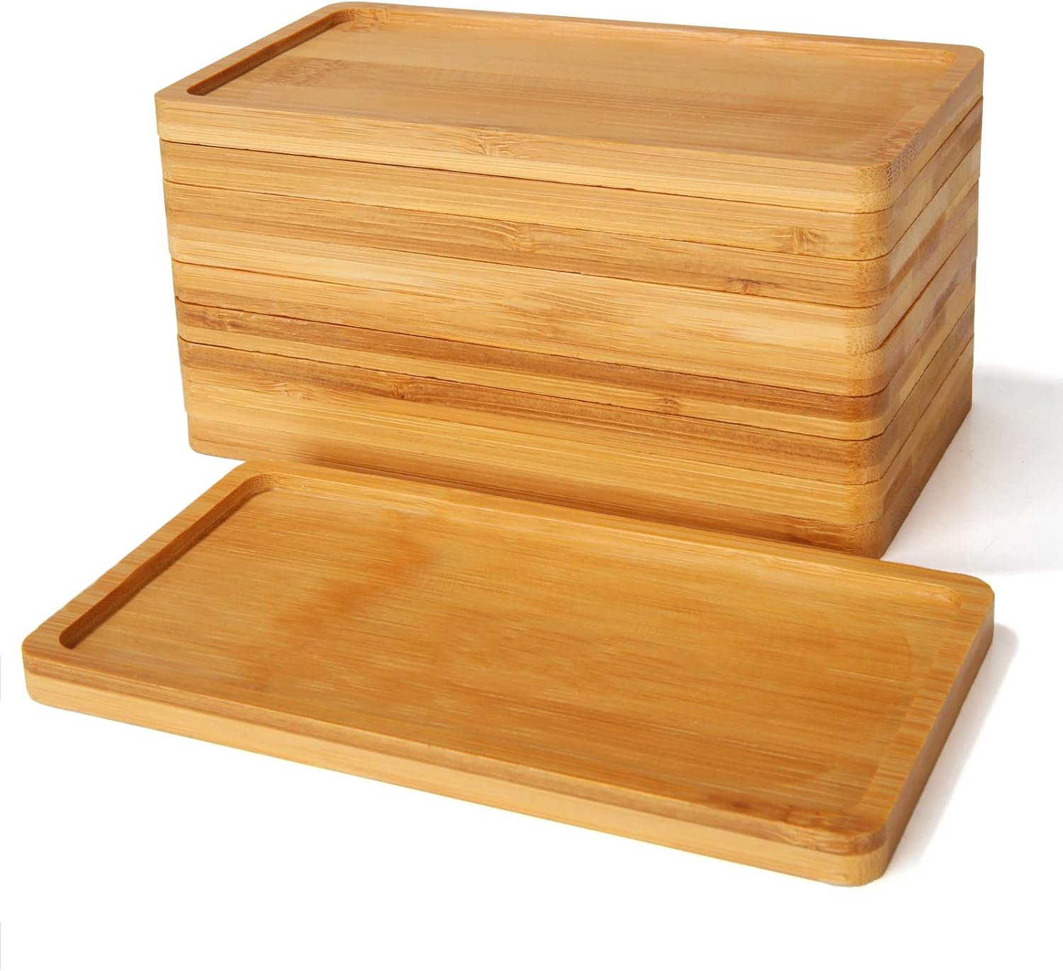
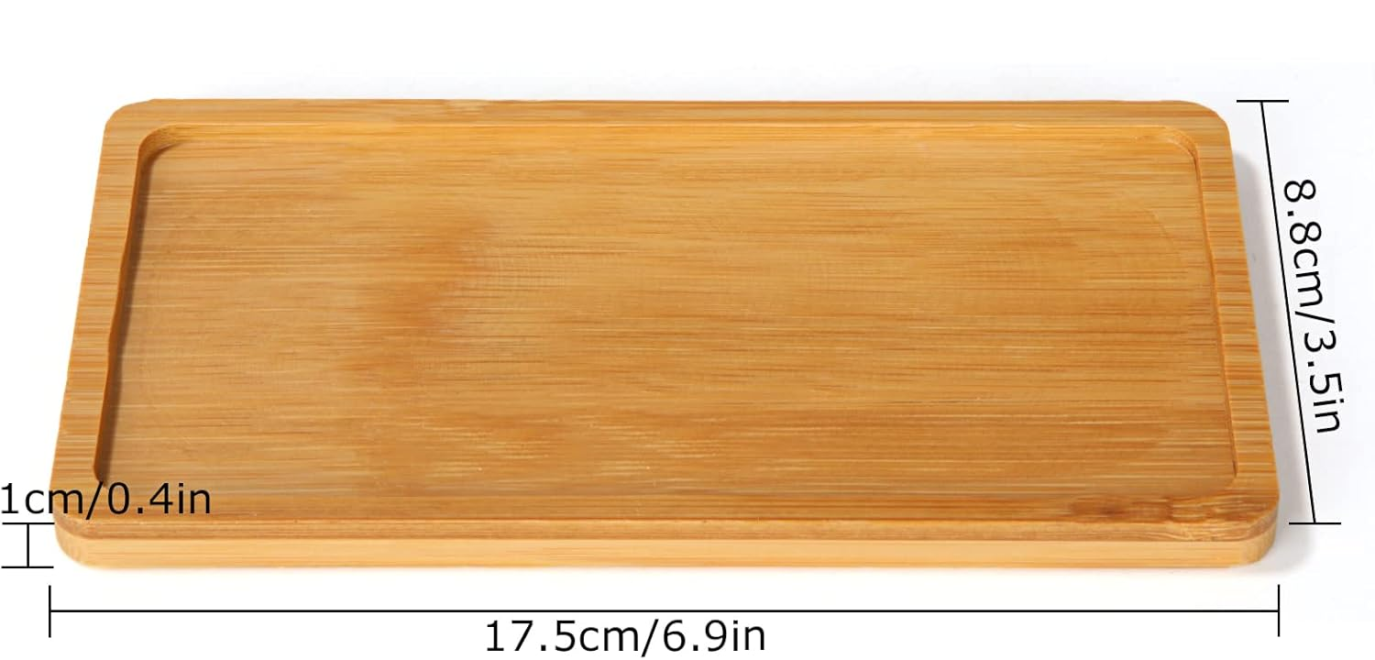
3. 台灯及包装设计
STYLISH BAG AND ACCESSORY DESIGN
台灯的包装 Bamboo table lamp packaging
设计说明Design Description：
色彩Color：
材质 Material：
设计效果图 Design Renderings：
工艺尺寸图Size Process Drawings ：
碳化
页面内的文字和图示仅为示例，自行设计并撰写说明
The text and illustrations in the page are only examples, design and write your own instructions

Slide 24
设计汇总
DESIGN SUMMARY
台灯
Two taels/100g tea packaging
台灯的包装
Half catty/250g tea packaging

Slide 25
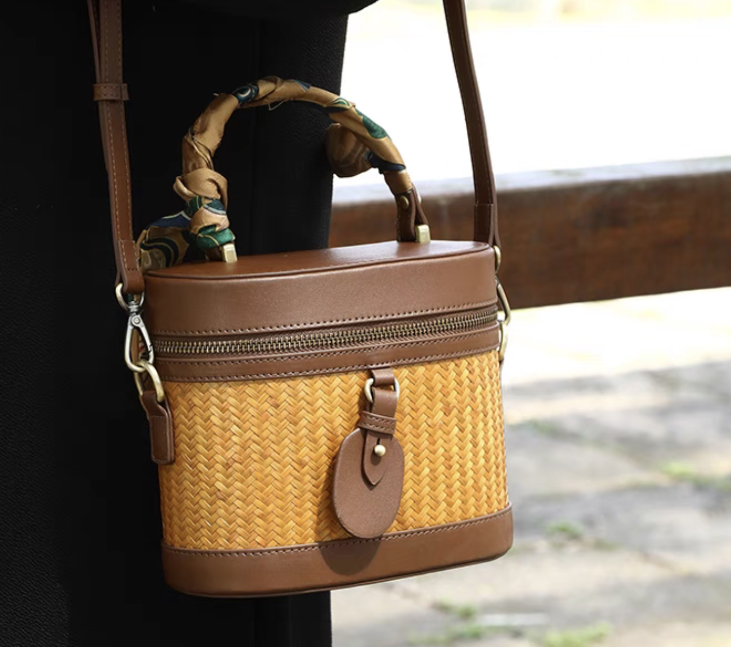
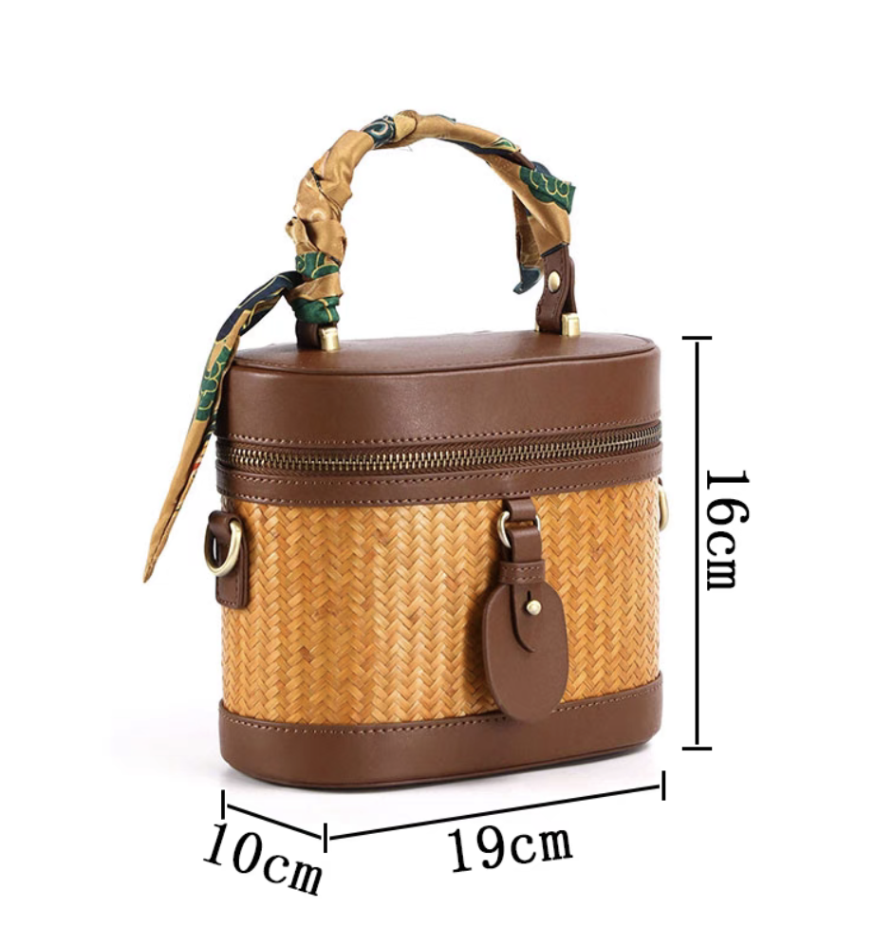
4. 时尚包袋及配饰设计
STYLISH BAG AND ACCESSORY DESIGN
包袋 Bags
设计说明Design Description：
色彩Color：
偏黄
材质 Material：
竹编织材料Bamboo woven material
皮革Leather
丝巾Silk scarf
金属拉链、撞钉、搭扣
Metal zippers, nails, buckles
设计效果图 Design Renderings：
工艺尺寸图Size Process Drawings ：
长：19cm 宽：10cm 高：16cm
Length 19*width 10*height 16cm
页面内的文字和图示仅为示例，自行设计并撰写说明
The text and illustrations in the page are only examples, design and write your own instructions

Slide 26
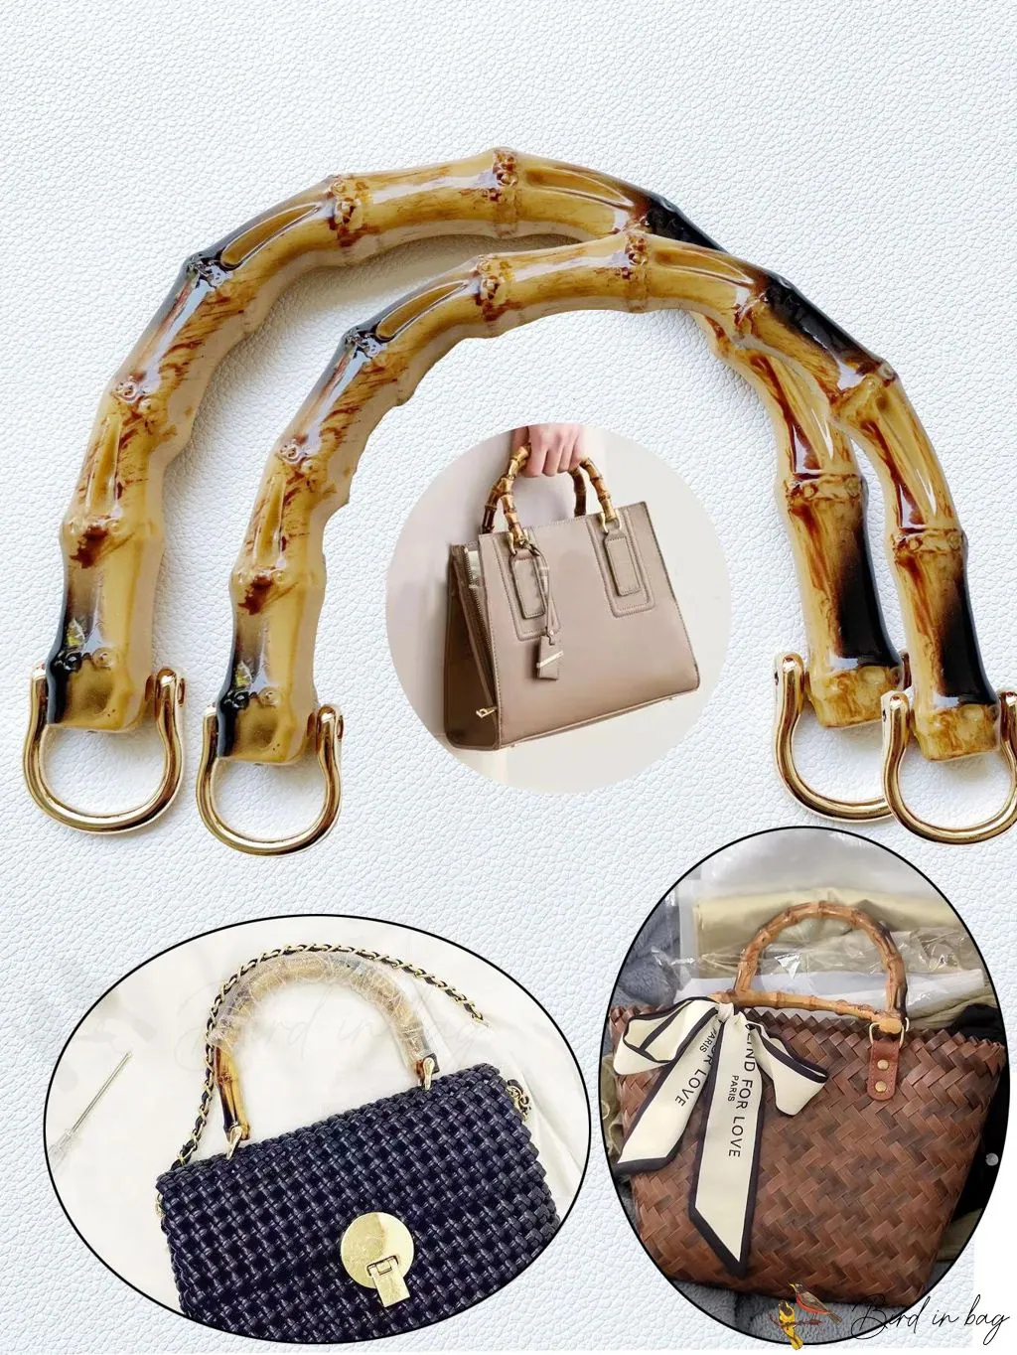
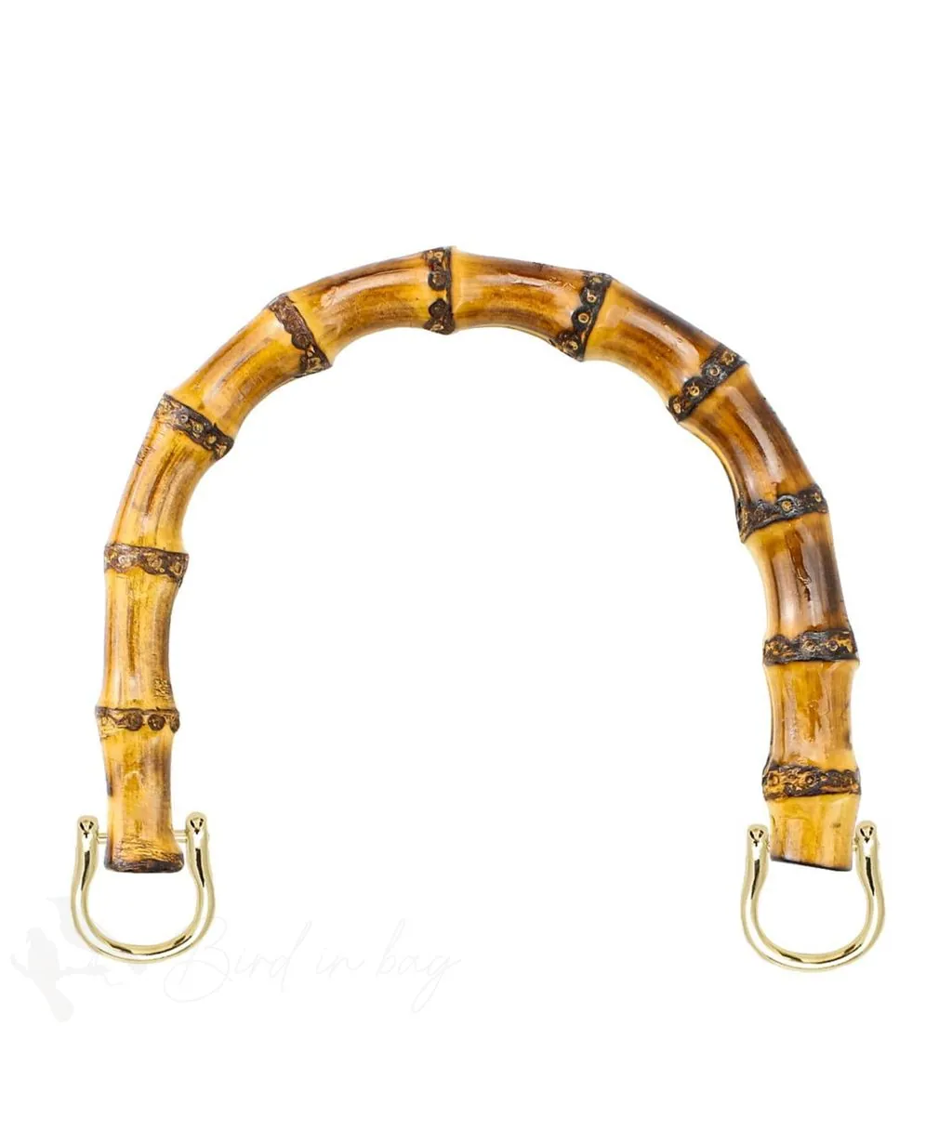
4. 时尚包袋及配饰设计
STYLISH BAG AND ACCESSORY DESIGN
包的配饰设计 Accessory design of the bag
设计说明Design Description：
色彩Color：
偏红
材质 Material：
原竹original bamboo
金属配件metal accessories
丝巾scarves
设计效果图 Design Renderings：
工艺尺寸图Size Process Drawings ：
直径 18cm
高 16cm
页面内的文字和图示仅为示例，自行设计并撰写说明
The text and illustrations in the page are only examples, design and write your own instructions

Slide 27
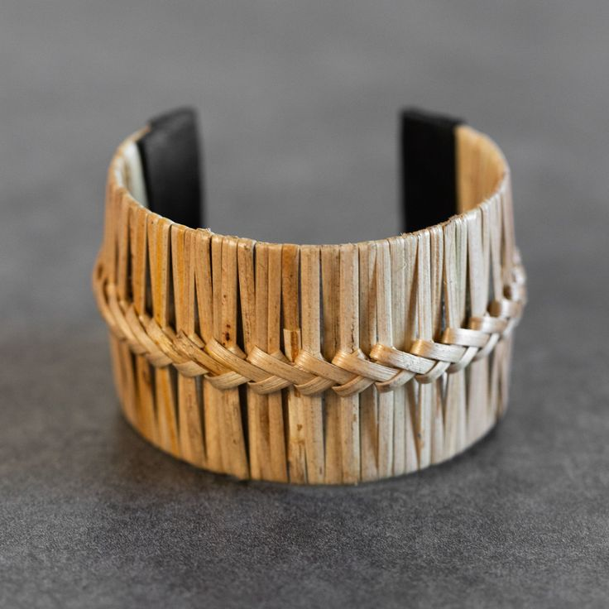
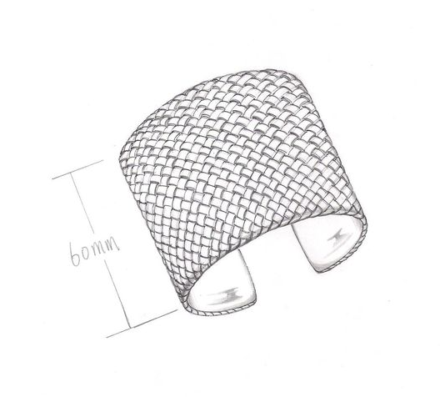
4. 时尚包袋及配饰设计
STYLISH BAG AND ACCESSORY DESIGN
手镯 Cuff bracelet
设计说明Design Description：
色彩Color：
材质 Material：
竹编材料Bamboo woven material
皮革leather
设计效果图 Design Renderings：
工艺尺寸图Size Process Drawings ：
碳化
内径：5.5-6.0cm
直径：0.8cm
页面内的文字和图示仅为示例，自行设计并撰写说明
The text and illustrations in the page are only examples, design and write your own instructions

Slide 28
设计汇总
DESIGN SUMMARY
包袋
Bags
手镯
Cuff bracelet
包的配饰设计
Accessory design of the bag

Slide 29
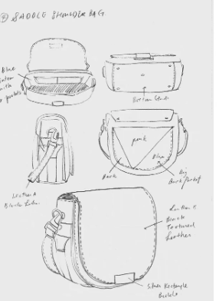
设计草图
DESIGN DRAFT
不少于四张
(no less than four)
页面内的文字和图示仅为示例，自行设计并撰写说明
The text and illustrations in the page are only examples, design and write your own instructions

Slide 30
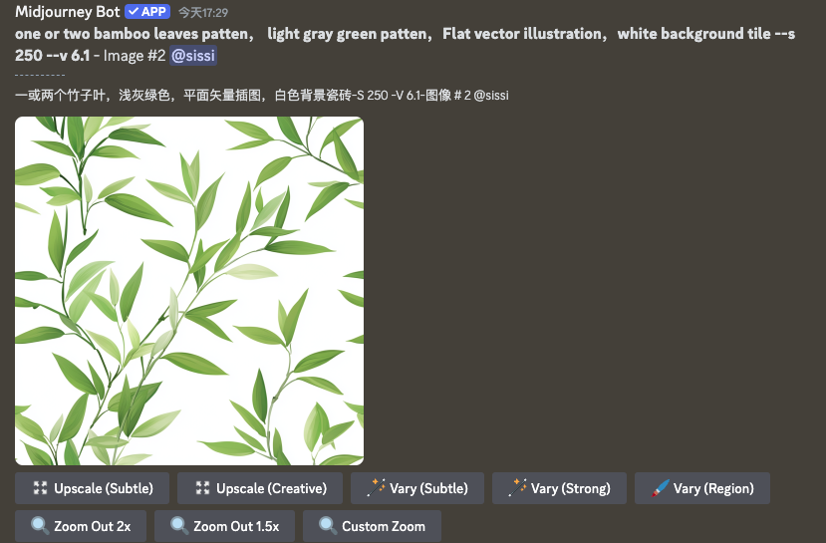
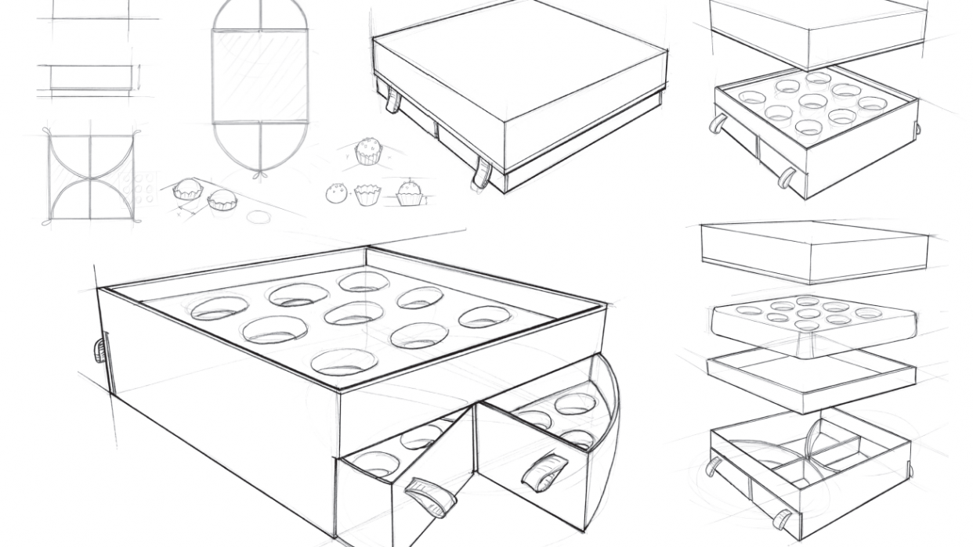
AIGC的生成过程
THE AIGC GENERATION PROCESS
Prompt：one or two bamboo leaves patten， light gray green patten，Flat vector illustration，white background tile --s 250 --v 6.1 - Image #2
AI工具：deepseek+豆包
AI tool: deepseek+ doubao
页面内的文字和图示仅为示例，自行设计并撰写说明
The text and illustrations in the page are only examples, design and write your own instructions

Slide 31
安吉·余村 2025 ISFS Award第三届国际民俗礼品时尚创新大赛
参赛作品知识产权协议
ANJI · YUCUN 2025 ISFS AWARD
THE 3RD INTERNATIONAL FOLK GIFTS INNOVATIVE DESIGN CONTEST INTELLECTUAL PROPERTY AGREEMENT
  1. 参赛者所填写的资料必须真实有效。如提供虚假材料，将取消其比赛资格。
  Information provided by participants must be truthful and valid. Providing false materials will result in disqualification.
  2.参赛作品须为本人原创设计且未公开发表的作品，不得一稿多投，不得侵犯他人知识产权及其他权利。用于生成式人工智能产品的预训练、优化训练数据，也不可含有侵犯知识产权的内容。如有违反，将取消参赛资格，由此引起的一切法律后果由参赛者自行负责。
  All entries must be original, unpublished works created solely for this competition, and must not infringe upon any third-party intellectual property rights or other legal rights. Additionally, any data used for pre-training or optimization of generative artificial intelligence products must be free from intellectual property violations. Any violation of these terms will result in disqualification, and the participant shall bear full legal responsibility for any consequences arising therefrom.
  3. 大赛主办方及相关单位有权无偿使用所有参赛作品及参赛者肖像作为活动宣传或商业推广用途。对于获奖作品（包括时尚大奖、最佳创意奖、最佳设计奖和文化交流奖），大赛主办方及相关单位向参赛者支付对应奖金，同时大赛主办方及相关单位拥有获奖作品的全部知识产权，参赛者仅享有署名权并不得将该作品以任何方式提供给其他任何第三方使用或者自行使用。
  The organizers and related entities have the right to use all submitted works and participant images for promotional or commercial purposes. For winning works (including fashion awards, best creative awards, best design awards, and cultural exchange awards), the organizers will pay corresponding prizes, and they will have full intellectual property rights. Participants only have the right to be credited and cannot provide or use the work for any other third party.
  参赛者学校/Name of your University：
  参赛作品名称/Name of your Works：
  参赛者签名/Signature：
  日期/Date：

