Slide 1
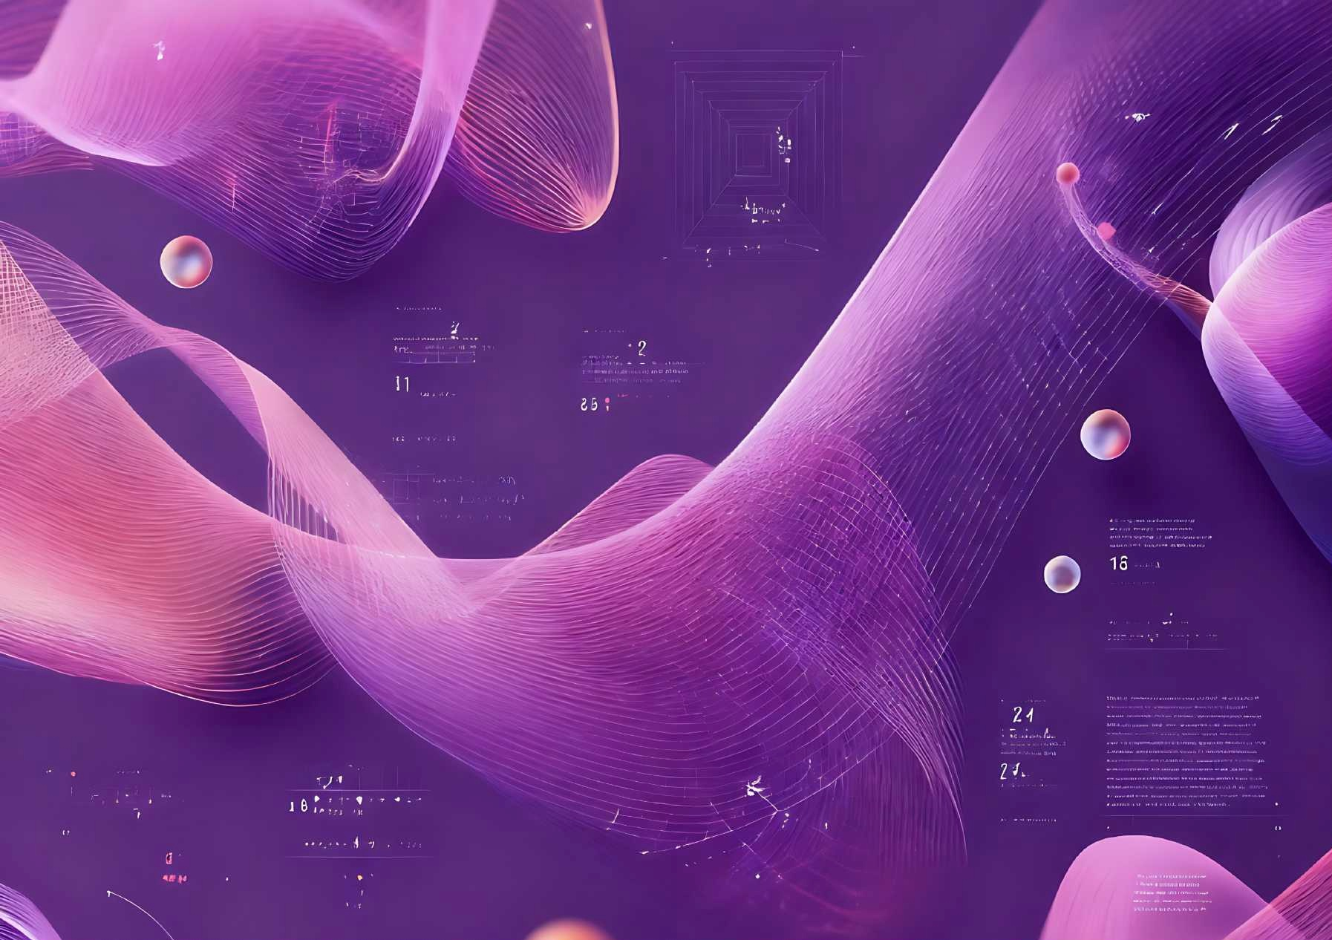

第四届国际民俗礼品时尚创新大赛
THE 4TH INTERNATIONAL FOLK GIFTS INNOVATIVE DESIGN CONTEST
[ 赛道 TRACK 1 ]
时尚礼品设计作品设计要求与模版
FASHION GIFT DESIGN WORKSDESIGN REQUIREMENTS & TEMPLATE
作品名称 TITLE OF WORK：
中文姓名 CHINESE NAME：
英文姓名 ENGLISH NAME：
国 家 COUNTRY :
城 市 CITY :
学 校 UNIVERSITY :
指导教师（如有） SUPERVISOR (IF ANY) :
联系方式（微信或手机）CONTACT INFORMATION (WECHAT OR MOBILE PHONE)：

Slide 2
作品提交要求
DESIGN SUBMISSION REQUIREMENTS
1. 提交内容：1份PPT电子文件（建议同步导出PDF文件一并提交）；所有设计稿源文件（PSD、AI或高清PDF格式）。
Submission content: 1 PPT electronic file (it is recommended to export the PDF file and submit it at the same time); Source files for all designs (PSD, AI or HD PDF format).
2. 作品规格：PPT页面设置为A3大小，页内图片及设计稿源文件精度不低于300dpi；源文件需包含设计效果图、 1:1图案设计稿，设计草图和AIGC的生成过程也需要一起提交，并请自行保留所有设计稿源文件至大赛全部结束；导出的PDF文件分辨率不低于300dpi。
Specifications: The PPT page is set to A3 size, and the accuracy of the pictures and design source files on the page is not less than 300dpi; The source files should contain design renderings, 1:1 pattern design drafts， the design sketch (No less than four) and the AIGC generation process also need to be submitted together, and please keep all the source files of the design draft until the end of the competition; The resolution of the exported PDF file should not be at least 300dpi.
3. 提交模板：组委会提供各赛道作品提交模板，可通过网站下载或大赛微信群获取。
Submission templates: The organizing committee provides submission templates for each track, which can be downloaded from the website or obtained from the WeChat group of the competition.
4. 提交路径：发送电子邮件至联系邮箱： sific10260448@163.com ，邮件名：“学校-作者姓名-作品名”。
Submission path: Send an email to the contact email: sific10260448@163.com, email name: "school-author's name-work name".

Slide 3
作品内容
CONTENTS OF WORK
作品内容包含产品&品牌调研和设计作品两部分，调研占评分10% ，设计占评分90%。
参赛作品须为本人原创设计且未公开发表的作品，不得一稿多投，不得侵犯他人知识产权及其他权利。用于生成式人工智能产品的预训练、优化训练数据，也不可含有侵犯知识产权的内容。如有违反，将取消参赛资格，由此引起的一切法律后果由参赛者自行负责。
Submissions must comprise two key elements: product & brand research and design works，with the research component contributing 10% to the overall score and the design component accounting for 90%.
All entries must be original, unpublished works created solely for this competition, and must not infringe upon any third-party intellectual property rights or other legal rights. Additionally, any data used for pre-training or optimization of generative artificial intelligence products must be free from intellectual property violations. Any violation of these terms will result in disqualification, and the participant shall bear full legal responsibility for any consequences arising therefrom.

Slide 4
1.
产品&品牌调研
PRODUCT & BRAND RESEARCH
调研说明及要求
RESEARCH DESCRIPTION AND REQUIREMENTS
1. 在设计方案开始之前，请先做一份产品调研。调研对象为具有民俗文化特色的棒球帽、羊毛围巾、T恤衫和袜品。你可以优先选择你所在城市的品牌，并鼓励大家找一些融入上海城市文化元素的品牌和产品；
Before starting the design plan, please conduct a product research. The research subjects are baseball caps, wool scarves, T-shirts, and socks with folk cultural characteristics. You can prioritize brands from your city and encourage everyone to find brands and products that incorporate elements of Shanghai city culture；
2. 你可以挑选自己生活的城市或地区最受欢迎、最有地方特色的品牌进行调研，国家、地区不限；
You can choose the most popular and local brands in the city or region where you live to conduct research. There are no restrictions on countries and regions；
3. 调研包括：品牌名称、产品的设计和功能特点说明，以及店内产品照片，若无法拍摄店铺照片也可以网上找典型图片代替。
The research includes: brand name, product design and functional characteristics description, and in-store product photos. If you can't take store photos, you can also find typical pictures online instead.

Slide 5
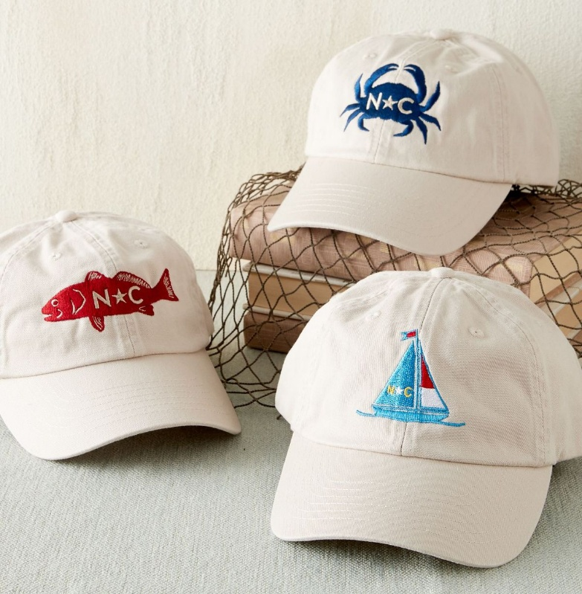
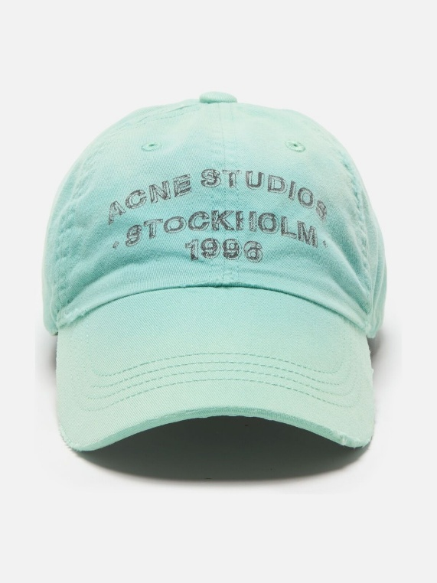
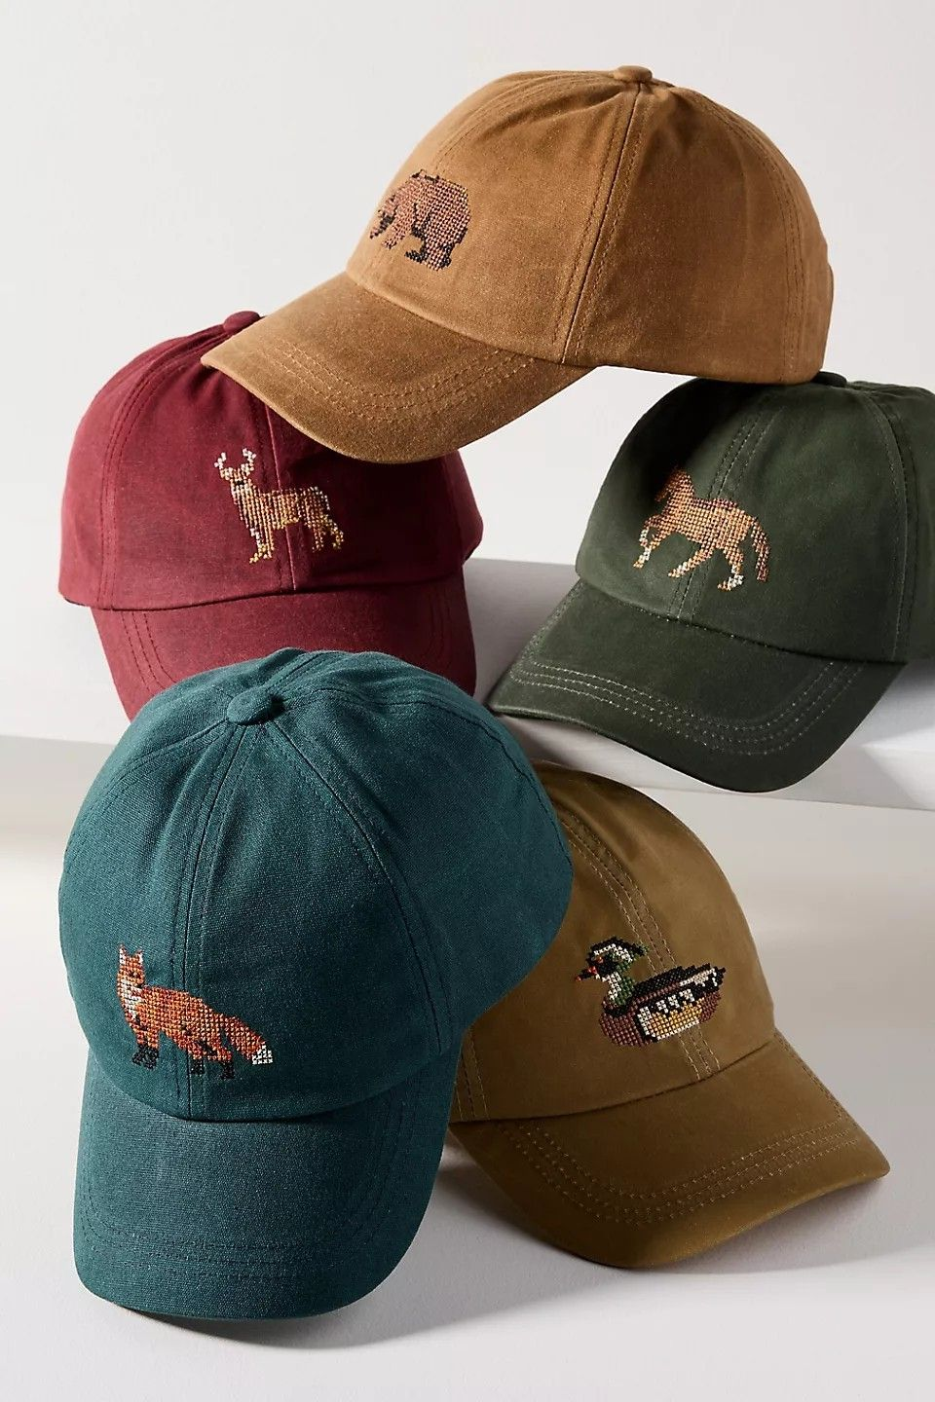
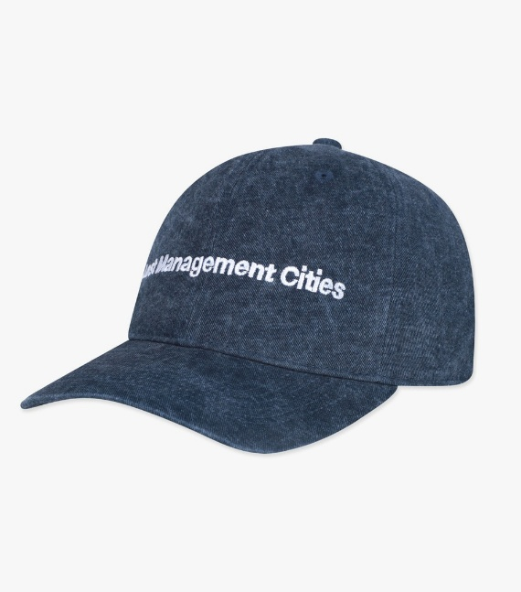
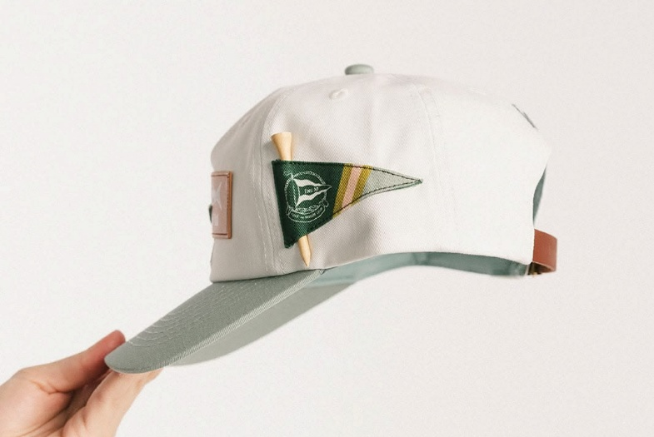
1.
产品&品牌调研
PRODUCT & BRAND RESEARCH
BASEBALL CAP
品牌名称 BRAND NAME：
产品的设计和功能特点说明 PRODUCT DESIGN AND FUNCTIONAL CHARACTERISTICS DESCRIPTION ：
产品照片
PRODUCT PICTURES

Slide 6
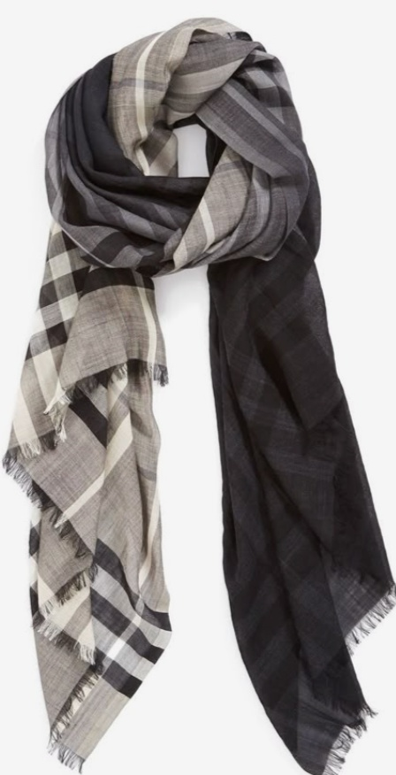
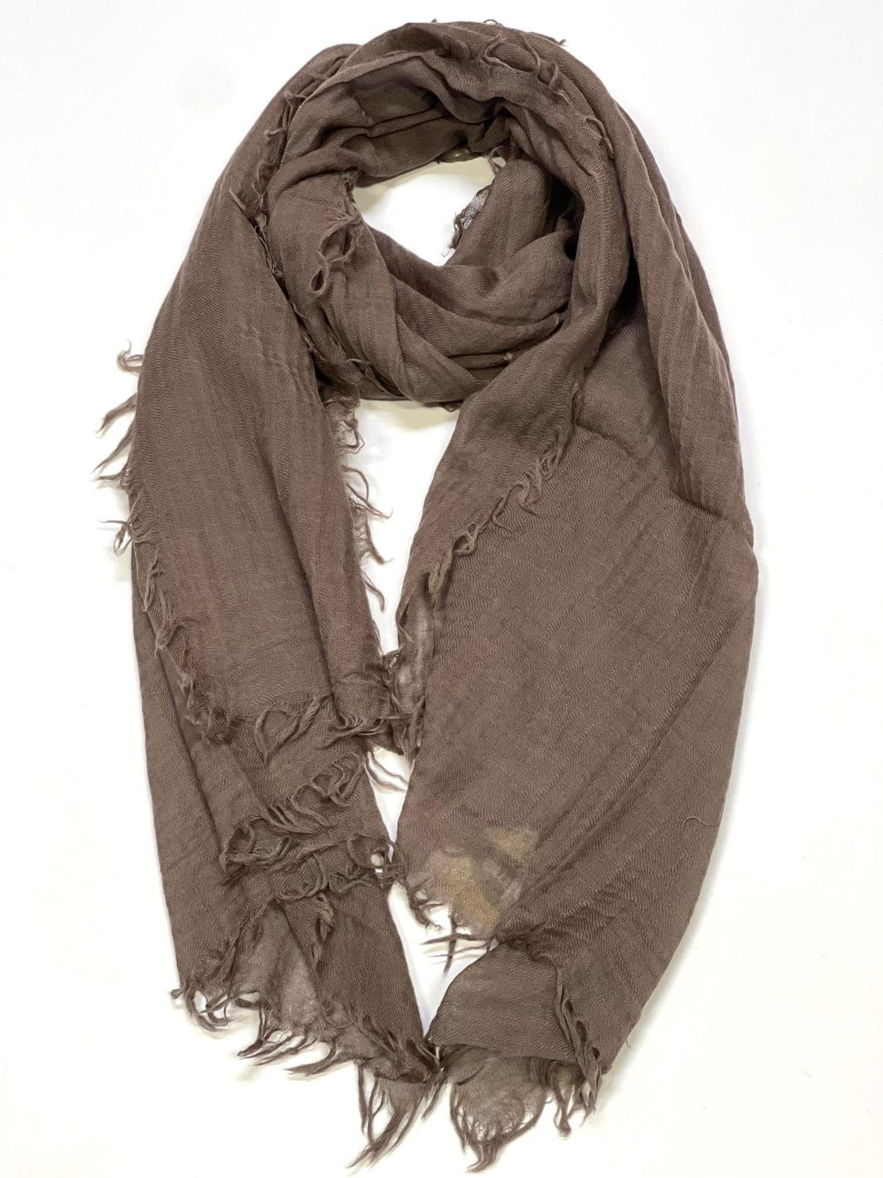
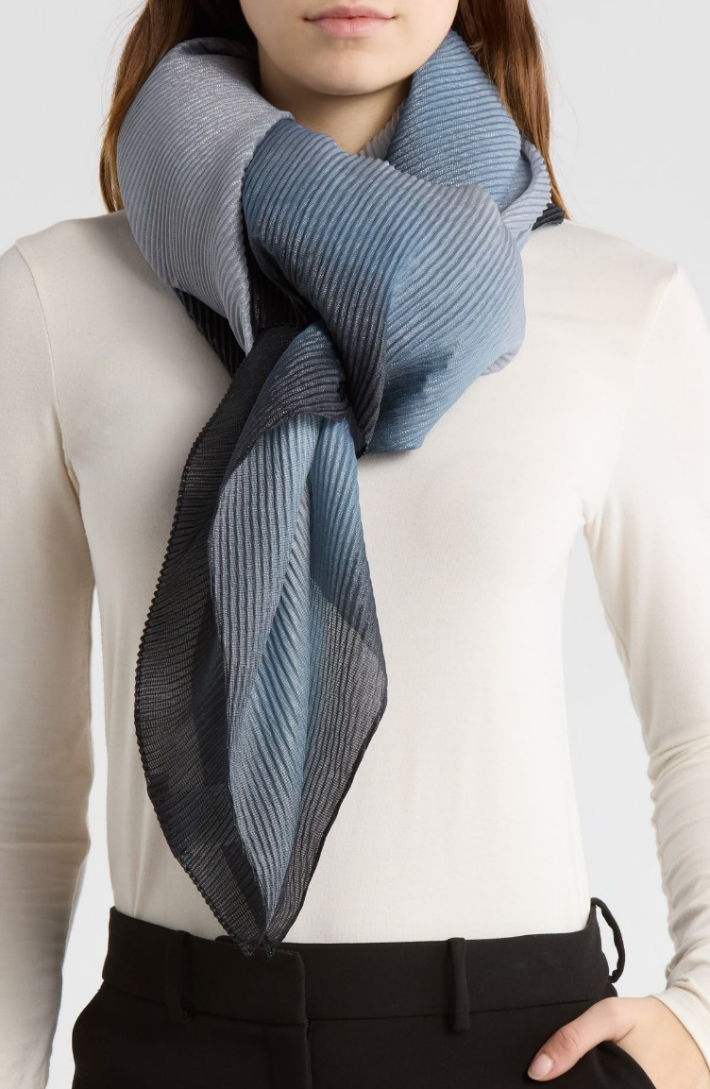
1.
产品&品牌调研
PRODUCT & BRAND RESEARCH
WOOL SCARVES
品牌名称 BRAND NAME：
产品的设计和功能特点说明
PRODUCT DESIGN AND FUNCTIONAL CHARACTERISTICS DESCRIPTION ：
产品照片
PRODUCT PICTURES

Slide 7
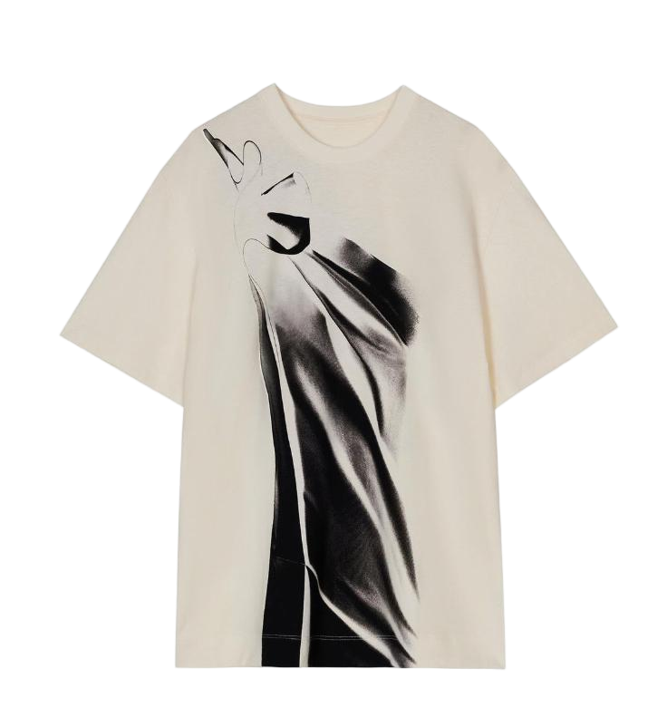
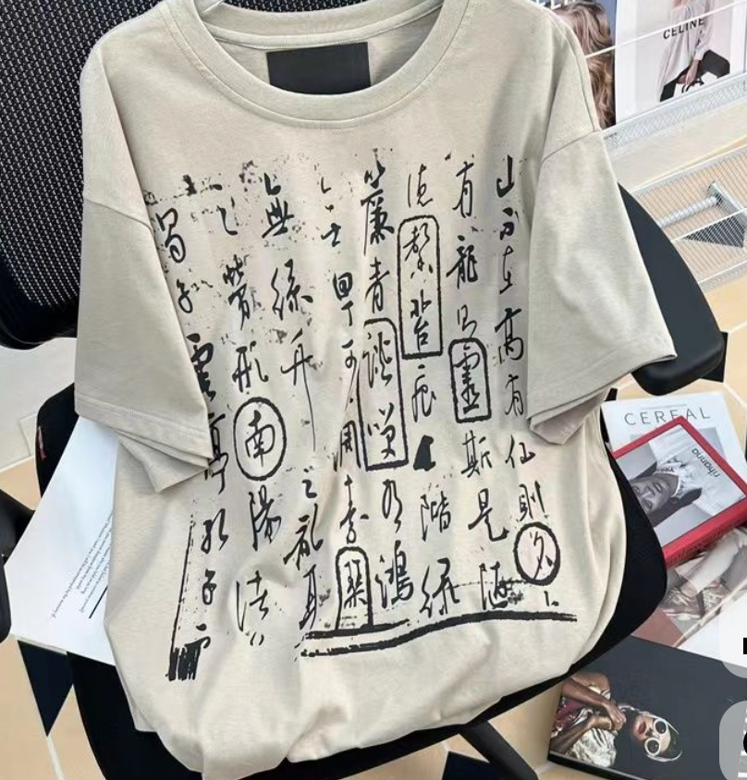
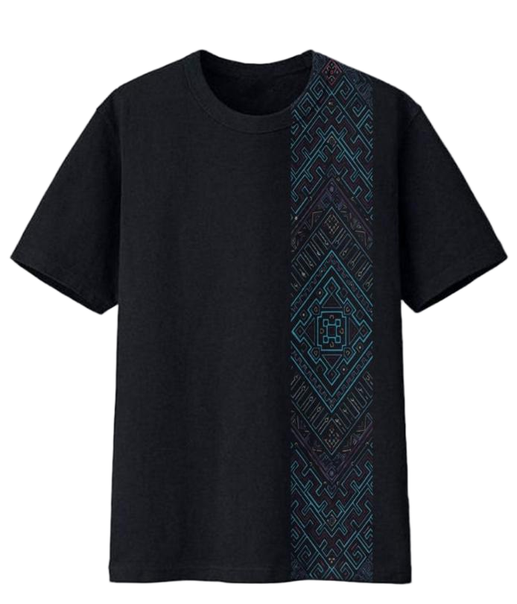
1.
产品&品牌调研
PRODUCT & BRAND RESEARCH
T-SHIRT
品牌名称 BRAND NAME：
产品的设计和功能特点说明 PRODUCT DESIGN AND FUNCTIONAL CHARACTERISTICS DESCRIPTION ：
产品照片
PRODUCT PICTURES

Slide 8
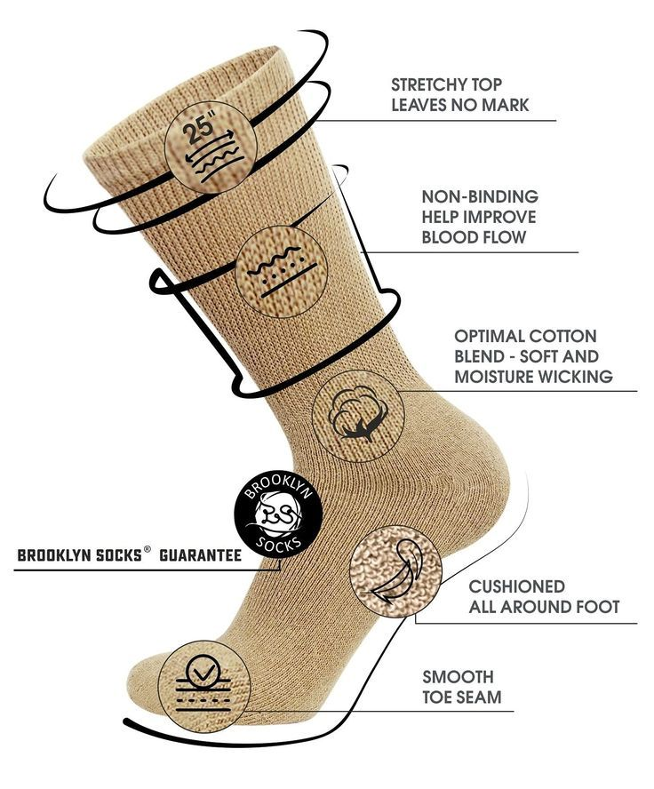
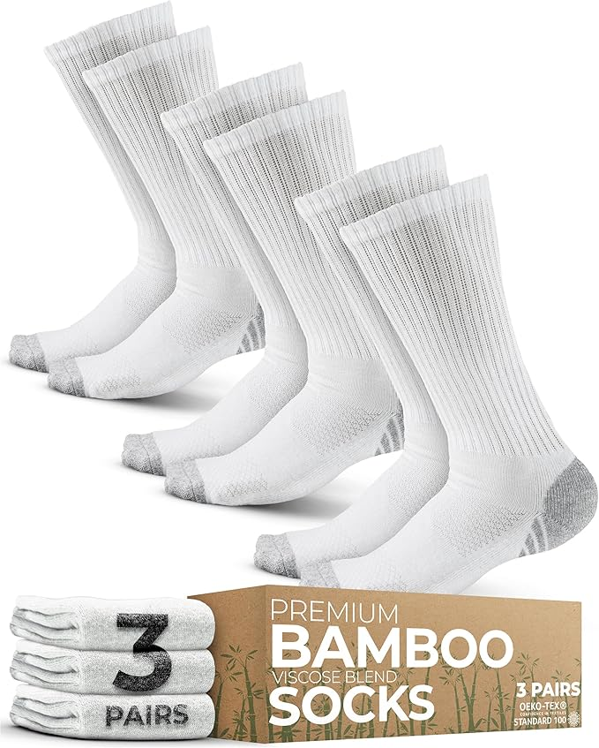
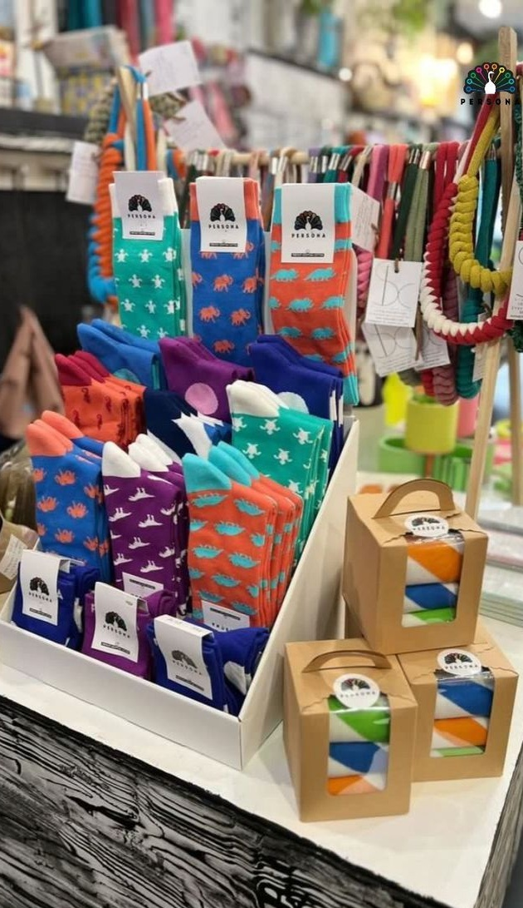
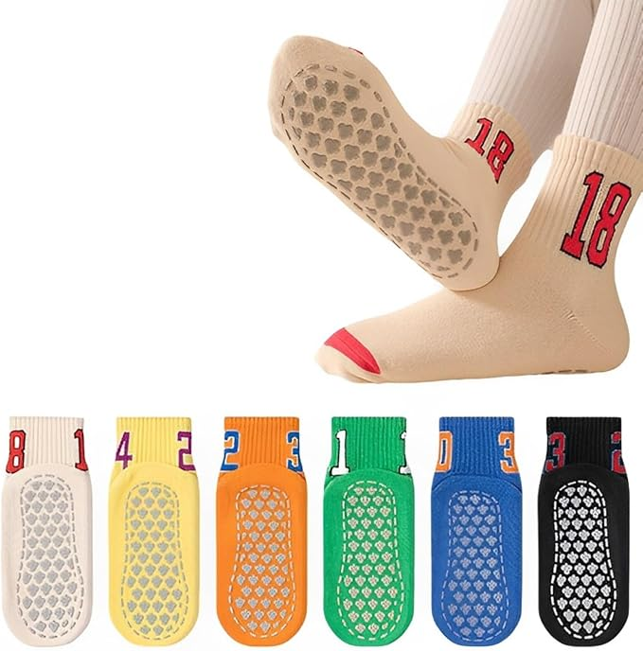
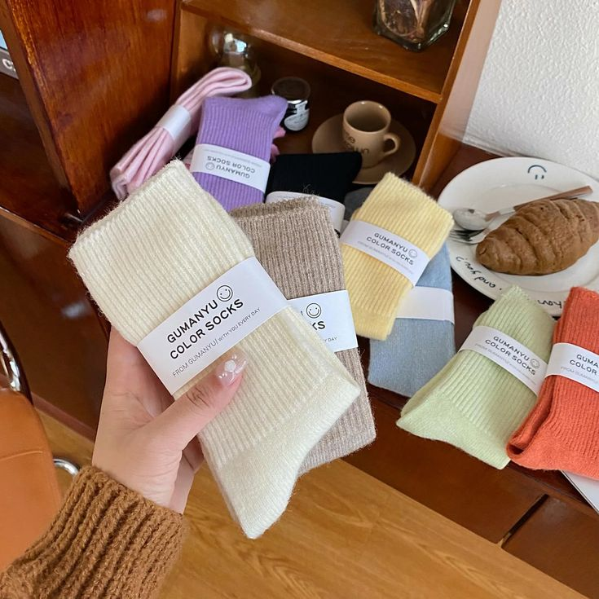
1.
产品&品牌调研
PRODUCT & BRAND RESEARCH
SOCKS
品牌名称 BRAND NAME：
产品的设计和功能特点说明 PRODUCT DESIGN AND FUNCTIONAL CHARACTERISTICS DESCRIPTION ：
产品照片
PRODUCT PICTURES

Slide 9
2.
设计作品
DESIGN WORKS
设计说明及要求 DESIGN DESCRIPTION AND REQUIREMENTS ：
1. 请结合中外民俗文化元素，从绿色设计理念出发，完成一个系列的民俗礼品设计，打造文化生活新风尚。设计中鼓励重点突出上海城市文化元素。设计内容包括：
  1顶棒球帽
  1条羊毛围巾
  2件T恤衫
  2双袜品
1. Please design a series of folk gift items, incorporating elements of Chinese and foreign folk culture and based on green design principles, to create a new trend in cultural life. The designs are encouraged to highlight elements of Shanghai's urban culture. The design content should include:
  1 baseball cap
  1 wool scarf
  2 T-shirts
  2 pairs of socks
Notes:
根据国际竹藤组织提出的“以竹代塑”倡议，结合竹子材料及竹文化为设计元素，完成单个或一个系列的文创产品、家居产品设计(如:家居装饰、灯具类、日用器具等)。

Slide 10
2.
设计作品
DESIGN WORKS
2. 设计作品包括：灵感来源、作品名称、色彩、设计说明、设计效果图。
灵感来源应融合中外民俗文化元素，尤其鼓励融入上海城市文化元素，并贯彻绿色设计理念，打造文化生活新风尚。
设计说明应详细阐述设计的文化理念，着重说明如何将这些理念转化为具体的设计方案。
色彩：统一标注色彩名称和潘通色号。
棒球帽设计要求：
  可以根据个人喜好选择黑色或白色底色的棒球帽，二选一进行设计；
  图案以刺绣和印花为主，可根据自己的设计需要选择放置在帽子的任意位置；
  设计图稿包含正、背面效果图，以及左右侧面效果图。
2. Design works include: inspiration source, work name, color, design description and design effect drawings.
The inspiration source should integrate elements of Chinese and foreign folk cultures, particularly encouraging the incorporation of elements of Shanghai city culture, and implementing the concept of green design to create a new trend in cultural life.
The design description should elaborate on the cultural ideas of the design, emphasize how to translate these ideas into specific design schemes.
Color: unified color name and Pantone color number.
Baseball cap design requirements:
  Choose either black or white as the base color for the baseball cap based on personal preference;
  The patterns are primarily embroidery and printing, and you can place it anywhere on the cap according to your design needs;
  Design sketches include front, back, left, and right side views.
Notes:
根据国际竹藤组织提出的“以竹代塑”倡议，结合竹子材料及竹文化为设计元素，完成单个或一个系列的文创产品、家居产品设计(如:家居装饰、灯具类、日用器具等)。

Slide 11
2.
设计作品
DESIGN WORKS
羊毛围巾设计要求：
  正反面印花相同；
  采用数码印花工艺，用色不限数量；
  尺寸为30cm*180cm。
T恤衫设计要求：
  设计黑色和白色的印花T恤衫各一件；
  图案以数码印花为主，可根据自己的设计需要选择放置在衣服的任意位置；
  设计图稿包含正、背面效果图。
Wool scarf design requirements:
  Same pattern print on front & back;
  Use digital printing, unlimited colors;
  Dimensions: 30cm*180cm.
T-shirts design requirements:
  Design one black and one white printed T-shirt each;
  The patterns are primarily digital prints, allowing you to place them anywhere on the garment according to your design needs;
  Design artwork includes front and back renderings.
Notes:
根据国际竹藤组织提出的“以竹代塑”倡议，结合竹子材料及竹文化为设计元素，完成单个或一个系列的文创产品、家居产品设计(如:家居装饰、灯具类、日用器具等)。

Slide 12
2.
设计作品
DESIGN WORKS
袜品设计要求：
  设计效果图包含单只袜子正反面图、单只袜子平铺图、袜子设计图案平铺图；
  袜子可以左右同款，也可以不同款；
  袜头、袜跟素色，不设计花型；
  一只袜子中的用色控制在6个以内；
  袜子以印花、色织制作工艺为主；
  袜筒长度自行调节。
Socks design requirements:
  Design renderings include Both sides of a single sock, Ichnography of a single sock and Ichnography of sock design;
  Socks can be left & right the same style, also can be different style;
  Toe and heel are in one color，no pattern;
  Use a maximum of 6 colors for one sock;
  The socks are primarily made using digital printing and dyed weaving techniques;
  Length adjusts by yourself.
Notes:
根据国际竹藤组织提出的“以竹代塑”倡议，结合竹子材料及竹文化为设计元素，完成单个或一个系列的文创产品、家居产品设计(如:家居装饰、灯具类、日用器具等)。

Slide 13
2.
设计作品
DESIGN WORKS
如果采用人工智能协助设计，需完整呈现AIGC的生成过程，包括使用的AI工具、提示词、工作流示意图或分工清单，清晰展示从概念意向到模型/手绘底图，再到初次生成、迭代，最终完成成图的整个流程。不得采用他人知识产权的图片垫图。
If the design is assisted by artificial intelligence, the generation process of AIGC should be fully presented, including the AI tools used, prompt words, workflow diagrams or labor division lists, and the entire process from conceptual intention to model/hand-drawn base drawing, to initial generation, iteration, and finally the completion of the drawing should be clearly shown. It is not allowed to use other people's intellectual property rights.
Notes:
根据国际竹藤组织提出的“以竹代塑”倡议，结合竹子材料及竹文化为设计元素，完成单个或一个系列的文创产品、家居产品设计(如:家居装饰、灯具类、日用器具等)。

Slide 14
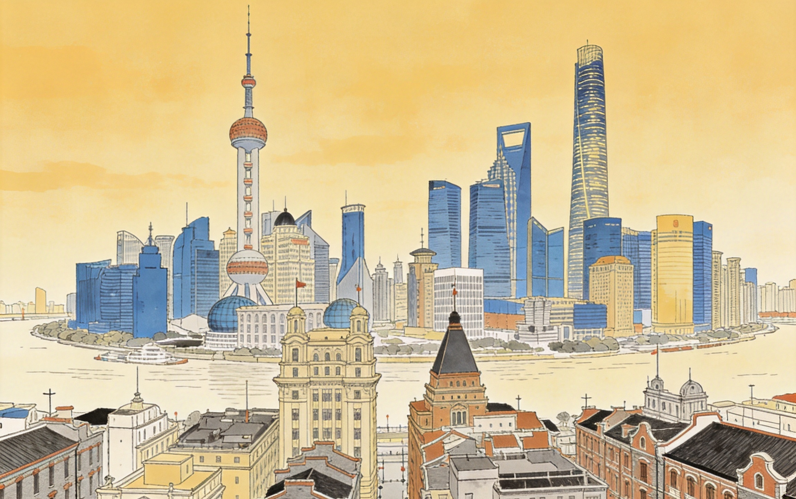
灵感来源
INSPIRATION SOURCES
此图片仅为示例，请替换为自己的灵感图
This image is for reference only. Replace it with your own inspiration image.
灵感来源图片 INSPIRATION PICTURES
作品名称 THE TITLE OF THE WORK
文字描述 DESCRIPTION

Slide 15
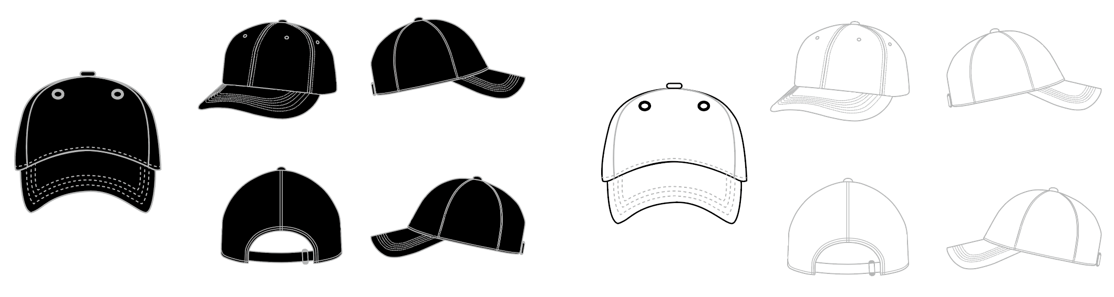




棒球帽
BASEBALL CAP
作品说明：
Work Description：
色彩：
Color：
设计效果图
DESIGN RENDERINGS
或者
or
Base Pattern Color
此图仅为示例，棒球帽图案自行设计。提交作品格式：电子格式AI文件或PS文件均可，高清PDF设计作品必须保证其真实性和原创性，禁止使用AIGC。
This image is sample only, please design the baseball cap style on your own.
Submission Format: Electronic format in AI or PS files, high-quality PDF Designs must be authentic and original; the use of AIGC is prohibited.
14-1208 TCX
燕麦奶
17-0210 TCX
玉石色
15-1333 TCX
橙色月光石
尺寸：
Dimension:
参考Reference | 度量点 Measurement Points | 规格尺寸Dimensions
a | 帽檐板正中至纽扣 Center of brim to button | 16.5
b | 中心面板宽度从缝到缝 Width of central panel from seam to seam | 9
c | 边板宽度从缝到缝 Width of side panel from seam to seam | 9.5
d | 侧面板长度至纽扣 Length of side panel to button | 16
e | 后面板宽度 Width of back panel | 7
f | 中心背板长度 Length of central back panel | 11
g | 帽檐边宽Width of brim edge | 19
h | 帽檐中长Mid-length of brim | 7
i | 头围Circumference | 58
j | 带宽Band width | 2.2
k | 带长Band length | 16
设计要求：
1. 可以根据个人喜好选择黑色或白色底色的棒球帽，二选一进行设计；
2. 图案以刺绣和印花为主，可根据自己的设计需要选择放置在帽子的任意位置；
3. 各部位尺寸如下表所示；
4. 设计图稿包含正、背面效果图，以及左右侧面效果图。
Design Requirements:
1.Choose either black or white as the base color for the baseball cap based on personal preference;
2.The patterns are primarily embroidery and printing, and you can place it anywhere on the cap according to your design needs;
3.Dimensions for each part are as shown in the table below;
4.Design sketches include front, back, left, and right side views.

Slide 16

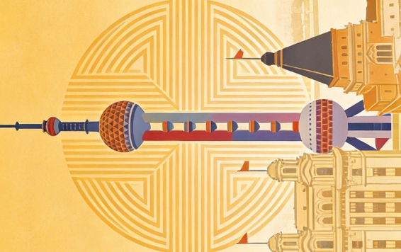
羊毛围巾
WOOLEN SCARF
作品说明：
Work Description：
色彩：
Color：
设计效果图
DESIGN RENDERINGS
Base Pattern Color
14-1208 TCX
燕麦奶
17-0210 TCX
玉石色
15-1333 TCX
橙色月光石
羊毛围巾
30cm*180cm
Woolen Scarf
W: 30cm*L: 180cm
页面内的文字和图示仅为示例，自行设计并撰写说明
The text and illustrations in the page are only examples, design and write your own instructions

Slide 17
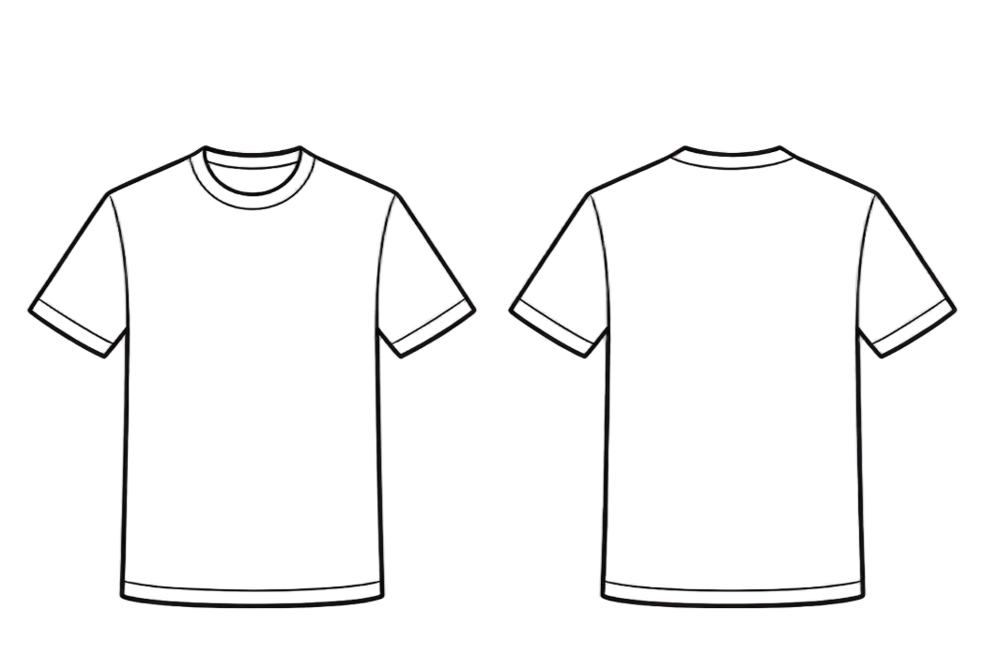
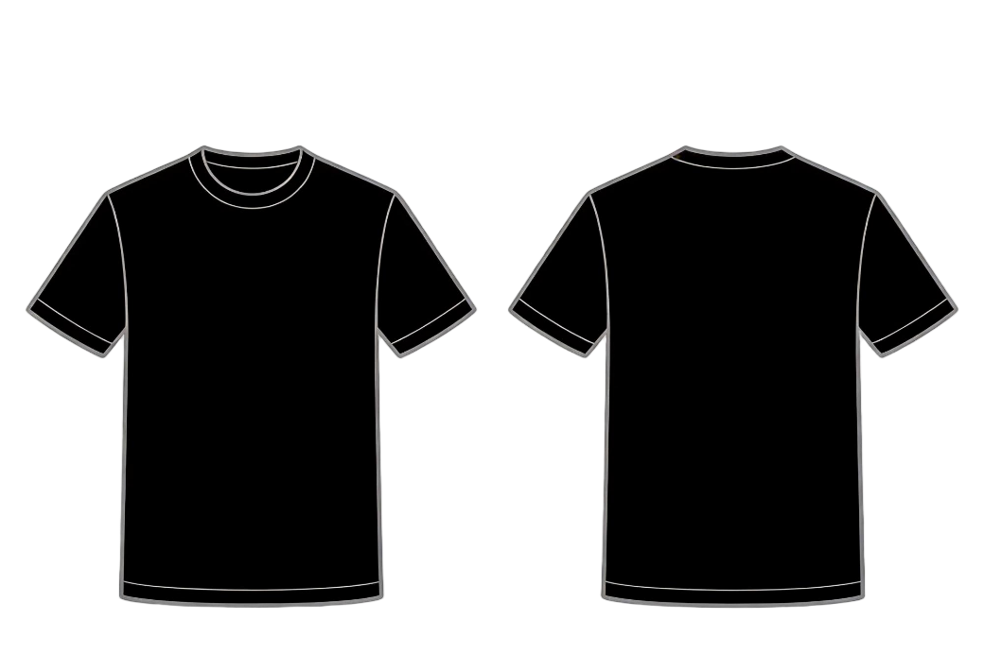
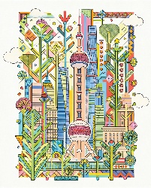
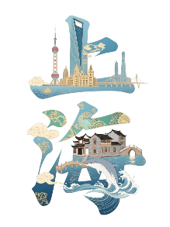
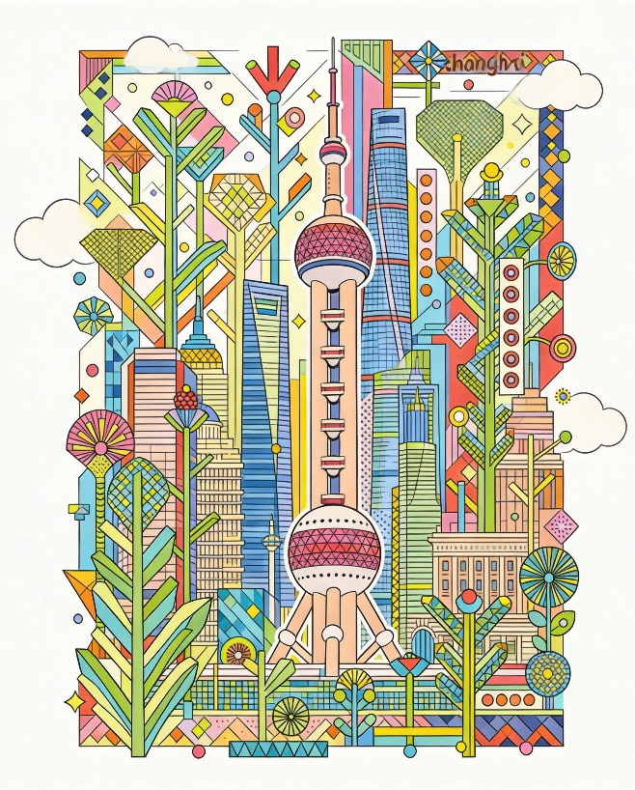

T恤衫设计
T-SHIRT DESIGN
作品说明：
Work Description：
色彩：
Color：
材质：
Material：
细节说明：
Detailed description：
设计效果图
DESIGN RENDERINGS
Base Pattern Color
14-1208 TCX
燕麦奶
17-0210 TCX
玉石色
15-1333 TCX
橙色月光石
工艺尺寸图Size Process Drawings ：
宽W: 17cm*高H: 28cm
宽W: 16cm*高H: 28cm
页面内的文字和图示仅为示例，自行设计并撰写说明
The text and illustrations in the page are only examples, design and write your own instructions

Slide 18
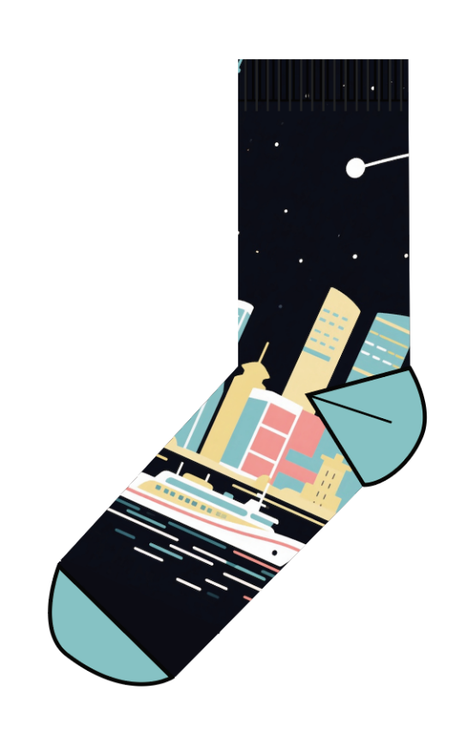
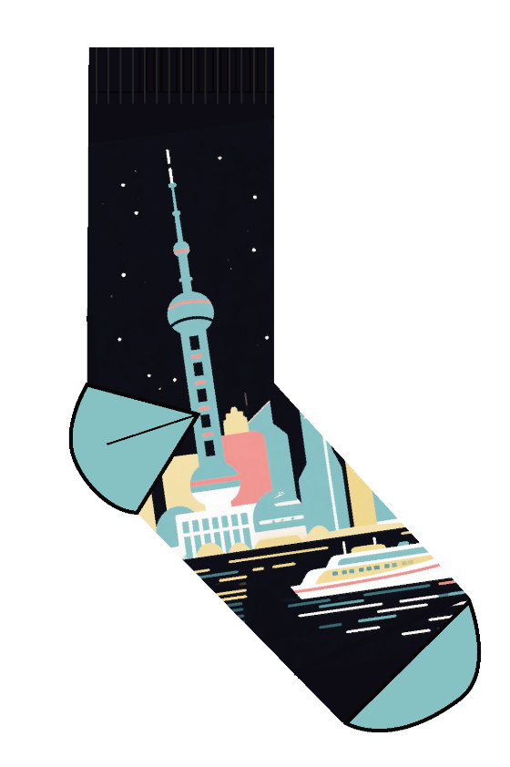
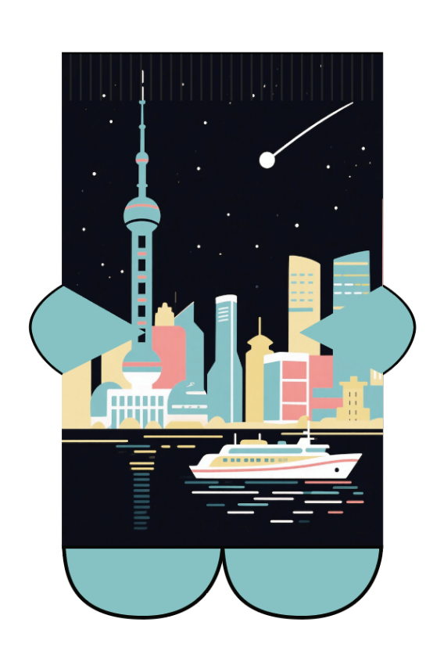
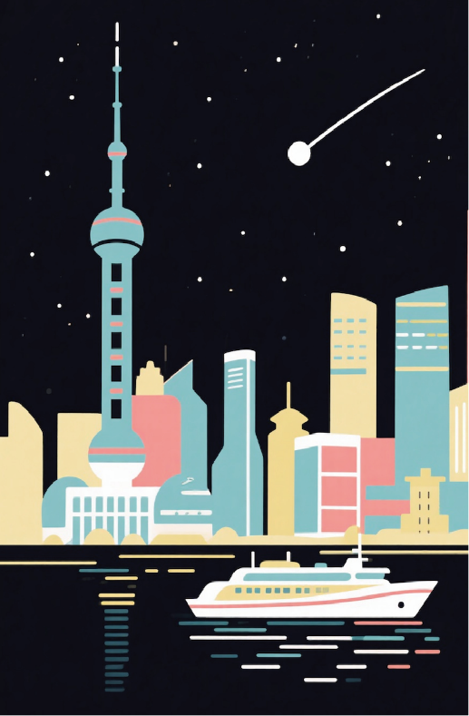
袜子设计 1
SORKS DESIGN 1
作品说明：
Work Description：
色彩：
Color：
设计效果图
DESIGN RENDERINGS
左右脚相同款的设计
Left and Right Socks is the Same Style
Base Pattern Color
14-1208 TCX
燕麦奶
17-0210 TCX
玉石色
15-1333 TCX
橙色月光石
15-1333 TCX
橙色月光石
15-1333 TCX
橙色月光石
单只袜子正反面
Both sides of a single sock
单只袜子平铺图
Ichnography of a single sock
袜子设计图案平铺图
Ichnography of sock design
页面内的文字和图示仅为示例，自行设计并撰写说明
The text and illustrations in the page are only examples, design and write your own instructions

Slide 19
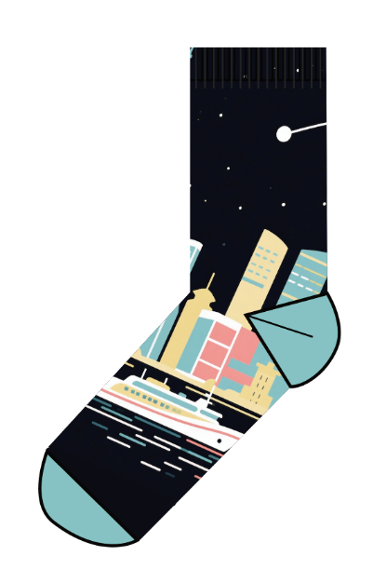



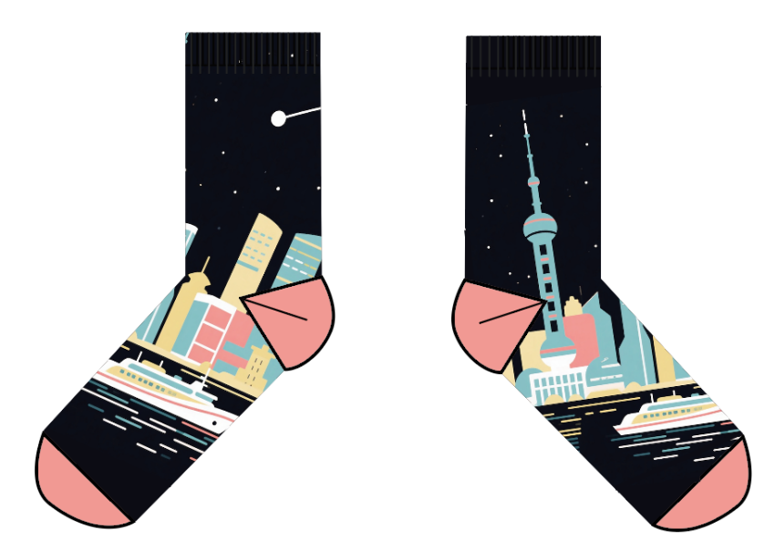
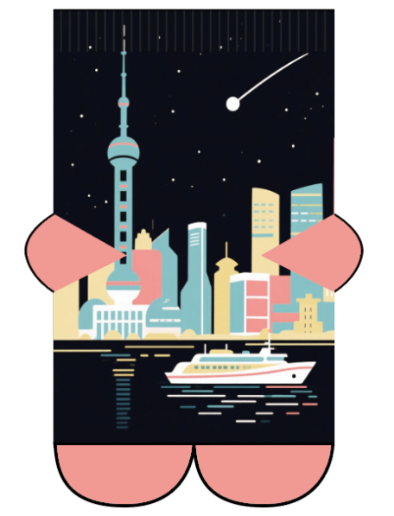
袜子设计 2
SORKS DESIGN 2
作品说明：
Work Description：
色彩：
Color：
设计效果图
DESIGN RENDERINGS
左右脚不同款的设计
Left and Right Socks is the Different Style
Base Pattern Color
14-1208 TCX
燕麦奶
17-0210 TCX
玉石色
15-1333 TCX
橙色月光石
15-1333 TCX
橙色月光石
15-1333 TCX
橙色月光石
单只袜子正反面
Both sides of a single sock
单只袜子平铺图
Ichnography of a single sock
袜子设计图案平铺图
Ichnography of sock design
页面内的文字和图示仅为示例，自行设计并撰写说明
The text and illustrations in the page are only examples, design and write your own instructions

Slide 20









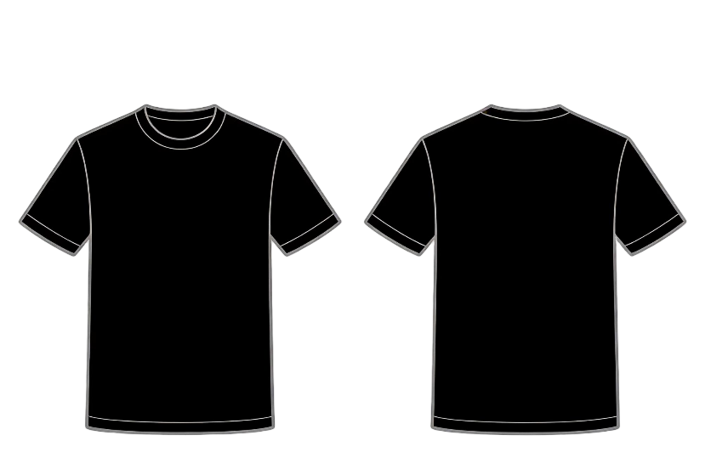
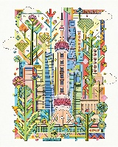
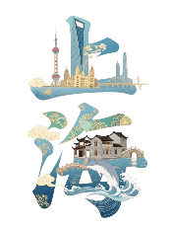
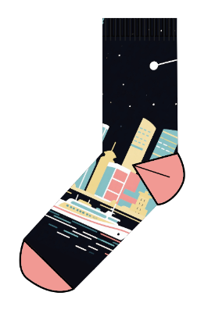
设计汇总
DESIGN SUMMARY
棒球帽 Baseball cap
或
OR
羊毛围巾 Woof Scarf
袜子 Socks
T恤衫 T-shirt
页面内的文字和图示仅为示例，自行设计并撰写说明
The text and illustrations in the page are only examples, design and write your own instructions

Slide 21
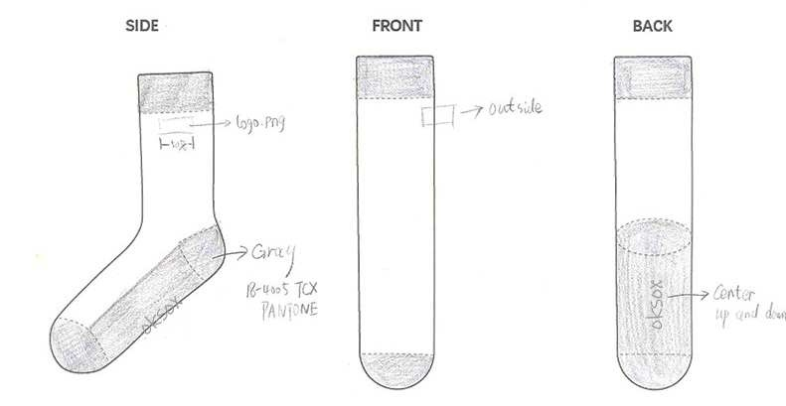
设计草图
DESIGN DRAFT
不少于四张
(no less than four)
页面内的文字和图示仅为示例，自行设计并撰写说明
The text and illustrations in the page are only examples, design and write your own instructions

Slide 22
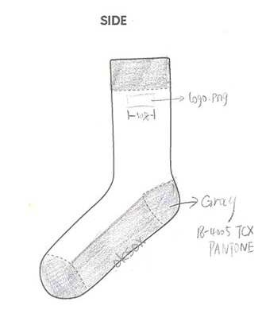
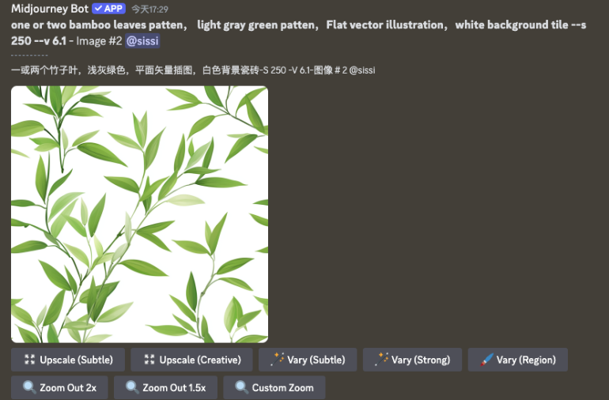



AIGC的生成过程
THE AIGC GENERATION PROCESS
Prompt：one or two bamboo leaves patten， light gray green patten，Flat vector illustration，white background tile --s 250 --v 6.1 - Image #2
AI工具：deepseek+豆包
AI tool: deepseek+ doubao
页面内的文字和图示仅为示例，自行设计并撰写说明
The text and illustrations in the page are only examples, design and write your own instructions

Slide 23
2026 ISFS Award 第四届国际民俗礼品时尚创新大赛参赛作品知识产权协议
2026 ISFS AWARD THE 4TH INTERNATIONAL FOLK GIFTS INNOVATIVE DESIGN CONTEST INTELLECTUAL PROPERTY AGREEMENT
  1. 参赛者所填写的资料必须真实有效。如提供虚假材料，将取消其比赛资格。
  Information provided by participants must be truthful and valid. Providing false materials will result in disqualification.
  2.参赛作品须为本人原创设计且未公开发表的作品，不得一稿多投，不得侵犯他人知识产权及其他权利。用于生成式人工智能产品的预训练、优化训练数据，也不可含有侵犯知识产权的内容。如有违反，将取消参赛资格，由此引起的一切法律后果由参赛者自行负责。
  All entries must be original, unpublished works created solely for this competition, and must not infringe upon any third-party intellectual property rights or other legal rights. Additionally, any data used for pre-training or optimization of generative artificial intelligence products must be free from intellectual property violations. Any violation of these terms will result in disqualification, and the participant shall bear full legal responsibility for any consequences arising therefrom.
  3. 大赛主办方及相关单位有权无偿使用所有参赛作品及参赛者肖像作为活动宣传或商业推广用途。对于获奖作品（包括时尚大奖、最佳创意奖、最佳设计奖和文化交流奖），大赛主办方及相关单位向参赛者支付对应奖金，同时大赛主办方及相关单位拥有获奖作品的全部知识产权，参赛者仅享有署名权并不得将该作品以任何方式提供给其他任何第三方使用或者自行使用。
  The organizers and related entities have the right to use all submitted works and participant images for promotional or commercial purposes. For winning works (including fashion awards, best creative awards, best design awards, and cultural exchange awards), the organizers will pay corresponding prizes, and they will have full intellectual property rights. Participants only have the right to be credited and cannot provide or use the work for any other third party.
  参赛者学校/Name of your University：
  参赛作品名称/Name of your Works：
  参赛者签名/Signature：
  日期/Date：

